Slide 1
Landscape Mapping and Review of Technology-Based Interventions
to Mitigate Child Marriage and Female Genital Mutilation in 13 Countries across Africa and Asia
Webinar: Presentation of The Results
UNFPA, UNICEF & Data-Pop Alliance
May 2023

Slide 2
Agenda
01.
8.00-8.05: Opening Remarks
02.
8.05-8.15: Presentation of Technological Landscape of Africa, MENA and Asia
(Mateo Rojas, Co-Project Manager)
03.
8.15-8.35: Presentation of Technological Landscape of Africa, MENA and Asia
(Mateo Rojas, Co-Project Manager)
04.
8.35-8.55: Presentation of Key Findings and Recommendations from Deep-Dives
(Anna Spinardi, Project Manager)
05.
8.55-9.25: Q&A
06.
9.25-9.30: Closing Remarks

Slide 3
Overview of the Project
Review of Technology-based Interventions to Mitigate Child Marriage and Female Genital Mutilation

Slide 4
Review of Technology-based Interventions to Mitigate Child Marriage and Female Genital Mutilation
Mapping and Review
In-Depth Analysis
✔ Comprehensive landscape mapping of key technology-driven and technology-enabled interventions to mitigate child marriage and FGM across 13 countries in Africa and Asia.
✔ Assessment of the digital solutions and tools used in these interventions, their effectiveness and potential areas for improvement.
Intersectional Feminist Approach
13 Country Case Studies
In-Depth Assessment Report (3 Case Studies)

Slide 5
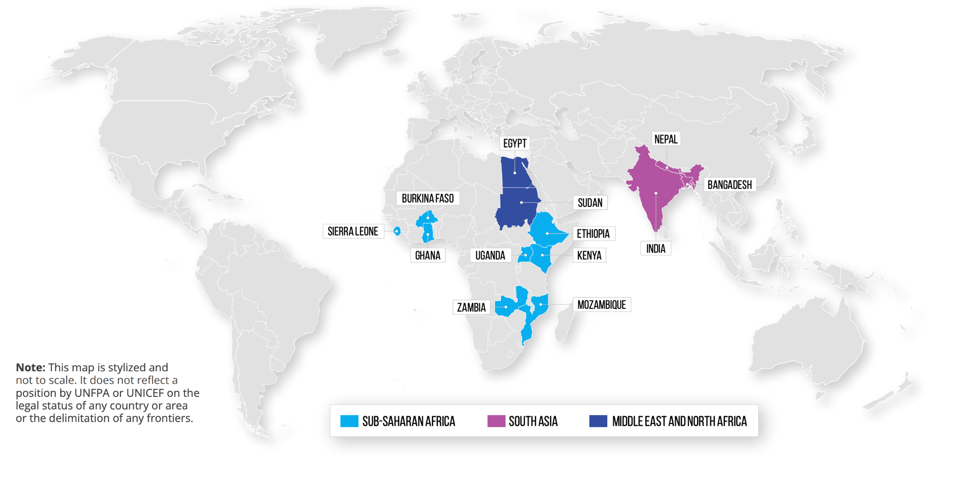
Countries of Focus

Slide 6
Part I. Review of Technological Landscape
Technological Landscape of Africa, MENA and Asia

Slide 7
OVERALL TECHNOLOGICAL LANDSCAPE
DIGITAL ACCESS AND GOVERNMENT SUPPORT |  | AFRICA | MIDDLE EAST | ASIA
Urban to rural electricity access ( % of population with access to electricity) |  | Urban: 78.4% Rural: 38.2% | Urban: 100% Rural: 98.6% | Urban: 98.1% Rural: 91.5%
Network coverage (% of population that are within range of at least a xG mobile cellular signal) |  | 3G: 82.3% 4G: 54.6% | 3G: 99.5% 4G: 96.6% | 3G: 95.5% 4G: 91.4%
Internet access (% of individuals with internet access) |  | Men: 55% Women: 43% | Men: 87.6% Women: 85.6% | Men: 79.2% Women: 74.8%
Mobile cellular ownership (% of male/females that have a mobile phone to make and receive personal calls) |  | Men: 86% Women: 81.1% | Men: 98.9% Women: 96.4% | Men: 95.7% Women: 90.6%
Government support for digital literacy (Scale 0-3) |  | Medium: 2.2 | High: 2.7 | Medium: 2.3
Notes:
The African continent is composed of 44 Member States, including 28 classified as least developed countries (LDCs), five as small island developing States (SIDS) and fifteen as landlocked developing countries (LLDCs). LLDCs lack direct access to the sea, which often makes international connectivity more expensive. Many LDCs are very rural, and others have large, sparsely populated land areas, which makes the roll-out of terrestrial communication infrastructure more difficult. ICT uptake therefore also differs considerably among economies in the region.

Slide 8
Part II. Key Findings and Recommendations
Landscape Mapping of Africa and Asia

Slide 9
COMPARATIVE MAPPING OF INTERVENTIONS ACROSS 13 COUNTRIES IN AFRICA AND ASIA
50
27
interventions mapped
have applied a feminist intersectional approach
35
15
RADIOS AND
MOBILE PHONES
most common types
of technology used
are tech-driven
(tech is a core element)
are tech-enabled
(tech is secondary to the intervention)
9 | Webinar Final Results

Slide 10
Key Findings
01.
Tech
Features
02.
Impact Areas & Key Achievements
03.
Stakeholders
COVID-19 = higher adoption of tech tools.
Most interventions employ a combination of both traditional and modern tools
E.g. radio, TV, videos and films, mobile apps, web platforms, social media, IVR, virtual reality
Sometimes these are combined with offline methods
E.g. Trainings, community dialogues
Most interventions focus on 1) access to service provision, 2) SRHR education, 3) changing attitudes and norms at individual and community levels.
Success (mitigation of child marriage and FGM) results from a combination of context-based social, economic and technological development.
Different levels of involvement from different partners.
The most impactful interventions are multi-sectoral initiatives
E.g. Through partnerships with CSOs, INGOs, government, and the private sector.
10 | Webinar Final Results
Notes:
IVR = interactive voice response

Slide 11
Key Findings
04.
05.
Intersectional Feminist Approach
Opportunities & Challenges
Consultations with experts and/or local leaders (majority)
Consultations with the populations targeted (13)
Monitoring and evaluation activities (15)
Designed and/or implemented by a women/girl-led organization (6).
Growing interest and capacities to leverage technology to address harmful practices
Proven impact and capacity of reach
Technological landscape is constantly improving
Challenges preventing adoption and scaling:
high costs
digital gender gap
lack of digital literacy
systemic patriarchy and inequalities.
11 | Webinar Final Results
Notes:
IVR = interactive voice response

Slide 12
Key Recommendations
01.
User/human-centred design
Know the people you are designing for.
02.
Adopt feminist intersectional approaches
Technology and content should cater to different groups within the target population, avoid exclusion.
03.
Design for scale and build for sustainability
Interventions can and should seek to impact the most difficult to reach and vulnerable groups by assessing the technological landscape.
04.
Be collaborative
Sharing information, insights, strategies and resources across projects, organizations and sectors = increased efficiency and impact.
05.
Donors and key stakeholders need to be involved
Their support is crucial to accomplish goals, specially in places with limited technological resources.

Slide 13
Deep-Dives
Mozambique: Linha Fala Criança
Sudan: Saleema Initiative
India: Love Matters India

Slide 14
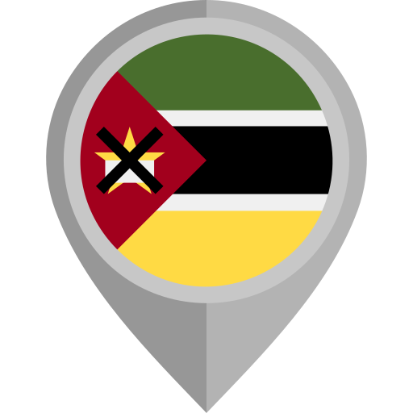
Linha Fala Criança (Talk-Child Helpline)
What?
Linha Fala Criança (LFC) is a non-profit organisation dedicated to protecting and ensuring the well-being of children in Mozambique through the ‘116’ emergency telephone helpline.
Mission?
The helpline is meant to provide support to all children and adolescents who are victims of violence or at risk of violence and violations of their rights, including child marriage.
Key Statistics
How?
LFC operates predominantly through telephone lines.
Phone calls received are answered by trained staff (counsellors) who provide immediate support and refer cases to the relevant entities in each district. Phone calls made to the line are completely free of charge for the users through a partnership established between LFC and national telecommunications companies.
170,655
122,422
68.8%
calls received
resulted in an intervention
referred to child care services

Slide 15
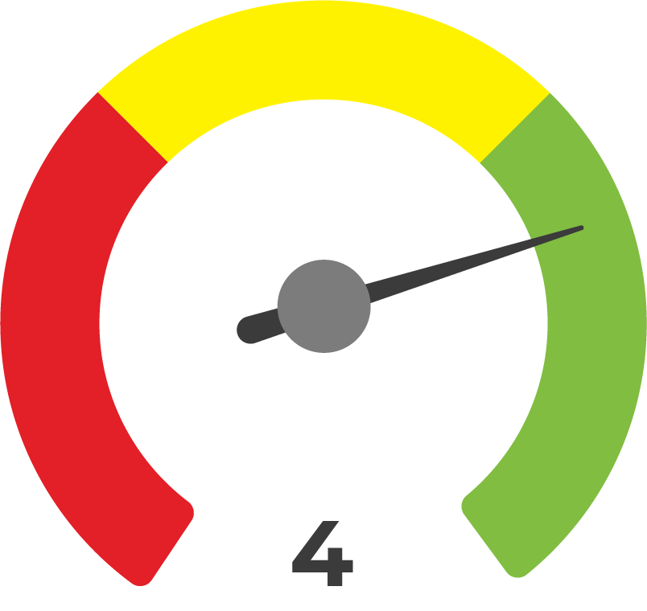
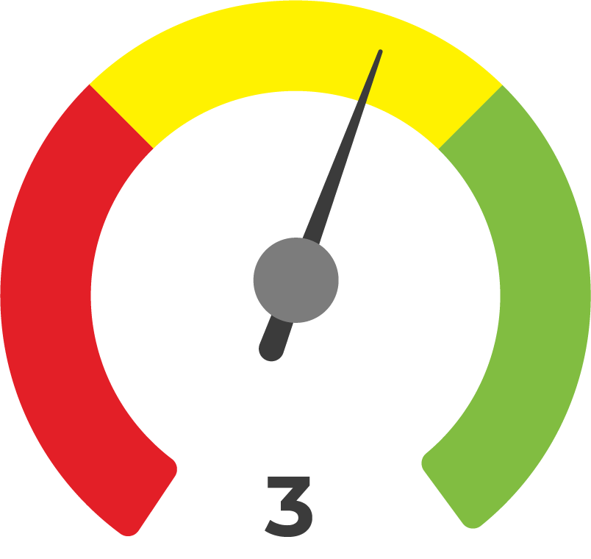
TMA
Technology Maturity Analysis:
LFC Key Findings
Understanding the Digital Ecosystem
Technology and Data Management
Technology Development and Implementation
Ethical Considerations
Sustainability and Scalability
- Clear vision and knowledge about the socioeconomic and political context of Mozambique
- Lack of a deeper understanding of Mozambique's digital ecosystem
- Consideration about children possibly not having access to phones was given after the launch of LFC
- Placement of physical reporting boxes in the schools (targeting children in remote areas who lack access to a telephone)
- Clear and well-designed structure on division of roles and responsibilities related to data collection and storage
- Well-documented data protection and privacy protocols
- Routine of reports production, providing key information about VAC
- Data cannot be quickly or automatically shared
- Satisfaction surveys with end-users are applied at the end of each call
- Improvements based on feedback received through consultations
- Traditional technology applied in an innovative way (e.g. free of charge)
- Technical documentation (with clear steps, objectives and modus-operandi) is not open or publicly accessible
- Adherence to the Policy Protection from Sexual Exploitation and Abuse (PSEA-UNHCR), and Code of Conduct and Internal Regulations
- Lack of a ethical risks assessment
- Intersectionality: LFC has an inclusive vision and considers the different aspects of the target population (e.g. language, gender, socio-economic status, etc.). However, efforts to include and consider people with disabilities are recent, and there are still many challenges
- Tech revision carried out on a needs basis, rather than periodically
- Funding received from several organizations, although UNICEF is its main donor. Important partnership with telecommunication companies
- Lack of a robust MEL system implemented from the onset of the initiative.
- LFC emergency line model was imported from Child Helpline in South Africa, and is now being replicated in others Portuguese-speaking countries (e.g. Angola)

Slide 16
User
Experience
Review of The User Experience:
LFC Key Findings
Key Success Factors
S
✔ Reduction in the fear to report cases among users.
✔ Collaboration with local institutions has facilitated the reporting process for users and made them aware of who to resort to in emergency situations.
1. Access / Use of Benefits: combination of alternative technological platforms along with in person campaigns.
2. The free of cost nature of the helpline coupled with the possibility to make anonymous reports.
3. Provision of services beyond reporting.
1. Fit with Local Environment: attendance in rural regions and reaching more vulnerable populations.
2. Lack of infrastructure to respond to the quantity of calls.
3. Need for more in-person assistance.
4. Make the operation accessible 24/7.
STRENGTHS
CHALLENGES
"Sometimes we are afraid of being judged, afraid of the person who committed the crime, and LFC makes us feel more secure. They know how to advise us and have an influence on the institutions that can help our cases."
C
Excerpted piece from the interview with end-user A5

Slide 17
Saleema Initiative
The Saleema Initiative is an innovative social marketing campaign which advocates for the long-term and collective abandonment of FGM at the community level through positive norm building.
What?
Mission?
Launched in 2008, the initiative aims to change norms, attitudes, and intentions surrounding FGM and increase social acceptability of being uncut.
1) The intervention involves campaign messaging targeting the entire population, with a focus on practising communities, community leaders, and families with girls at risk of FGM.
2) The campaigns are done through the use of radio, television, posters, social media, animations, stickers, children’s puzzles, comic books, and multimedia kits.
Key Statistics
How?
50
2018
Radio
Drama Episodes have been transmitted
Adopted and scaled up by the African Union across the continent

Slide 18
TMA
Technology Maturity Analysis:
Saleema Key Findings
Understanding the Digital Ecosystem
Technology and Data Management
Technology Development and Implementation
Ethical Considerations
Sustainability and Scalability
- Lack of an in-depth analysis to understand the digital ecosystem where the project was to be implemented.
- However, the initiative did try to characterize digital access patterns among populations of different ages
- No specific strategy in place to mitigate potential limitations that the target population might face in accessing the technology used in the initiative.
- Clear, robust, and well-designed data governance structure.
- Only a few well-documented data protection and privacy protocols
- Access to the data is highly regulated and restricted
- Consultations with target group were carried out during early stages but mostly focusing on the content and messaging of the intervention.
- Improvements to the initiative were executed based on feedback, but there is a lack of information on how it was done.
- The intervention is innovative due to its strong sense of ownership and positive messaging, rather than its technological and digital components.
- Technical documentation is not open or publicly accessible
- Saleema Initiative complies with the four humanitarian principles and the "do no harm" principle.
- No clear ethical risk assessments of the intervention’s technological components were carried out.
- Intersectionality: No explicit consideration of the various intersecting characteristics of the target population beyond gender in its design phase.
- Revision and upkeep of the initiative’s contents is carried out on a periodic basis.
- Funds for the Saleema initiative in Sudan mainly come from UNICEF, with occasional support from other international organisations such as the British Department for International Development, UNFPA, Save the Children, and the GIZ.
- Lack of a robust MEL system implemented from the onset of the initiative.

Slide 19
User
Experience
Review of The User Experience:
Saleema Key Findings
Key Success Factors
S
✔ Positive messaging emphasize the benefits of not practicing FGM and the importance of respecting the rights of girls and women rather than fear-based messaging to discourage the practice.
✔ Extensive use of educational campaigns and facilitated discussions helped raise awareness about the harmful effects of FGM and provided communities with the tools they needed to take action to end the practice.
1. Access / Use of Benefits: Social media, traditional media and community dialogues are the main channels through which participants have obtained access to the benefits of the Saleema initiative.
2. Access / Use of Benefits: Creation of an “echo-chamber” as a result of participants more involved in raising awareness.
3. Positive messaging in the social marketing approach.
STRENGTHS
1. Fit with Local Environment: Limited access in rural and remote areas.
2. Fit with Local Environment: Challenges in digital literacy of the local population.
3. Dealing with families strongly rooted in traditional gender norms in local communities.
CHALLENGES
"Because of the sessions I took before with Saleema, I started talking to people about the negative sides associated with FGM and that it is important to keep our girls (uncut & healthy)."
C
Excerpted piece from the interview with end-user B1

Slide 20
Saleema Initiative
Love Matters India (LMI) is the country’s leading programme providing Sexual and Reproductive Health and Rights (SRHR) information in line with young people’s needs, including on child marriage and FGM. It began operations in 2011.
What?
Mission?
Offering open, comprehensive, non-judgmental and science-based information on romantic relationships and sexual and reproductive health education using innovative media formats.
1) Its main channel is the website, available both in Hindi and English, which acts as a resource hub containing articles, tips, personal stories, mythbusters and advice columns.
2) Love Matters also reaches its young audiences through other channels (e.g. social media, virtual reality films and campaigns, augmented reality app, etc.) all publically available and free of cost.
3) Through a hybrid strategy (digital components being its central approach), Love Matters also has direct contact with the communities on the ground and in the training of young multipliers.
Key Statistics
How?
1.3m
20m
Social media followers
Web platform visitor base

Slide 21
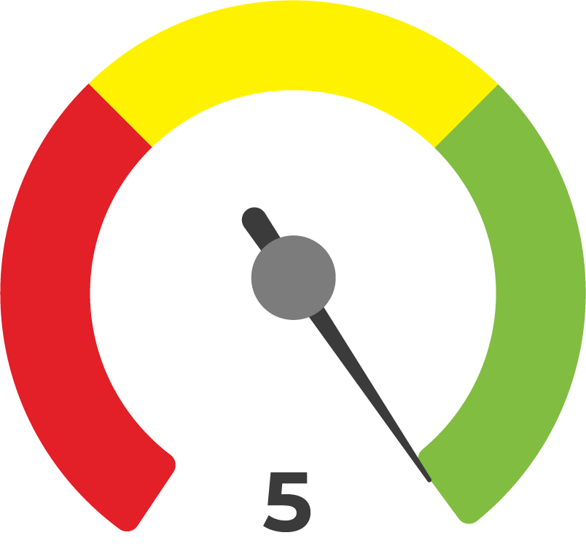
TMA
Technology Maturity Analysis:
Love Matters Key Findings
Understanding the Digital Ecosystem
Technology and Data Management
Technology Development and Implementation
Ethical Considerations
Sustainability and Scalability
- Keen awareness of the context and needs of target audience
- Extensive desk research, FGDs, and direct consultations (schools, CSOs)
- In-depth understanding of India’s digital landscape
- Building digital communities: Training of youth peer educators & delivery of mobile phones
- Consent is free and informed (e.g. for publication online, for participation in research activities)
- Data protection and privacy protocols (e.g. EU’s General Data Protection Regulation)
- Yet, measures to ensure the security and privacy of users' data are insufficient (e.g. “Ask a Question”)
- Unique approach to data management (e.g. digital and data literacy trainings)
- Unclear strategy for data governance, interoperability and accessibility
- Periodic consultations with youth (i.e. at the start of the year or a project)
- Consultations may involve digital literacy trainings (e.g. how to use a mobile phone, Zoom)
- Strong human-centred design (e.g. use of youth’s vernacular) and hybrid approach (online-offline)
- Detailed and open technical documentation
- No standardised ethical framework; yet, LMI carries out 4 specific activities to mitigate potential ethical risks
- Strong emphasis on the “do no harm” principle
- Compliant with the humanitarian principles
- Strong intersectional feminist approach (e.g. people with disabilities create content)
- Periodic revisions & assessment of technological tools and content (e.g. use of chatbots)
- NOT supported by an ecosystem of funders (i.e. multiple donors)
- Detailed, periodic and effective MEL system
- LMI model has been replicated successfully in other regions (i.e. Africa, the Middle East, Latin America, and China)

Slide 22
User
Experience
Review of The User Experience:
Love Matters India Key Findings
Key Success Factors
S
✔ Youth-friendly, sex-positive and judgement-free language
✔ Placing the voices of young people (especially girls and young women) at the forefront
✔ The hybrid approach
✔ Complementary focus on building digital and media literacy skills
1. Access / Use of Benefits: the combination of online with offline strategies (i.e. digital and media literacy training, peer youth programme) offers a myriad of entry points for girls and young women to access LMI.
2. The use of open and youth-friendly language allows for engaging discussions around issues that are usually seen as taboo.
3. Increased awareness of child marriage related risks.
STRENGTHS
1. Traditional norms, along with community and family resistance.
2. Fit with Local Environment: Limited technology access in rural and remote areas.
CHALLENGES
"In my village, girls have gained confidence to take a stand against child marriage… Had Love Matters never come to my village/region, what would be the situation of child marriage? It would be bad. But, what’s worse, we would also not be able to learn about these things (SRHR), these internal things that are very important for young girls."
C
Excerpted piece from the interview with end-user C4

Slide 23
Recommendations
For Future Improvement of Tech and Digital Solutions to Address FGM and Child Marriage

Slide 24
Technology Maturity Analysis
Problem
Recommendation
Understanding the Digital Ecosystem
Lack of pre-design studies for a better understanding of the local digital ecosystem
To conduct preliminary studies on the digital ecosystem prior to the design of the technological intervention, in order to reflect upon which technology tools best fit the context and needs of the target population.
Technology and Data Management
Lack of knowledge on data protection and security guidelines among data collectors
To provide periodic training for data collectors on data protection and security to ensure that they are equipped with the necessary knowledge and skills to handle sensitive information.
Technology Development and Implementation
Technology is not (fully) adapted to the context and needs of target population
Combine various technologies based on the specific goals of the intervention and target audience needs.
Ethical Considerations
Insufficient application of feminist intersectional lenses
By design, implementing organisations need to closely consider how to embrace and address different layers of intersectionality (e.g. consultation participants, use of language, hiring practices, etc.).
Sustainability and Scalability
Lack of MEL instruments to measure impact and scale up
Interventions should develop a standardised MEL system (i.e. official tools, indicators, check-in meetings and reports) which need to be established at the onset of the intervention.
24 | Webinar Final Results

Slide 25
User Experience
Problem
Recommendation
Lack of digital and tech literacy trainings for end-users
Implement comprehensive digital literacy training programs that not only teach individuals how to use technology, but also address issues related to data privacy and security.
Access and Use of Benefits
Lack of culturally and linguistically adapted content to reach audiences more effectively and promote inclusivity
Adopt the language (vernacular) of the target population(s) on every piece of content so that they feel more connected and engaged with the intervention's goals.
Fit with Local Environment
25 | Webinar Final Results

Slide 26
Q & A

Slide 27
Thank you
@datapopalliance
www.datapopalliance.org

