Slide 1
Assuring Quality Testing
Module 2: Lab Systems and POC Testing
POC EID Training Toolkit
v. May 2019

Slide 2
Agenda
1
Learning Objectives
2
  POC Quality Management Systems
3
  Safety and Waste Management
4
  Connectivity and Data Management
5
  Supply Chain and Device Management
2

Slide 3

Learning Objectives
1
By the end of this module, participants should be able to:
Understand the critical role of the laboratory system for POC testing
Explain the systems approach to laboratory quality assurance and its benefits
Identify the essential elements of laboratory quality systems and how they apply to POC testing; recognize key factors that may compromise the quality of POC testing
Understand the importance of safety practices and waste management
Understand the importance of correct documentation for data
collection, supply chain and device management
3

Slide 4
Agenda
1
Learning Objectives
2
  POC Quality Management Systems
3
  Safety and Waste Management
4
  Connectivity and Data Management
5
  Supply Chain and Device Management
4

Slide 5
Facilities need strong lab systems to sustain quality POC testing
2
Quality
Monitoring
Safety
Environment
POC Testing
Supply Chain &
Device Management
Records
Management
Supervision and Mentorship
Notes:
The advantages of PoCT have been reported as:
- Simpler sample collection in some cases, simpler pre-analytical processes including reduced time between collection and analysis, more rapidly available test results leading to more timely treatment and greater satisfaction for the patient however there are also disadvantages that should be weighed up against such as lack of expertise to assess the quality of result produced by POCT device, resolving errors, inadequate documentation of results and output, etc. For POCT to be carried out successfully, it need a strong lab system for support network that includes SOPs, quality assurance, safety in handling infections materials, managing supplies and device troubleshooting, record management and access to training and mentorship. Lab will be responsible for the ongoing performance of the systems including checking
quality control, performing calibrations when necessary, coordination and review of external quality assurance programs, periodic comparisons with the
laboratory methods and providing assistance to all PoCT users.

Slide 6
What Is “Quality?”
2
The ability of a product or service to satisfy stated or implied needs of a specific customer
Quality is achieved by conforming to established requirements and standards
Notes:
Provide example on quality discussions – solicit idea from the participants
Fish in the market – a quality experience
How do you buy fish in the market?
What are your expectations ?
How do you ensure that you buy the right fish?

Slide 7
Why do we care about quality?
2
Test Site
Quality
Accurate,
Reliable
Testing
Quality in
All Aspects
of Health Care

Slide 8
What is a ‘Systems Approach’ to quality?
2
Considers all components within a system
Identifies the connection and relationship (e.g., cause and effect) among the components
Example: The human body
→ A headache may be caused by a problem somewhere else in the body

Slide 9

The Laboratory Quality System
2
The organizational structure, responsibilities, processes, procedures, and resources for implementing quality management of the laboratory or testing site.
Organization
Personnel
Equipment
Purchasing & Inventory
Process Control QC & Specimen Management
Information
Management
Documents & Records
Occurrence Management
Assessment
In other words…all activities contribute to the quality of testing, directly or indirectly!
Process
Improvement
Customer
Service
Facilities &
Safety

Slide 10
Who is responsible for quality?
2
EVERYONE!
Laboratory management and program staff establish and oversees quality assurance procedures
Test site personnel implement the quality assurance procedures
Everyone is responsible for maintaining quality in testing

Slide 11
Comparison of QA approaches for POC testing
2
 | External Quality Assessment (EQA) Panels | Internal Quality Control (IQC) | Duplicate Testing/Inter-laboratory Sample Testing | Connectivity | Mentorship
Technology and Systems
Instrument/device performance | ✓ | ✓ | ✓ | ✓ | ✓
Patient identification | X | X | X | X | ✓
Sample & reagent storage conditions | X | X | X | X | ✓
Sample transportation conditions | X | X | X | X | ✓
Inter-laboratory comparison | ✓ | X | ✓ | ✓ | ✓
User
Overall technical procedure | ✓ | ✓ | ✓ | ✓ | ✓
Sample handling | X | ✓ | X | X | ✓
Reagent application | ✓ | ✓ | X | ✓ | ✓
Sample collection | X | ✓ | X | X | ✓
Sample application | ✓ | ✓ | X | ✓ | ✓
Result interpretation or reading | ✓ | X | ✓ | ✓ | ✓
Data processing (records) | ✓ | X | X | ✓ | ✓
QA
Approaches
Notes:
No single approach fits all – in order to address all aspects of the QA cycle, a combination of approaches is recommended.
Regular Data management through connectivity provides the most cost-effective method of minimizing the risk of poor quality testing, and in combination with EQA panels, duplicate testing or inter-lab testing once or twice per year can ensure each POC site maintains comparability with the reference conventional technologies, and /or with global standards. This scheme can also be coupled with periodic site mentorship to ensure all aspects of diagnostic testing – including the pre-testing phase -- are monitored.

Slide 12
Quality Assurance vs. Quality Control
2
 | Quality Assurance | Quality Control
Definition | Activities to ensure processes are adequate for a system to achieve its objectives | Activities to evaluate a product or work result
Examples | Establish standard operating procedures for sample collection & testing Define criteria for acceptable samples | Analyze known QC samples before a patient sample to determine if a test is valid Decide if a sample is acceptable for testing

Slide 13
Why do errors occur?
2
Some causes include:
Individual responsibilities are unclear
No written procedures – SOPs/job aids are not available
Written procedures are not followed
Training is not done or not completed
Test kits not stored properly
QC or EQA is not performed
Equipment is not properly maintained
Errors can occur at any time throughout the testing process

Slide 14
Errors can occur at any phase of the testing process
2
Examples:
Specimen not labelled properly
Specimen stored incorrectly
Test kits stored incorrectly
Patient/Client Prep
Sample Collection
Staff Competency
Test Evaluations
Post-Testing
Reporting
Pre-Testing
Data and Laboratory Management
Safety
Customer Service
Sample Receipt
and Accessioning
Examples:
Transcription error in recording
test result
Record not legible
Report sent to wrong location
Record Keeping
Sample
Transport
Quality Control
Testing
Examples:
SOP not followed correctly
Incorrect timing of test
Incorrect reagents used
Testing
Notes:
Explain the QA cycle within the country’s context

Slide 15
Trouble shooting errors
2
What do I do when an error occurs on my POC device?
How can we avoid errors and POC testing downtime?
In case of an issue, a message will be displayed (often, with an error code)
Refer to the Operator’s Manual and look for the error code, follow the recommended corrective actions
If the problem persists, contact supervisors
In case of a discordant result, refer to SOPs or contact supervisor
Make sure POC test cartridge is filled properly following the SOP (exact volume, no air bubbles)
Ensure there is no sample leakage/spills before closing the lid and running the test
Make sure NO vibration/machine movements while test is running
On mPima, make sure channel window is clean (no dirt and smudges)
On GeneXpert, do the Xpert Check or calibration check once a year or as needed

Slide 16
Site supervision and mentorship help to identify testing issues early in order to take corrective and preventive actions
2
Assessment report
Generated from POC Database on testing and error trends or equivalent report
Supervision
Mentorship
Carried out by trained lab tech as needed
Occurs every quarter or every 6 months
Based on the supervision/data report findings and EQA performance
To be used during site supervision
Carried out by trained lab tech/lab coordinator using the POC supervision and mentorship checklist
Notes:
Data reports are report generated in the database transmitted real time via connectivity

Slide 17
Summary: Why is a Quality System important for POC testing?
2
Quality is the foundation of everything we do
The Quality System sets the standard for the level of quality the facility will achieve
Prevents misdiagnoses that affect the quality of life of the clients/patients
Allows facility to meet client/patient expectations
Provides means to prevent, detect and correct problems/errors – monitors all parts of testing system
Is the core of a monitoring, evaluation, & improvement system consistent between testing sites
Reduces costs by reducing wastage
Even the simplest test is not foolproof!!!

Slide 18
Agenda
1
Learning Objectives
2
  POC Quality Management Systems
3
  Safety and Waste Management
4
  Connectivity and Data Management
5
  Supply Chain and Device Management
18

Slide 19
What is a biohazard and why is it important to take safety precautions in the lab?
3
A biohazard is a biological agent, infectious material or derived products capable of causing harm to humans, animals and plants
Coming in contact with biohazards – such human blood or blood products – is potentially dangerous
Safety involves taking precautions to protect you, your colleagues, the client/patient or the environment against infection
Laboratory safety is achieved through administrative controls, engineering controls, the use of personal protective equipment, practices and behavior

Slide 20
What are universal or standard precautions?
3
Universal precautions are the recommended physical requirements, procedural actions and precautions for safe work with human pathogenic materials or microbes in healthcare, laboratory and other work environments
Every specimen should be treated as infectious

Slide 21
Apply safety practices throughout the testing process
3
Pre-Testing
  Specimen collection
  Specimen preparation
  Specimen transport
Testing
  Testing
Post-Testing
  Disposal
Patient/Client Prep
Sample Collection
Staff Competency
Test Evaluations
Post-Testing
Reporting
Pre-Testing
Data and Laboratory Management
Safety
Customer Service
Sample Receipt
and Accessioning
Record Keeping
Sample
Transport
Quality Control
Testing
Testing

Slide 22


Develop safe work habits
3
Handwashing is the simplest, most effective means of preventing infections if done properly and frequently
– US Centers for Disease Control
Wash hands before and after collecting samples from each patient
Washing hands before and after conducting testing
Wear a fresh pair of gloves with each patient
Wear a laboratory coat or apron
Dispose of contaminated sharps and waste appropriately, and immediately after testing

Slide 23
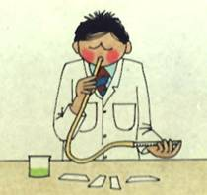

Develop safe work habits (cont.)
3
Pipetting by mouth is strictly forbidden
Never eat, drink or smoke at the test site
Keep food out of the laboratory/testing site refrigerator

Slide 24
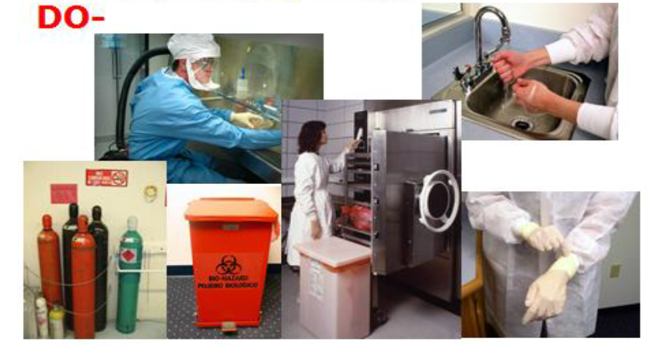
Develop safe work habits (cont.)
3

Slide 25

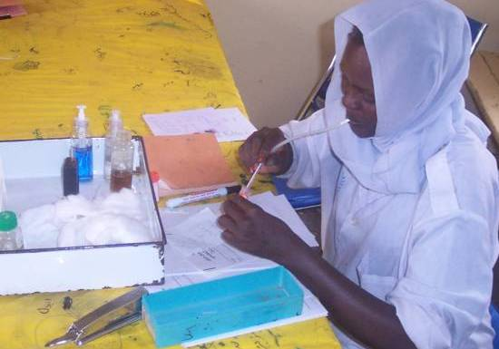



Develop safe work habits (cont.)
3
DO NOT

Slide 26
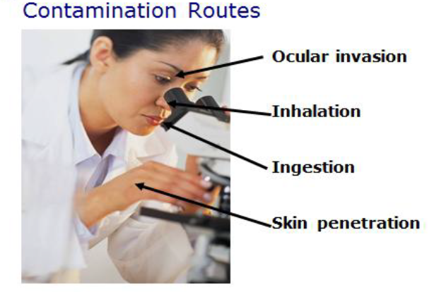
Contamination can occur in a number of ways
3

Slide 27

Personal Protective Equipment (PPE) can prevent contamination
3
Gloves
Lab gowns/coats
Eye protection-Goggles
Respiratory protection-Mask
Face Shields
Head cover
Foot wear
Up-to-date vaccinations (e.g. Hep B)

Slide 28
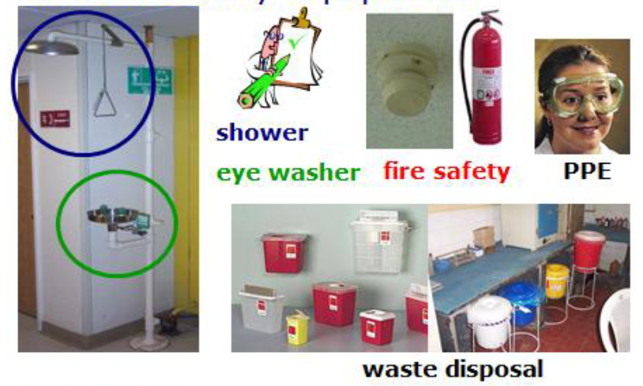
General safety equipment
3
Shower
Eye washer
Fire Safety
PPE
Waste Disposal
Notes:
Trainer should consider mentioning BSC cabinets as well, which may not be necessary for POC testing

Slide 29


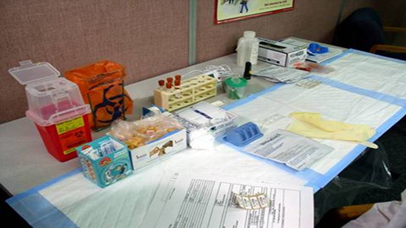
Maintain a clean working area and work surfaces
3
Keep work areas uncluttered and clean
Disinfect work surfaces daily
Restrict or limit access when working
Keep all necessary supplies ready
Store supplies in a safe/secure area
Keep eye wash units in working order and within expiry date
Keep hand washing basin/sink clean and uncluttered

Slide 30
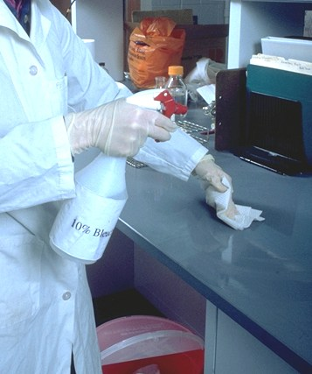
Disinfect work areas with bleach
3
Disinfection: Use of chemical agents to destroy harmful organisms on inanimate objects
Chlorine compounds or Alcohol (70%)
Kills germs and pathogens
Keeps work surface clean
Prevents cross-contamination
Reduces risks of infection

Slide 31
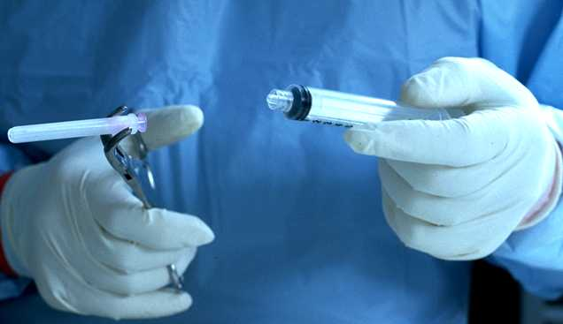
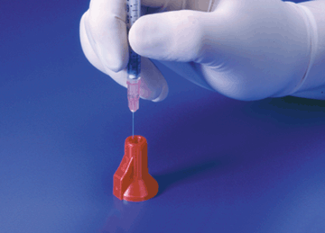
Sharps and waste containers – Don’ts
3
Do NOT:
Break, bend, re-sheath/re-cap or reuse lancets, needles or syringes
Shake sharps containers to create space
Allow sharps containers to get full
Use a container that is not puncture-resistant, leak-proof
Place the sharps container far away from work surface
2.4

Slide 32

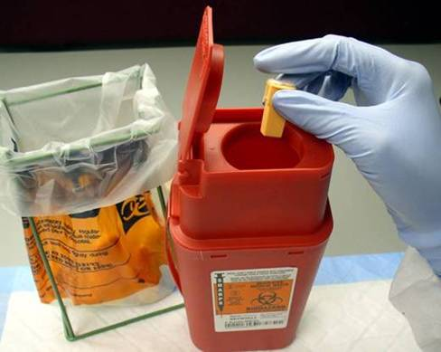
Good practice for handling sharps
3
The use is responsible for disposal of sharps
Users must dispose of sharps after each test
Users must place sharps in sharps boxes
Do not drop sharps on the floor or in the office waste bin
Place sharps container near your workspace
Seal and remove when box is ¾ full
Incinerate all waste

Slide 33

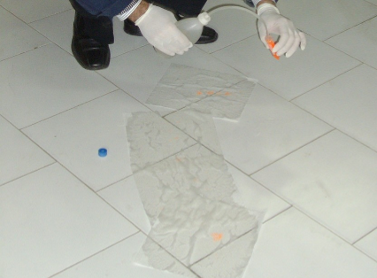
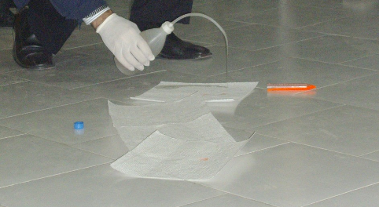
Emergency Response – spill and splash
3

Slide 34
What to do in the event of contamination
3
Personal contamination
Surface contamination
Alert co-workers
Clean exposed surface with soap/water, eyewash (eyes), or saline (mouth)
Apply first aid and treat as an emergency
Notify supervisor. Write occurrence report
Report to medical clinic for counseling/ treatment (e.g. PEP)
1. Alert co-workers
2. Define/isolate contaminated area
3. Put on appropriate PPE
4. Remove glass/lumps with forceps or scoop
5. Apply absorbent towel(s) and wet with water to spill; remove bulk & reapply if needed. Then dry the area with absorbent paper towels to ensure all residual liquid are removed
6. Apply disinfectant to towel surface (10% bleach or 1% v/v Sodium Hypchlorite
7. Allow adequate contact time (15-20 mins)
8. Remove towel, mop up; clean with alcohol or soap/water
9. Properly dispose of materials
10. Notify supervisor
Notes:
Risk of accidental spillage: For GeneXpert HIV SR vials and cartridges and blood samples. For Alere q mostly blood samples

Slide 35
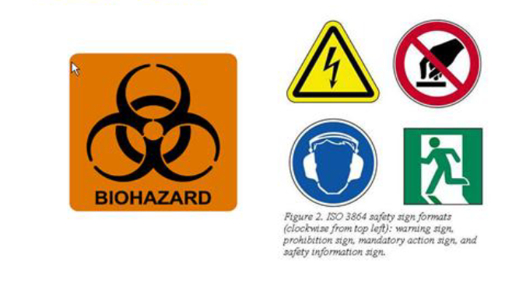
Waste management
3
Safety signage
Waste is any material that is “discarded” or intended to be discarded
Waste management is the collection, processing, recycling, disposal, monitoring and transport of waste materials

Slide 36
Waste management process
3
  Segregation
  Packaging
  Labeling
  Handling and storage of waste products
  Transportation
  Disposal

Slide 37
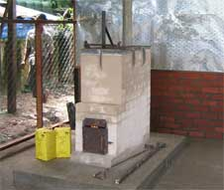
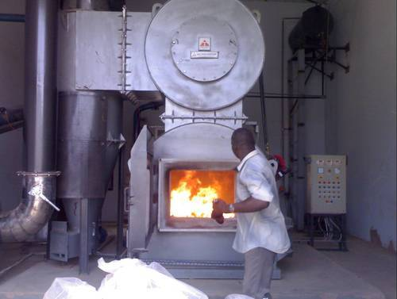
Incineration of waste
3
Incineration is the complete burning of contaminated waste or bio-waste at high temperatures ( >1000 ˚C) to destroy hazardous substances and kill micro-organisms
Incineration:
  Is effective against potential re-use
  Protects environment
  Must be supervised
Used POC/near POC cartridges are contaminated waste and should be incinerated
Note: Check and follow manufacturer's instruction for the disposal of cartridges to ensure it is not harmful to the environment
Notes:
Check manufacturer's instruction for the disposal /incineration of cartridges to ensure it is not harmful to the environment
Develop SOP for safe cartridges disposal. Please note that some of the cartridges (GeneXpert HIV cartridges) contain cyanide or cyanide bi-product (Guanidinium Thiocyanate or GTC) and should be incinerated using high temperature (>1000 ˚C) for complete destruction

Slide 38

Reminders
3
What can cause injury --- e.g. needle prick?
Lack of concentration
Inexperience
Lack of concern for others
Improper disposal of sharps and waste
Adhere to safety precautions to protect you, your colleagues, family, the client and the environment against infection

Slide 39
Agenda
1
Learning Objectives
2
  POC Quality Management Systems
3
  Safety and Waste Management
4
  Connectivity and Data Management
5
  Supply Chain and Device Management
39

Slide 40
Data/record management
4
Record Management is the mechanism that ensures information is captured correctly, kept confidential, and is available and accessible when needed.
If using paper based records…
  The register and logs used in the lab or clinic that record tests that are performed, and can be used to trace patients records when necessary
If using electronic records...
Testing data should be routinely transmitted to a central database for back up
This system simplifies reporting, monitoring and evaluation

Slide 41
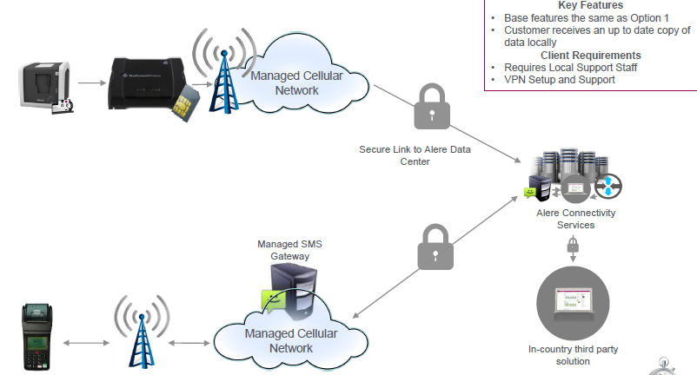
Connectivity provides visibility to monitor and manage the performance of POC devices, and speeds result transmission from centralized testing sites back to the facility
4
Data is sent from the POC device to a central database
Test results are sent from a central testing point to a facility via SMS printer
Notes:
Benefits of a remote reporting and connectivity solutions include faster result TAT to patient, decreased LTFU, improved utilization, stronger disease surveillance and control, etc.
Just give brief overview of the connectivity to use in country (replace this slide and add slides with country specific intervention)
-Do a separate orientation to sites onsite during site installation once the system is installed and ready for use (whichever system will be adopted)

Slide 42
Agenda
1
Learning Objectives
2
  POC Quality Management Systems
3
  Safety and Waste Management
4
  Connectivity and Data Management
5
  Supply Chain and Device Management
42

Slide 43
Supply chain management
Inventory management for POC testing is critical to ensure uninterrupted testing services
For POC testing, inventory needs to be tracked for:
Reagent cartridges
Sample collection materials
Supplies for POC commodities should be integrated into the facility’s existing inventory management system
[Before the start of the training, optional to insert language about the local inventory management system and how POC commodities will be incorporated in the local supply chain]

Slide 44

Error and service reports
If you encounter an error, refer to the device user manual for guidance
If you encounter three (3) errors consecutively, stop and report (and arrange for service data export) to national support team:
    MOH-Laboratory contact No. [Before training, fill in telephone number]
    Partner Support contact No. [Before training, fill in telephone number]
    Distributor’s contact No. [Before training, fill in telephone number]
If the POC device is down, needs service or a swap-out device is required, contact the
national support team for advise and next steps
Need Assistance?
Stop and Call!

Slide 45
Summary
Quality Testing is the backbone of results reliability , this prevent misdiagnosis that affect the quality of life of the clients/patients
Adherence to safety precautions will protect you, your colleagues, family, the client and the environment against infection
Connectivity allows data to be transmitted from POC devices in the field to a central point, where the data can be monitored centrally, simplify data aggregation and allow for timely reporting
Reliable supply chain and device management systems ensure uninterrupted testing and increase productivity

Slide 46

Questions?
Thank You!
46

Slide 47
Pre-testing Errors
2
Examples
Preventing and detecting errors before testing
Specimen not collected properly
Specimen mislabeled or unlabeled
Wrong Specimen/Specimen Container
Specimen stored inappropriately before testing
Specimen transported inappropriately
Test kits stored inappropriately
Check storage and room temperature
Collect appropriate specimen
Use of appropriate Specimen Container
Select an appropriate testing workspace
Check inventory and expiration dates
Review testing procedures
Record pertinent information, and label test device
Notes:
Extra slides with examples of pre-testing, testing and post-testing errors and how to prevent them. Trainer should decide whether to insert these after Slide 21; these can be left out to save time.

Slide 48
Testing Errors
2
Examples
Preventing and detecting errors during testing
SOPs not followed
Operators not trained or competent to perform the test
Incorrect timing of test
Results reported when control results out of range
Improper measurements of specimen or reagents
Reagents stored inappropriately or used after expiration date
Insufficient sample collected
Incorrect reagents used
Ensure the device runs everyday
Ensure all operators are trained and have appropriate certification
Perform and review Quality Controls (QC) – run standard controls, if necessary for the platform
Follow safety precautions
Conduct test according to written procedures (Follow SOP)
Correctly interpret test results

Slide 49
Post-testing Errors
2
Examples
Preventing and detecting errors during testing
Transcription error in recording and reporting
Report illegible
Report sent to the wrong location
Information system not maintained
Re-check patient/client identifier
Write legibly and ensure an up to date recording
Clean up and dispose of all waste accordingly
Package PT panels/specimens for re-testing, if needed

Slide 50




Acknowledgments
The development of the POC EID Training Package was made possible
thanks to Unitaid’s support.
Unitaid accelerates access to innovation so that critical health products
can reach the people who need them.

