Slide 1
Early Infant Diagnosis of HIV
Module 1: Introduction to EID and Point of Care EID Testing
POC EID Training Toolkit
v. May 2019

Slide 2
Agenda
1
Learning Objectives
2
  HIV and HIV in Infants: What you need to know
3
  Country Specific: Testing Algorithm, POC Testing SOPs and the Role of the Health Care Provider
2

Slide 3

Learning Objectives
1
By the end of this module, participants should be able to:
Review the basics facts of HIV and HIV diagnosis in infants
Describe the importance of early detection of HIV infection in infants
Understand country specific testing algorithms and protocols
Understand the role of Health Care Providers on early infant diagnosis of HIV
3

Slide 4
Agenda
1
  Learning Objectives
2
  HIV and HIV in Infants: What you need to know
3
  Country Specific: Testing Algorithm, POC Testing SOPs and the Role of the Health Care Provider
4

Slide 5
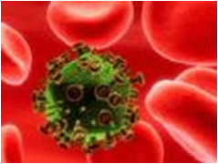
Basic Information on HIV
2
What is HIV?
HIV refers to the human immunodeficiency virus. There are two types of HIV: HIV-1 and HIV-2.
HIV-1 is responsible for the vast majority of HIV infections globally
HIV-2 is rare and localized mostly in West Africa and parts of Western Europe
5

Slide 6
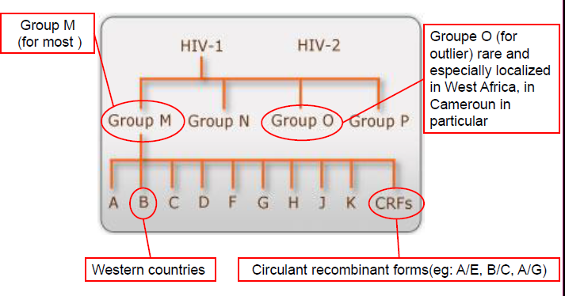
Basic Information on HIV
2
HIV Groups and sub groups
Source: Adopted from Alere presentation
6

Slide 7
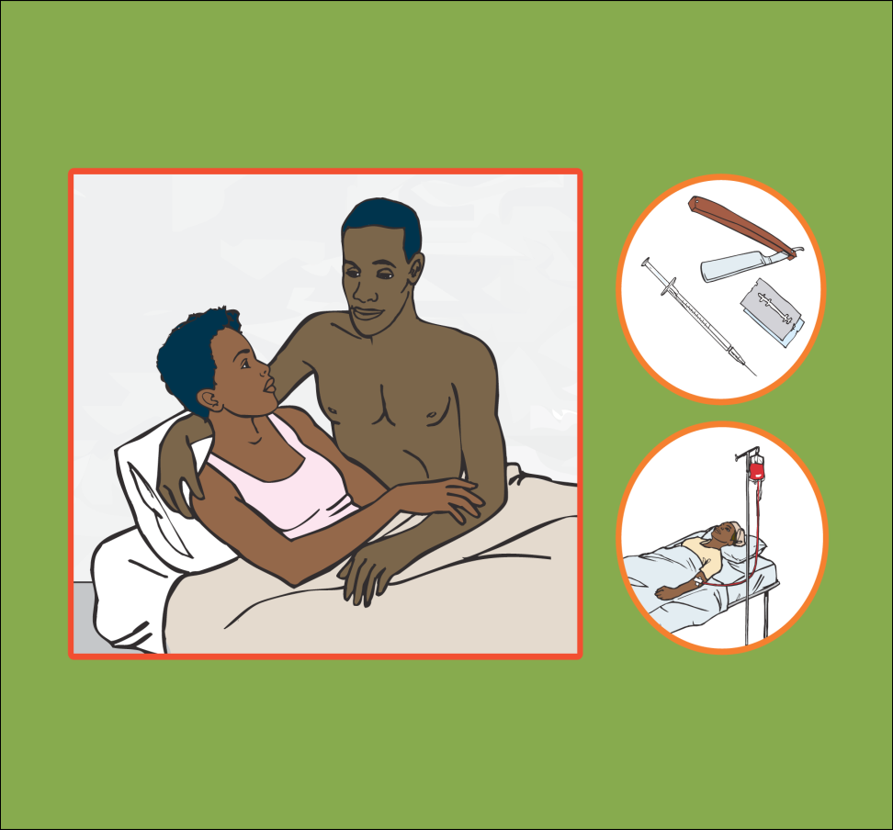
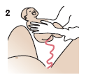
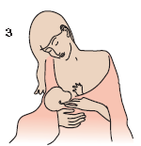
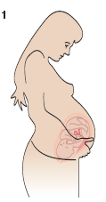
Basic Information on HIV: Transmission channels
2
The virus can be transmitted/passed through body fluids including: semen, breast milk, blood and secretion from mucous membranes
Unprotected sexual contact with an infected partner
Transfusion with HIV-infected blood
Injection using needles or syringes contaminated with HIV-infected blood
Accidental cuts in a hospital setting with blood contaminated sharp instruments
Exposure of broken skin or wound to infected blood or body fluids
Mother to child transmission
1
2
3
7

Slide 8
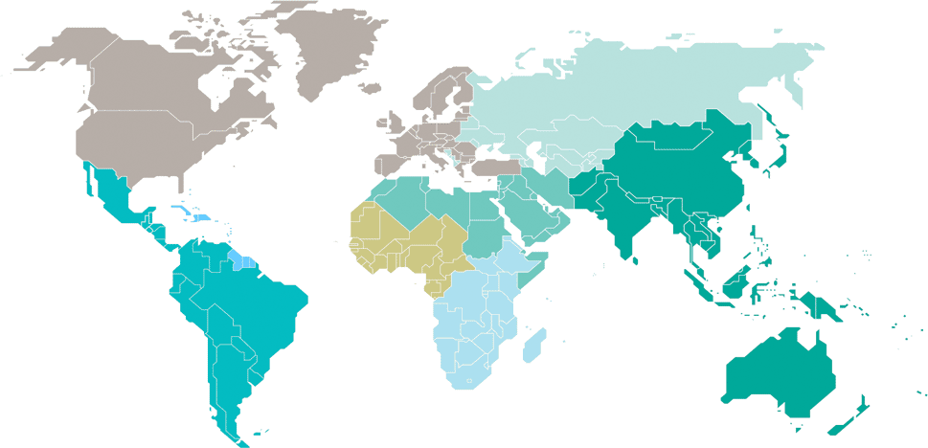
1.8 million estimated children (<15 years) living with HIV in 2017
2
Eastern Europe
and central Asia
…*
North America and western and central Europe
…*
Caribbean
9900
[7400–15 000]
Middle East and North Africa
8200
[6000–11 000]
Western and central Africa
500 000
[320 000–690 000]
Asia and the Pacific
110 000
[82 000–150 000]
Latin America
27 000
[19 000–36 000]
Eastern and southern Africa
1.2 million
[880 000–1.4 million]
Total: 1.8 million [1.3 million–2.4 million]
*Estimates for children are not published because of small numbers.
8
Source: UNAIDS, 2018

Slide 9
180,000 estimated new HIV infections among children (<15 years) in 2017
2
Eastern Europe
and central Asia
…*
North America and western and central Europe
…*
Caribbean
1100
[710 – 1900]
Middle East and North Africa
1300
[780–1900]
Western and central Africa
67 000
[36 000–100 000]
Asia and the Pacific
10 000
[7400–14 000]
Latin America
2400
[1800–3600]
Eastern and southern Africa
92 000
[61 000–130 000]
Total: 180 000 [110 000–260 000]
*Estimates for children are not published because of small numbers.
9
Source: UNAIDS, 2018

Slide 10
110,00 estimated deaths in children (<15 years) from AIDS in 2017
2
Eastern Europe
and central Asia
…*
North America and western and central Europe
…*
Caribbean
700
[<500 – 1300]
Middle East and North Africa
800
[500–1200]
Western and central Africa
45 000
[24 000–69 000]
Asia and the Pacific
6400
[4100–10 000]
Latin America
1700
[1200–2600]
Eastern and southern Africa
52 000
[31 000–78 000]
Total: 110 000 [63 000–160 000]
*Estimates for children are not published because of small numbers.
10
Source: UNAIDS, 2018

Slide 11
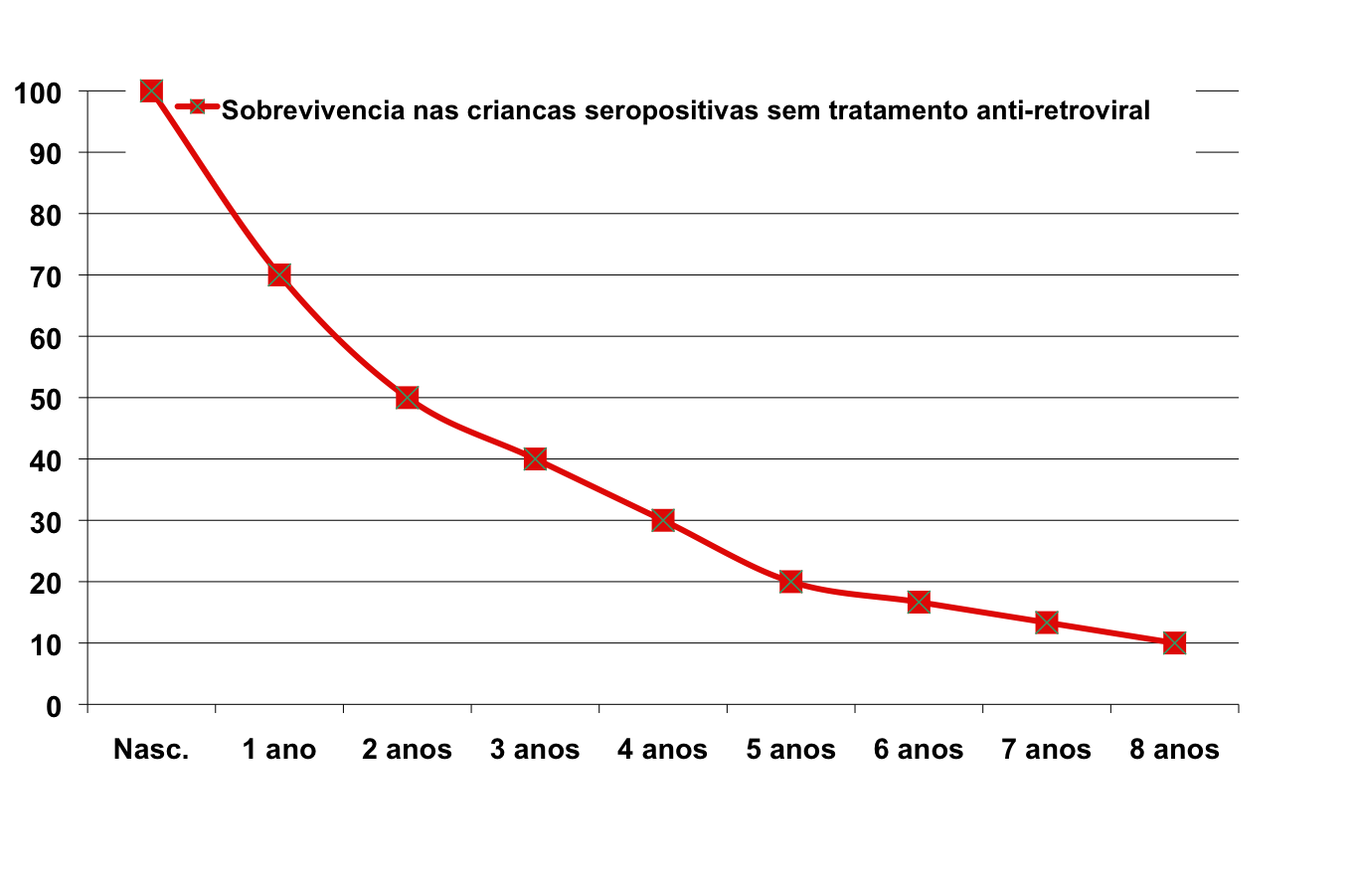
EID is an emergency test due to high mortality among HIV-positive infants not on ART
2
Survival rates for HIV-positive children who do not initiate ART
50 % of HIV+ infants die before 2 years without treatment
Percentage of Children Surviving
Birth
1 Year
2 Years
3 Years
4 Years
5 Years
6 Years
7 Years
8 Years
Age
11
Newell et al. Mortality of infected and uninfected infants born to HIV-infected mothers in Africa: a pooled analysis. Lancet. 2004 Oct 2-8;364(9441):1236-43.

Slide 12
Challenges with diagnosing HIV in infants
2
Children and infants exhibit accelerated symptoms of AIDS compared to adults
Left untreated, HIV mortality is 30% by age 1, 50% by age 2 and 75% by age 5
Clinical staging of disease may be too late for effective treatment
Risk of transmission persists through breast feeding feeing; diagnosis is a multi-year process
Before 18 months of age HIV serological test (e.g. rapid diagnostic tests) are unreliable
12

Slide 13

Diagnosing HIV in Infants – Why Rapid Tests Don’t Work
2
Reminder: Rapid tests look for HIV antibodies
HIV-positive mothers pass antibodies across the placenta to the fetus.
The standard rapid test cannot accurately diagnose infants until the age of 15 - 18 months, the earliest age at which the mother’s antibodies are no longer present in the infant’s blood.
By this time, many HIV-infected infants will have died.
Transfer of maternal antibodies complicates infants HIV diagnosis
13

Slide 14

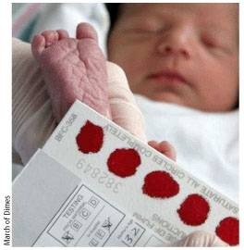
Early Infant Diagnosis (EID) uses nucleic acid testing to look for HIV genetic material
2
HIV infections in infants CAN be accurately diagnosed using virological nucleic acid testing (NAT) -- in the past this was a challenging test to perform…
Dried Blood Spot (DBS) is now available to make NAT easier. DBS samples are easy to prepare and can be stored and transported to testing facilities without refrigeration.
DBS testing in conventional laboratory networks expanded access to EID Testing, but only 51% of HIV-exposed infants were tested before 2 months of age in 2015.
14
Source: WHO Information Note: Novel Point of Care Tools for EID of HIV, July 2017

Slide 15
EID Testing – How Conventional Testing Works
2
Used to test HIV-exposed infants for HIV
Searches for nucleic acids – DNA or RNA – NOT human antibodies
Provides a qualitative test result (reactive/non-reactive)
There are unique infrastructure and equipment requirements
Testing is a complicated, multi-step procedure
Testing is a lengthy process (up to 8 hrs) → there can be quality concerns
Testing is typically performed at a few central labs, while samples are collected from many clinics across the country via sometimes unreliable sample transport networks
Long processing in the lab and unreliable sample transport =
Long turnaround time for results to return to facilities and caregivers
1. Extraction
HIV DNA is extracted from a dried blood spot (DBS) sample
3. Detection
HIV DNA strands are attached to gold or other particles and detected using an ELISA reader
2. Amplification
Strands of HIV DNA are
replicated many times over
15

Slide 16
The WHO provides recommendations for when, how and where to diagnose HIV in infants (1 of 3)
2
HIV virological testing should be used to diagnose HIV infection in infants and children below 18 months of age (strong recommendation, high-quality evidence)
Virological testing should be conducted at 4-6 weeks or at the earliest opportunity thereafter for all HIV-exposed infants (strong recommendation, high-quality evidence)
Addition of nucleic acid testing (NAT) at birth to existing early infant diagnosis (EID) testing approaches can be considered to identify HIV infection in HIV-exposed infants (conditional recommendation, low-quality evidence)
Virological test results should be returned as soon as possible to the clinic and child/mother/caregiver, but at the very latest within four weeks of specimen collection. Positive results should be fast-tracked to the mother-baby pair as soon as possible to enable prompt initiation of ART. (strong recommendation, high-quality evidence)
16
WHO. Consolidated guidelines on the use of antiretroviral drugs for treating and prevention HIV infection: Recommendations for a public health approach. 2016.

Slide 17
The WHO provides recommendations for when, how and where to diagnose HIV in infants (2 of 3)
2
ART should be started without delay for infants with an initial positive virological test result and, at the same time, a second specimen is collected to confirm the initial positive virological result. Do no delay ART. Immediate initiation of ART saves lives and should not be delayed while waiting for results of the confirmatory test. (strong recommendation, high-quality evidence)
Nucleic acid testing (NAT) technologies that are developed and validated for use at or near to the point of care can be used for early infant HIV testing (conditional recommendation, low quality evidence)
HIV exposure status should be ascertained for all infants with unknown or uncertain HIV exposure being seen in health-care facilities at or around birth or the first postnatal visit (usually 4-6 weeks) or other child health visits ((strong recommendation, high-quality evidence)
Consideration can be given to replacing the RDT at 9 months with NAT in the interest of minimizing challenges of interpretation and simplifying the infant testing algorithm (strong recommendation, high-quality evidence)
17
WHO. Consolidated guidelines on the use of antiretroviral drugs for treating and prevention HIV infection: Recommendations for a public health approach. 2016.

Slide 18
The WHO provides recommendations for when, how and where to diagnose HIV in infants (3 of 3)
2
Consideration can be given to replacing the RDT at 9 months with NAT in the interest of minimizing challenges of interpretation and simplifying the infant testing algorithm (strong recommendation, high-quality evidence)
Higher Yield Entry Points: In generalized epidemic settings, infants and children with unknown HIV status who are admitted for inpatient care or attending malnutrition clinics should be routinely tested for HIV.
(strong recommendation, low-quality evidence)
Lower Yield Entry Points: In generalized epidemic settings, infants and children with unknown HIV status should be offered HIV testing in outpatient or immunization clinics.
(conditional recommendation, low-quality evidence)
An indeterminate range should be used to improve the accuracy of nucleic-acid based early infant diagnosis assays (strong recommendation, moderate-certainty evidence)
18
WHO. HIV diagnosis and ARV use in HIV-exposed infants: A programmatic update. 2018
WHO. Consolidated guidelines on the use of antiretroviral drugs for treating and preventing HIV infection: Recommendations for a public health approach. 2016.
WHO. Interim Guidelines: Updated recommendations on first-line and second-line antiretroviral regimens and post-exposure prophylaxis and recommendations on early infant diagnosis of HIV. 2018
Notes:
Indeterminate range: a range of viral copy equivalents that would be too low to be accurately diagnosed as HIV infected. The indeterminate range suggested is currently estimated to be approximately equivalent to a cycle threshold of 33 on the Roche COBAS® Ampliprep/COBAS® TaqMan® HIV-1 Qualitative Test v2.0 assay. As of May 2019, no NAT platforms are calibrated to provide a result of “indeterminate”. To reduce the risk of incorrectly diagnosing an HIV-negative infant, a confirmatory test should be conducted for every infant who tests HIV-positive using a new sample. ART should not be delayed while awaiting results of the confirmatory test.

Slide 19
Infants are vulnerable to delays in diagnosis due to long result turnaround times
2
Each delay contributes to increase risk of mortality for this vulnerable population
If result is not available…
Caregiver and infant present at the clinic and test is advised
Caregiver continues to return until result is available
Caregiver & Infant proceed to appropriate follow-up services
Caregiver and infant proceed to point of sample collection
Caregiver returns to
clinic for
result
Loss to follow up
Death
Referral-based conventional EID often takes >60 days for results to be returned to the facility/caregiver, and many results are never returned at all
19

Slide 20
Point of care (POC) testing transforms the provision of HIV diagnosis by allowing same day sample collection, testing, result return, and treatment initiation
2
Continuum of Care
Same day EID to ART initiation
HIV Diagnosis
Enrollment in HIV care
Blood draw
Test performed
Result received
Clinical consultation
ART initiation
1
2
3
4
5
6
7
POC EID
1 day
POC EID can return results within the same day, allowing faster treatment initiation for HIV+ infants and more caregivers to receive the test results
20

Slide 21
POC testing overcomes challenges related to conventional EID to provide significant
public health benefits for HIV-infected infants
2
Referral-based conventional EID faces delays due to the need to batch samples for transport and analysis
In study settings and routine use, POC EID has been shown to:
  Reduce result turnaround time to <1 day
  Increase ART initiation rates
  Reduce time to ART initiation

Slide 22
Health workers should proactively identify HIV-exposed and infected infants outside of PMTCT
2
[Before the training begins, update this slide with the appropriate names of entry points in the local health system – the names for these clinics may vary by country, but should include any ward where infants may present for care]
HIV exposed infants may present at any entry point to the facility:
Mother-baby care point
PMTCT
Nutrition ward
Young Child Clinic / Under-5 clinic
Pediatric inpatient clinic
TB Clinic
Immunization / EPI
Outpatient department
22

Slide 23
Infants with unknown HIV status who present at the health facility should be routinely tested for HIV
2
1. Check child health passport of every infant for mother’s HIV status
  If mother is HIV-positive, counsel and refer for infant POC EID testing
2. Check mother’s health passport if no indication from child passport
  If mother is HIV-positive, counsel and refer for infant POC EID testing
3. If mother’s HIV status unknown, perform a rapid HIV test on her
  If mother is HIV-positive, counsel and refer infant for POC EID Testing
4. If unable to HIV test the mother, perform a NAT on the infant
  If mother is HIV-positive, refer to immediate ART care and her infant for POC EID Testing

Slide 24
Agenda
1
  Learning Objectives
2
  HIV and HIV in Infants: What you need to know
3
  Country Specific: Testing Algorithm, POC Testing SOPs and Role of the Health Care Provider
24

Slide 25
National EID clinical algorithm
3
[Before conducting training, insert country-specific EID testing algorithm here. During training, carefully review the algorithm, including the infant’s age when each test should be conducted and the type of test that should be conducted. Emphasis should be given to completing the entire EID algorithm through the end of the exposure period (3-months after cessation of breastfeeding)]
25

Slide 26
Example: POC EID Testing SOPs
3
[Before conducting training, update this slide with an example that aligns with local EID SOPs]
ELIGIBILITY
Based on the EID national testing algorithm for molecular testing (EID NAT)
TRIAGE*
If there are more than four clients, triage based on the following criteria:
    Sick children – the sicker children given testing priority
    Distance to the facility – those having to travel furthest given testing priority
    Willingness of the caregiver to stay around for the test and results – personal judgement of the end user, taking in to consideration the other clients in queue
POC EID TEST RESULTS
  HIV-1 detected, perform a confirmatory test using a new sample
    If detected return results to client, and manage the client according to National HIV Guidelines.
    If NOT detected on repeat test, collect DBS and send to molecular lab for test rerun; retain the infant/child on preventive therapy until DBS results are out.
  HIV-1 undetected, manage client according to National HIV Guidelines.
*Validate during clinical system training session

Slide 27
As health care providers, what role do you play?
Identify HIV exposed infants at all points of entry to the facility
Provide sufficient pre-and post- counseling
Collect sample and perform the test using POC EID device onsite
Ensure positive results are confirmed using a new sample
Refer and/or provide care and treatment when eligible
Ensure infants complete the entire EID algorithm to obtain final HIV status
Monitor patient progress throughout subsequent visits
Follow up defaulters and provide counseling
Monitor adherence to care and treatment
Helping the vulnerable children for an AIDS free generation
27
Photo source: WHO Information Note: Novel Point of Care Tools for EID of HIV, July 2017

Slide 28

Questions?
Thank You!
28

Slide 29




Acknowledgments
The development of the POC EID Training Package was made possible
thanks to Unitaid’s support.
Unitaid accelerates access to innovation so that critical health products
can reach the people who need them.

