Slide 1
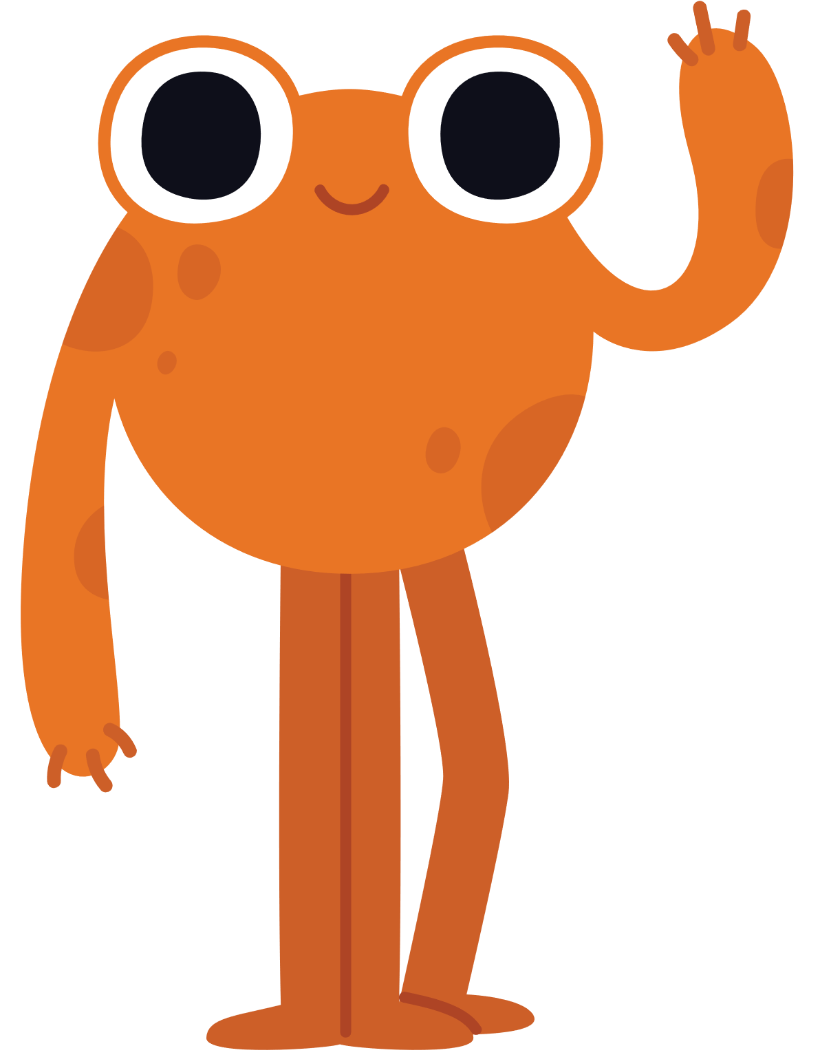

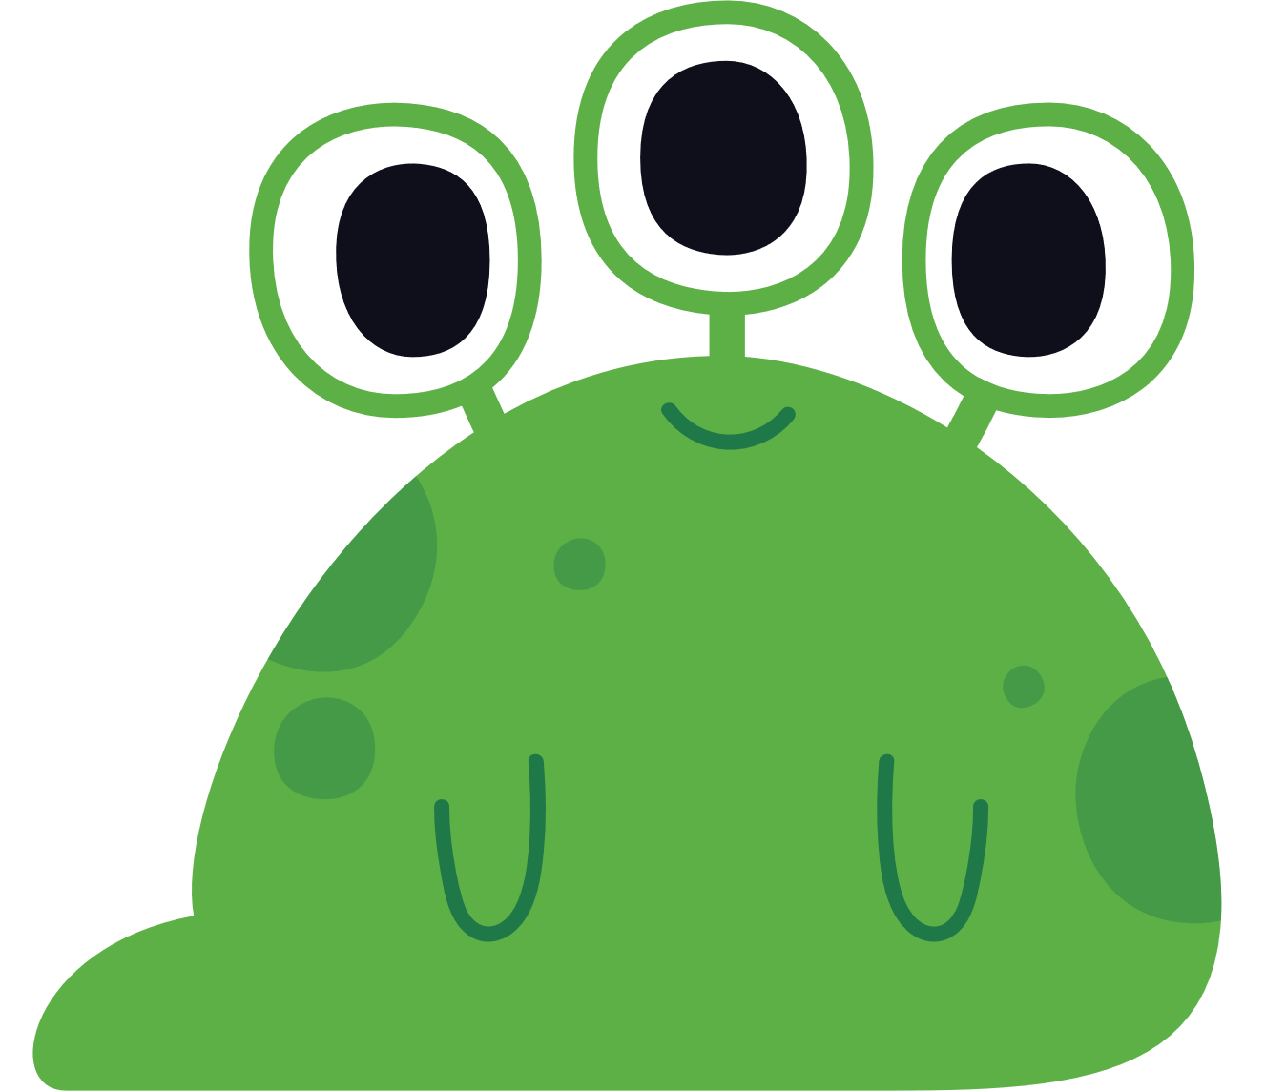
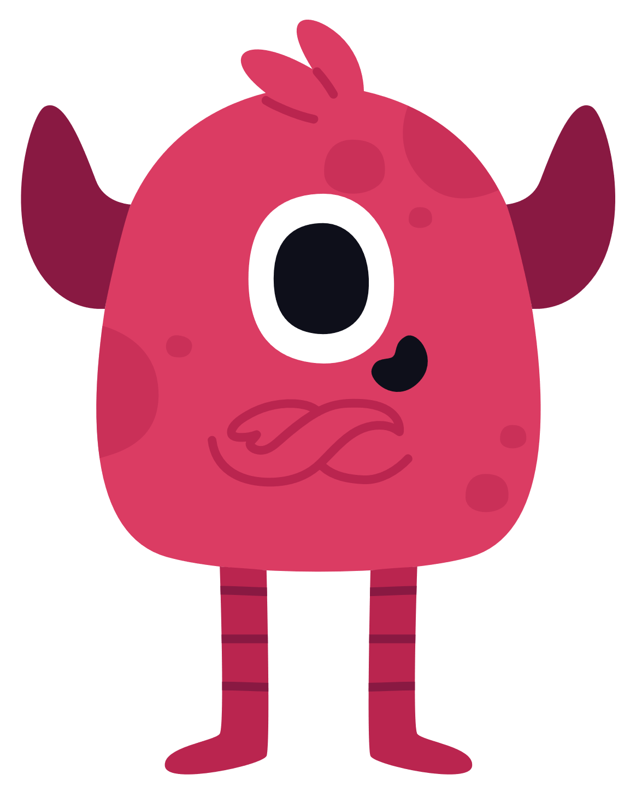
THE INCLUSION CHAMPIONS
PLAYBOOK
GREAT EXAMPLES OF ACTIVITIES FROM ACROSS UNICEF, BROUGHT TO YOU BY THE CULTURE & DIVERSITY
CARE • RESPECT • INTEGRITY • TRUST • ACCOUNTABILITY • SUSTAINABILITY

Slide 2
WHY A PLAYBOOK?
To help you in your efforts: As we all work together to increase our diversity and our sense of belonging in every office, we know colleagues are looking at the Global Staff Survey and Pulse Check results to help figure out the gaps that need to be addressed. Some offices are bringing together a few colleagues to look into solutions to help nuance and verify the data. Many offices have dedicated task forces or working groups to address DEI issues and are hosting conversations to bring everyone together on this journey.
To share some great example from country offices and teams: we can all learn together and there are some good ideas for: helping everybody to be heard, feel valued; connect with one another to listen, share ideas, raise concerns and find solutions that will help us to address cultural and systemic challenges.
So, this is an evolving Pocketbook of ideas and activities that you can all use and add to as you provide a safe and creative space for colleagues to learn about and contribute to making your environment an inclusive, diverse and rich learning environment for all - so we can do an even better job for the children we serve.
CARE • RESPECT • INTEGRITY • TRUST • ACCOUNTABILITY • SUSTAINABILITY

Slide 3
USING INSIGHTS
The different activities contained in this Playbook are based upon behavioural insights and research that focus on reinforcing safety, inclusion and dismantling unconscious bias and behaviours that contribute to discrimination. For example:
Many of the activities reinforce the need to be vulnerable and empathetic, as Brene Brown highlights “The definition of vulnerability is the emotion that we experience during times of uncertainty, risk and emotional exposure…and has been validated by every study I’ve done …” “We know that vulnerability is the cornerstone of courage-building, but we often fail to realize that without vulnerability there is no creativity or innovation.”
“Every human being has biases, the point of examining our implicit biases is to bring our conscious mind up to our unconscious mind and to know when we are behaving in in a stereotyped way”. “Shifting group boundaries with respect to forming new identities is enough to overcome bias. Mere membership in a group is sufficient to change one’s identity and preferences, bridge old divides while creating new ones.” (Source: The Power of Us”)
CARE • RESPECT • INTEGRITY • TRUST • ACCOUNTABILITY • SUSTAINABILITY

Slide 4
HOW TO USE THIS?
This set of activities is for YOU to use how you wish, in what ever order and in whatever way you need to adapt it or contextualize it. We have included suggested scripts in the notes section to help.
Discuss the approaches with a variety of colleagues such as: Human Resources colleague, a Staff Association Representative, Staff Counsellor, Ethics & Culture Champions, Social Behaviour Change colleagues, Peers Support Volunteers or other employees with a different function but with an interest in this topic, so you can bring different perspectives to determine what works.
The role of a Staff Counsellor or Peer Support Volunteer can be really valuable during sessions where people are opening up and feeling a little vulnerable.
Use these tools throughout the year such as: all staff retreats, team meetings, as part of an annual review meeting, during learning sessions or brown bag lunches....
And please give us feedback and share your own ideas so we can add these to the pocketbook. Feel free to reach out to us at: orgculture@unicef.org
Do you need expert support in your office journey? Make a request to our team
CARE • RESPECT • INTEGRITY • TRUST • ACCOUNTABILITY • SUSTAINABILITY

Slide 5
HOW IT CAN HELP YOU
The Playbook is divided into 4 main categories focusing on areas you might wish to help improve in your journey. Each session activity will include an indication on aspects that they will address
  Building Psychological Safety
  Awareness of the power of our mindset and impact on bias
  Building inclusion and addressing discrimination
  Strengthen safety through belonging and inclusion
  Creating spaces for conversations and empathy
  Create safe spaces to chat about behaviours
  Addressing bystander inaction through allyship
  Strengthen allyship in creative ways
  Reinforcing purpose and our values
CARE • RESPECT • INTEGRITY • TRUST • ACCOUNTABILITY • SUSTAINABILITY

Slide 6
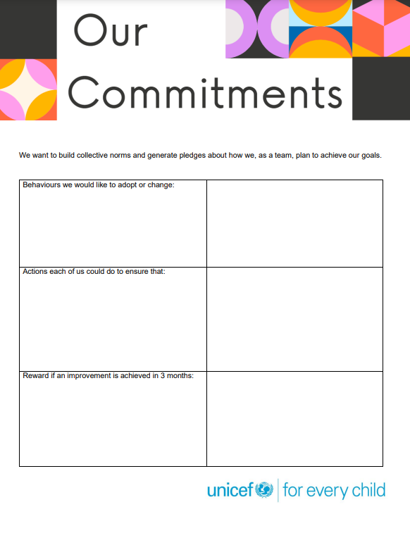

MAKE THE LEARNING LAST
As teams explore ways to move to commitments at an individual and office level, it helps to publicly share idea and make commitments (which helps ensure people follow through with their commitments). You could ask learners to fill in a simple form like the below as they go through various experiences. You can access the form from here.
CARE • RESPECT • INTEGRITY • TRUST • ACCOUNTABILITY • SUSTAINABILITY

Slide 7
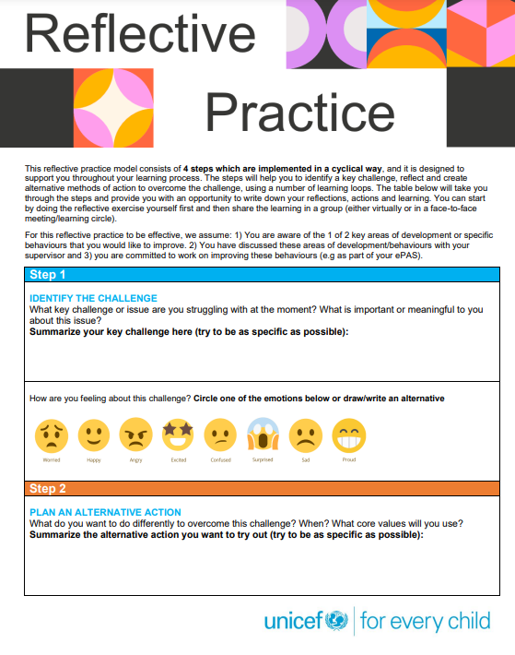
MAKE COMMITMENTS
To support the cycle of learning and growth that individuals are committing to, we have also developed a ‘Reflective Practice’ tool which is designed to support a colleagues throughout the learning process by helping to identify a key challenge, reflect and create alternative methods of action to overcome the challenge.
You can download the template from here.
CARE • RESPECT • INTEGRITY • TRUST • ACCOUNTABILITY • SUSTAINABILITY

Slide 8
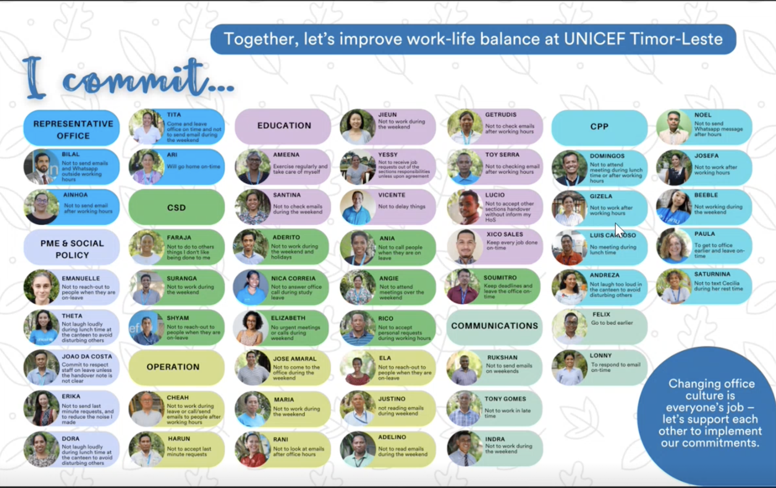
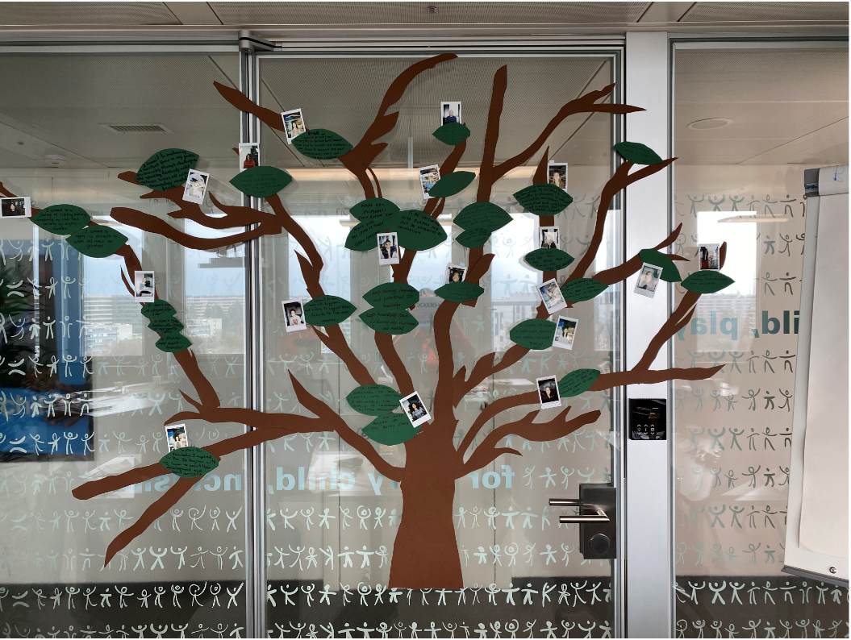
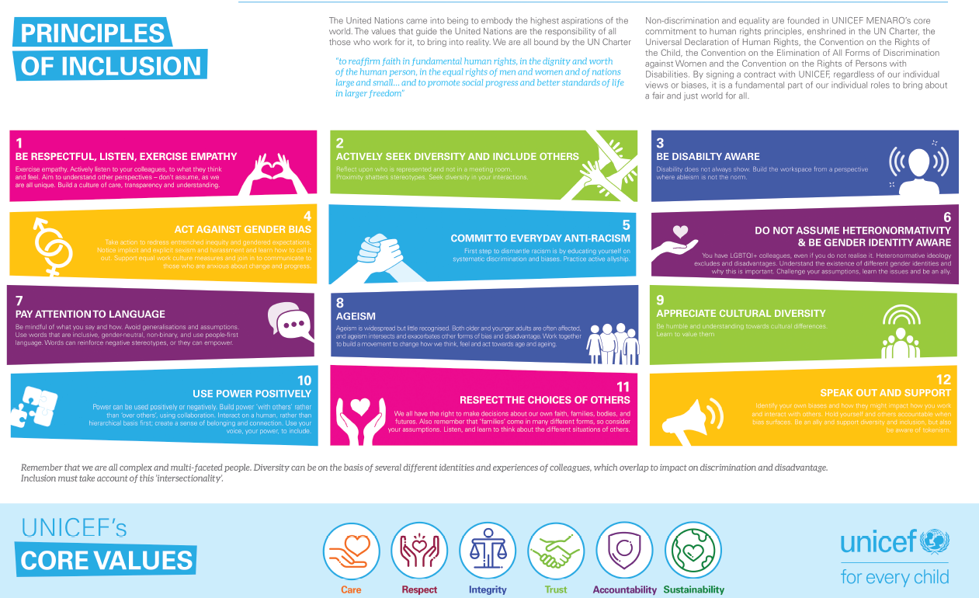
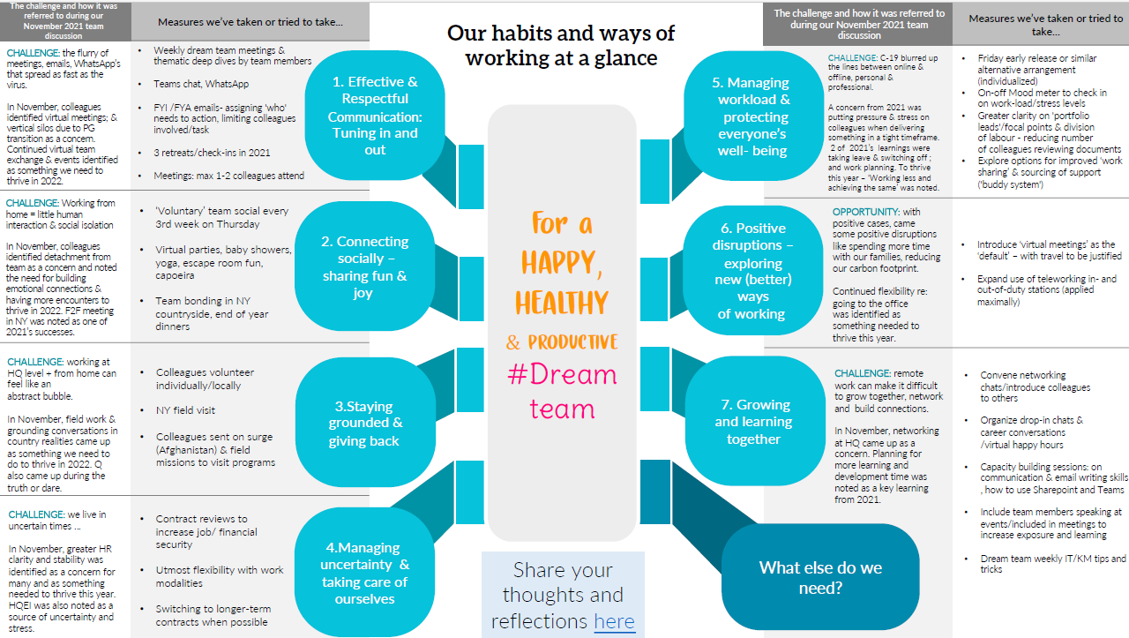
Examples of commitments by other offices
Commitment Tree – polaroid photos & commitment “leaves” on the tree
This is an active and visual activity where each participant will write on a “leaf” ONE action/commitment that demonstrates HOW they can enhance valuing people & culture in their respective offices ONE action/commitment they will take to address/mitigate what weakens the culture. A polaroid photo will be attached to each participant’s commitment.
CARE • RESPECT • INTEGRITY • TRUST • ACCOUNTABILITY • SUSTAINABILITY

Slide 9
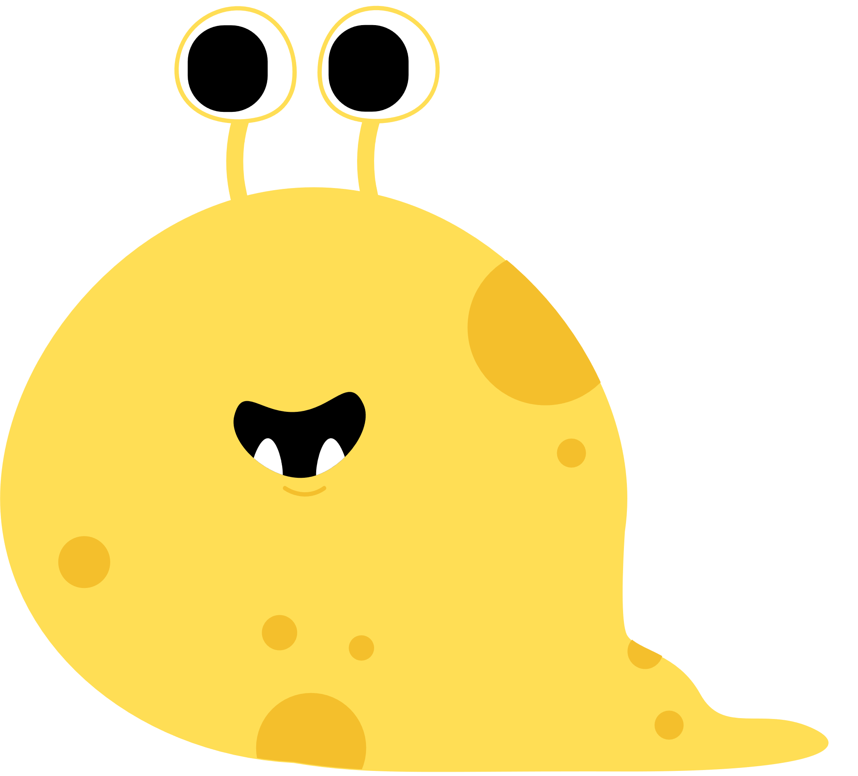

CARE • RESPECT • INTEGRITY • TRUST • ACCOUNTABILITY • SUSTAINABILITY
1. AWARENESS OF THE POWER OF OUR MINDSET AND IMPACT ON BIAS

Slide 10
The power of your Growth Mindset
  Building Psychological Safety
  Building inclusion and addressing discrimination
What is the Activity
This is a reflective activity for about 10 people sitting together, learning and sharing ideas of what a Growth Mindset is all about and how to apply it to their lives and ideas for the office/team. If possible, everyone will have watched Carol Dweck's video on the Power of Yet. And a facilitator can help guide colleagues with reflections on the video, more information of the growth and fixed mindset and discussion - using the accompanying presentation and pocketbook for colleagues.
What Tools You will Need:
A facilitator who is interested or has knowledge about the Growth Mindset
A safe, quiet space for people to sit together
Video screen if screening Carol Dweck’s Ted Talk during the session
Printed or on-screen versions of the Pocketbook for each colleague (and pens)
Flipchart for facilitator to note down common thoughts and ideas
CARE • RESPECT • INTEGRITY • TRUST • ACCOUNTABILITY • SUSTAINABILITY
Notes:
Please see the accompanying PPT for access to the overall script to explain the exercise and the accompanying pocketbook.

Slide 11
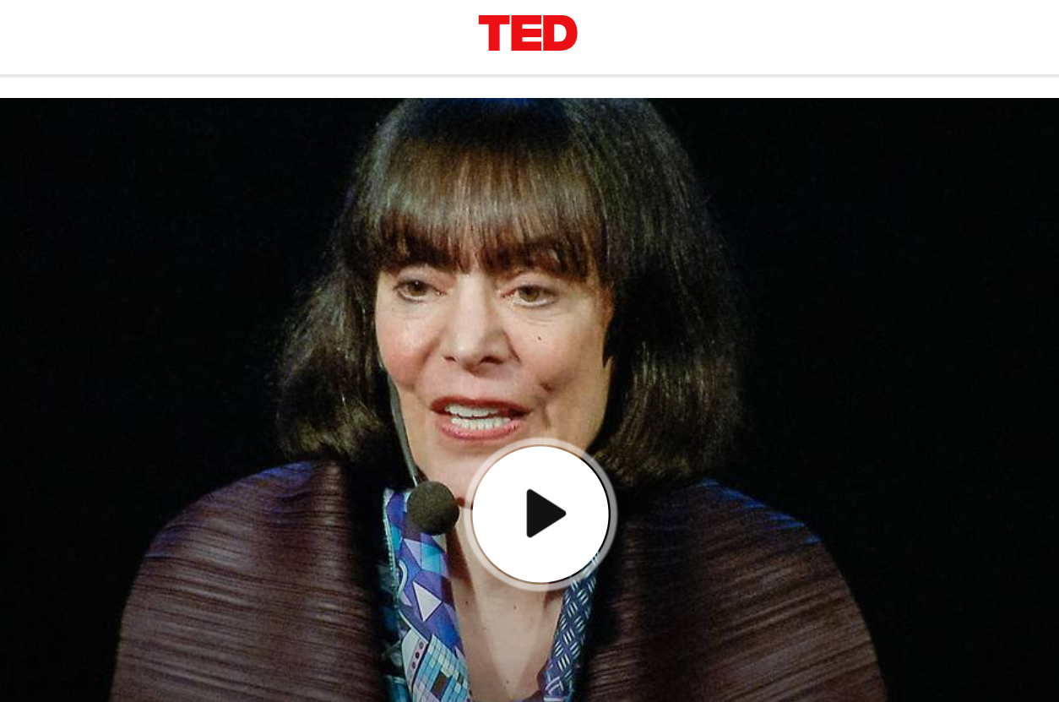
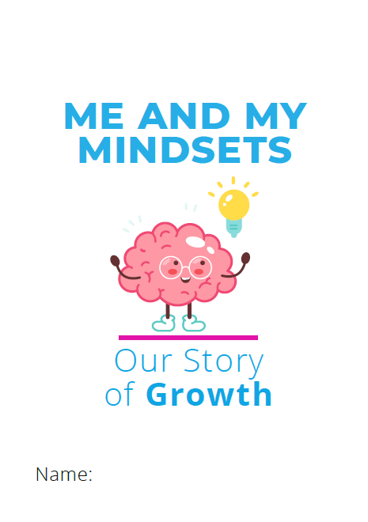
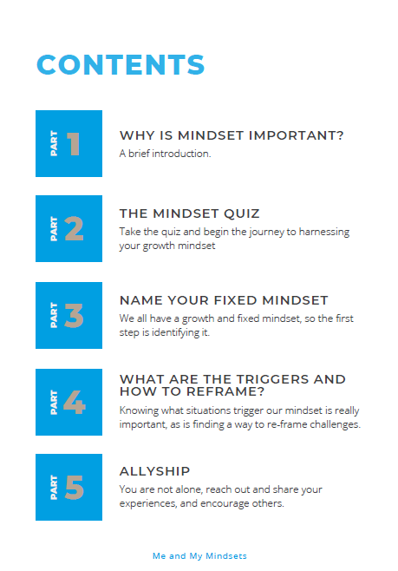
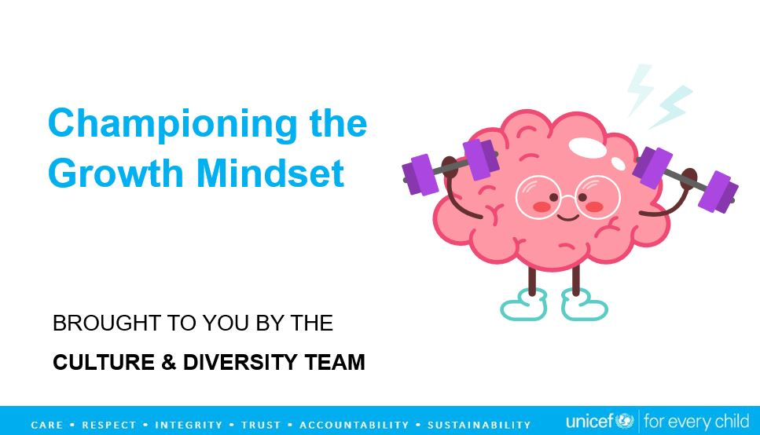
Your Tools
The Video – please click on the image above to go to the video link.
The Facilitator’s Presentation to guide the conversation is here
The Participant’s Pocketbook is here
CARE • RESPECT • INTEGRITY • TRUST • ACCOUNTABILITY • SUSTAINABILITY

Slide 12
Instructions
The facilitator can use guide the accompanying Powerpoint Presentation throughout the session.
Colleagues can refer to and use the accompanying Pocket Book.
Spend some time reflecting on the video and what everyone learnt from the video
Use the accompanying presentation to share more learning and participants can refer to their pocketbook and begin with the quiz. If time allows, let people take the quiz either during or ahead of the session. Go through the various activities in the pocketbook.
Spend the time discussing how this could apply to us as individuals and as a team - any challenges to overcome or ideas for making a collective commitment to model tis approach?
CARE • RESPECT • INTEGRITY • TRUST • ACCOUNTABILITY • SUSTAINABILITY
Notes:
Please see the powerpoint presentation for the script to guide you through the discussion and exercise.

Slide 13
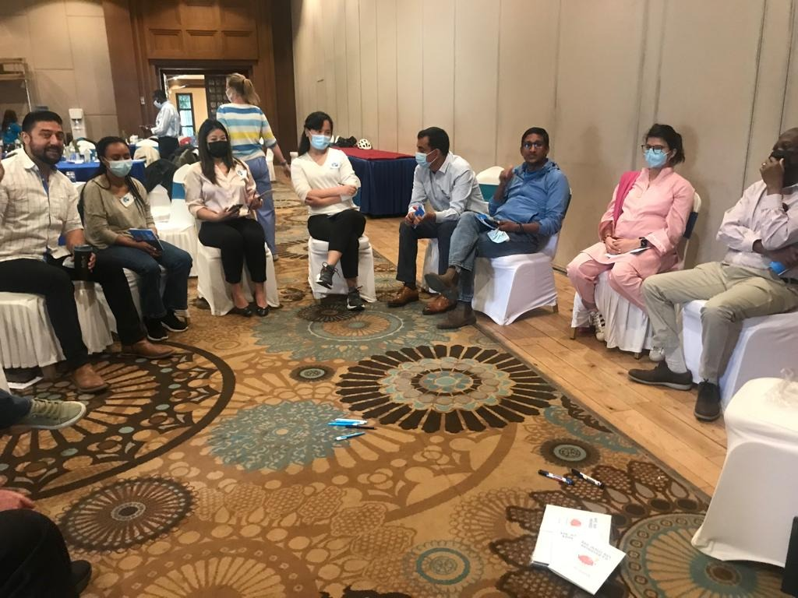
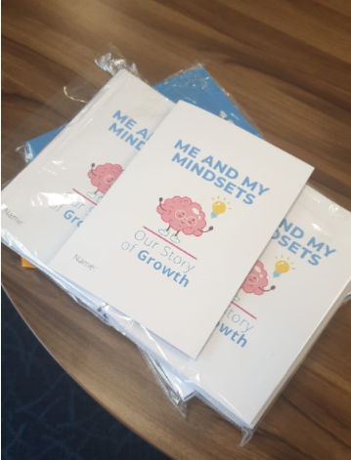
The Growth Mindset
in action
Any questions on how it worked? Reach out to Tania at tdhakhwa@unicef.org
CARE • RESPECT • INTEGRITY • TRUST • ACCOUNTABILITY • SUSTAINABILITY

Slide 14
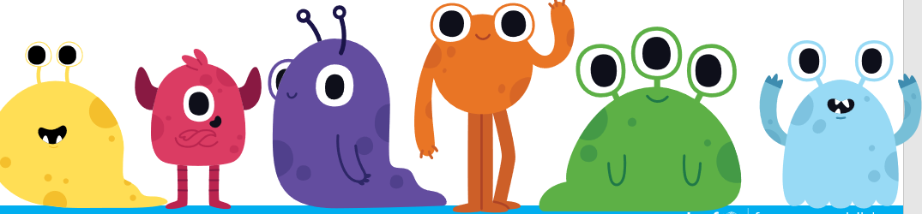
CARE • RESPECT • INTEGRITY • TRUST • ACCOUNTABILITY • SUSTAINABILITY
  2.STRENGTHENING SAFETY THROUGH BELONGING AND INCLUSION

Slide 15
All that We
Share - Game
  Building Psychological Safety
  Building inclusion and addressing discrimination
What is the Activity
This is fun activity that through a series of questions, helps learners to shift our identities and learn about others around us as human beings. It helps us remove the implicit boundaries of “us” and “them” and experience a sense of a shared identity with another learner. It helps us move from a fixed mindset about what we think we know about others, to one that is open to new information and a greater shared sense of empathy.
What Tools You will Need:
A facilitator who is a natural convenor and helps to reinforce a sense of inclusion.
An open and safe space for people to walk around.
Flipchart for facilitator to note down any reflections or ideas after the session to take beyond this session.
CARE • RESPECT • INTEGRITY • TRUST • ACCOUNTABILITY • SUSTAINABILITY

Slide 16
Instructions
One person reads out the questions to a large group who are all standing on one side of the space. If participants response is affirmative, they are asked to go stand together in a separate group and look around to see who they are standing with.
They then go back to the bigger group and wait for the next question. And so on and so forth.
After the last question, everyone should be standing together, and this is an opportunity to remind them that we are all one – no matter our different identities and lived experiences – and ask them all to give each other a round of applause in honour of the work each one does for children, every day.
As you go through the exercise:
Try to encourage the learners to look around them and see who is in their “in-group”. Is it a surprise? How do they feel?
At the end of the session, offer the space for learners to reflect on the session.
CARE • RESPECT • INTEGRITY • TRUST • ACCOUNTABILITY • SUSTAINABILITY
Notes:
Draft script:
Welcome to this fun activity that through a series of questions, helps us to shift between our multiple identities and learn about others around us as human beings. It helps us remove the implicit boundaries of “us” and “them” and experience a sense of a shared identity with another learner.
And if you learnt about the Growth Mindset, you will find that it helps us move away from a fixed mindset about what we think we know about others, to one that is open to new information and a greater shared sense of empathy with one another.
More than anything, you will find new surprises about your colleagues, so enjoy!

Slide 17
Your Tools
Questions
Who loves to dance?
Who is an only child?
Who cooked a wonderful meal this past week?
Who enjoyed the meals in school?
Who is madly in love?
Who is left-handed?
Who enjoys watching films/movies?
Who has laughed today?
Who loves cold weather?
Who has a pet dog?
Who belongs to the UNICEF family?
(Ending with an inclusive question like this allows everyone to then come together)
Please feel free to adapt the templated questions where you think there might be great alignment or relatability amongst the learners.
For example, one office focused on open-ended questions such as What kind of activities you love most to relax during weekend?: 1) sleeping; 2) reading books or watching films; 3) playing sports; 4) others; etc.
YOU CAN FINISH THE GAME BY PLAYING THIS INSPIRING VIDEO:
https://www.youtube.com/channel/UCQMaFeUpKFjJuCtWunchDUA/featured
CARE • RESPECT • INTEGRITY • TRUST • ACCOUNTABILITY • SUSTAINABILITY
Notes:
P

Slide 18
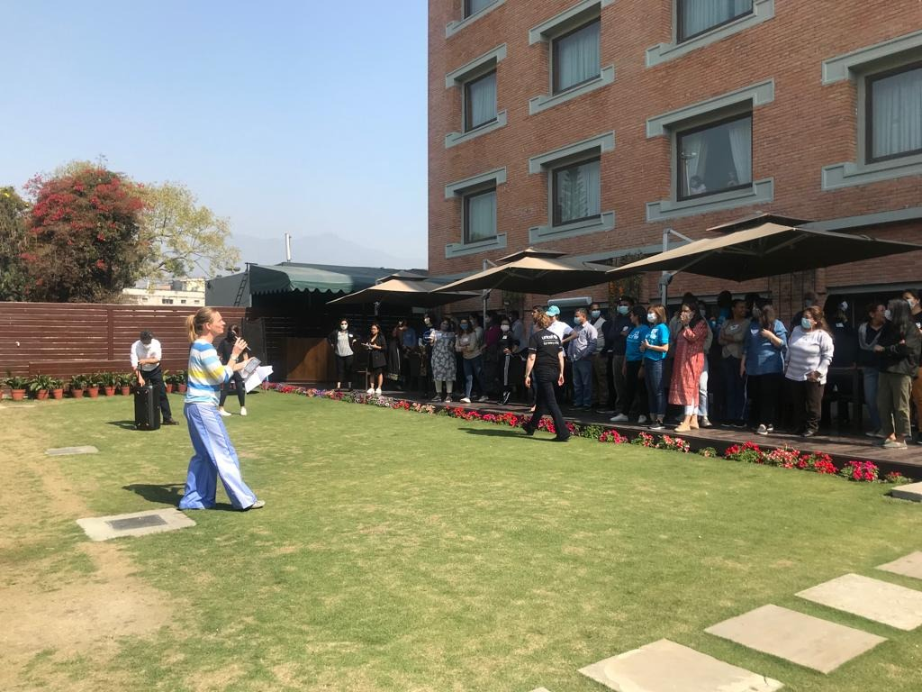
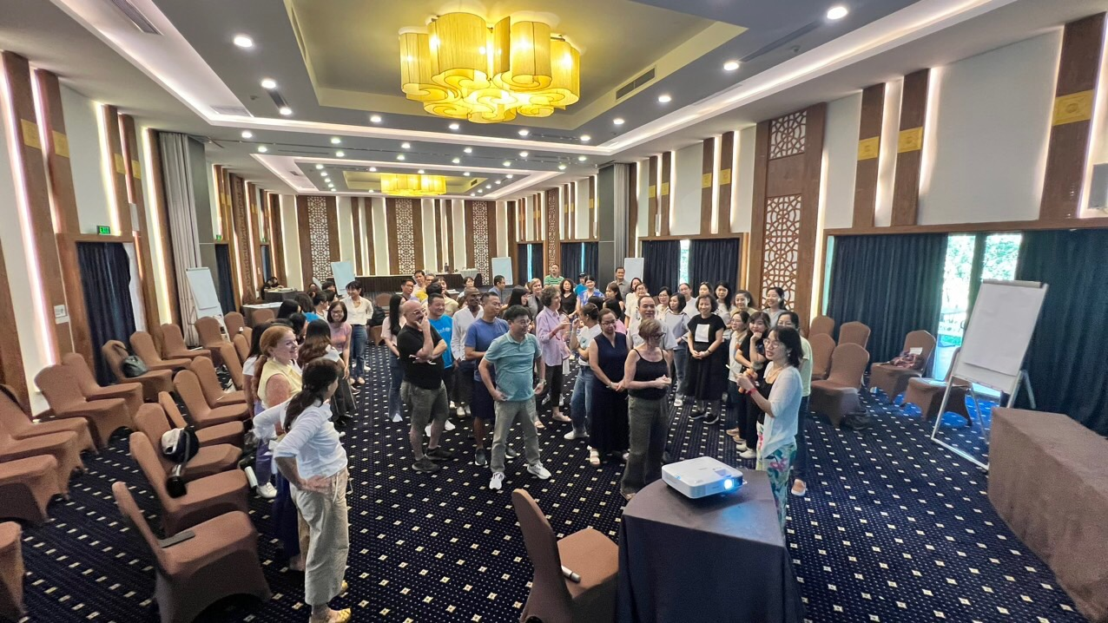
All that We Share
in Action
Any questions on how it worked? Reach out to Nicole at Nicole Klaesener-Metzner nklaesener@unicef.org
Any questions on how it worked? Reach out to Hoai at ptthoai@unicef.org
CARE • RESPECT • INTEGRITY • TRUST • ACCOUNTABILITY • SUSTAINABILITY

Slide 19
'Words Matter' Game
  Building inclusion and addressing discrimination
  Creating spaces for conversations and empathy
What is the Activity
This is an insightful activity to learn all about words that we use in our everyday work, some of which we know and others we do not, all of which are taken from the Glossary of terms related to diversity, equity and inclusion.
What Tools You will Need:
A facilitator who can help to explain the game, read the questions and facilitate discussion and reflection at the end.
A safe, large space for people to sit together in groups or pairs
Flipchart for facilitator to note thoughts and ideas
CARE • RESPECT • INTEGRITY • TRUST • ACCOUNTABILITY • SUSTAINABILITY

Slide 20
Instructions
Step one: The facilitator asks participants to go into pairs or into groups. And ensure that there are at least two groups that will compete together.
Step two: Each pair/group takes a stack of quiz cards and sits together.
Step three: A timer is set for 2 minutes.
Step four: One player poses a question and gives the multiple-choice answers to the partner/s using the text on the card and the partner/s has/have to guess it. When the partner/s guesses it correctly, they get to move onto the next card in the pack. This continues as quickly as possible until the 2 minutes are up.
Step five: the groups can play for about 15 to 20 minutes. At the end of the session, the facilitator can invite the players to count how many cards they guessed and share any reflections. And applause for all the learning!
1
CARE • RESPECT • INTEGRITY • TRUST • ACCOUNTABILITY • SUSTAINABILITY
Notes:
Draft script: Welcome to the game version of the DEI Glossary that allows teams to interact together and learn collectively. It can also be used to introduce staff interactions/discussions about behaviours.
You will have an opportunity to learn about some of the words in the DEI Glossary. Words matter and when we learn what they mean and what to use and what not to use we can better represent the communities and children that we serve, as well as be better colleagues within UNICEF.
Follow the instructions and have fun!
At the of the session:
Okay great everyone:
So, who won the most cards? Let’s give them a round of applause.
The reality is that you are all winners because you have learnt and grown rom playing this game.
Does anyone want to share any reflections? Or ideas for how we can play this again another time?

Slide 21
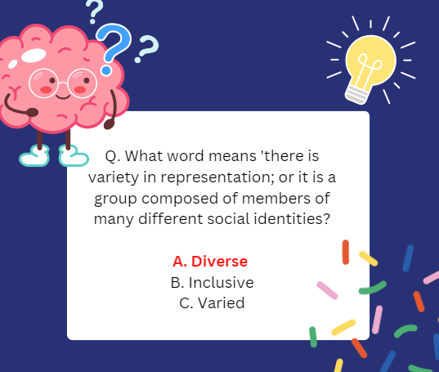
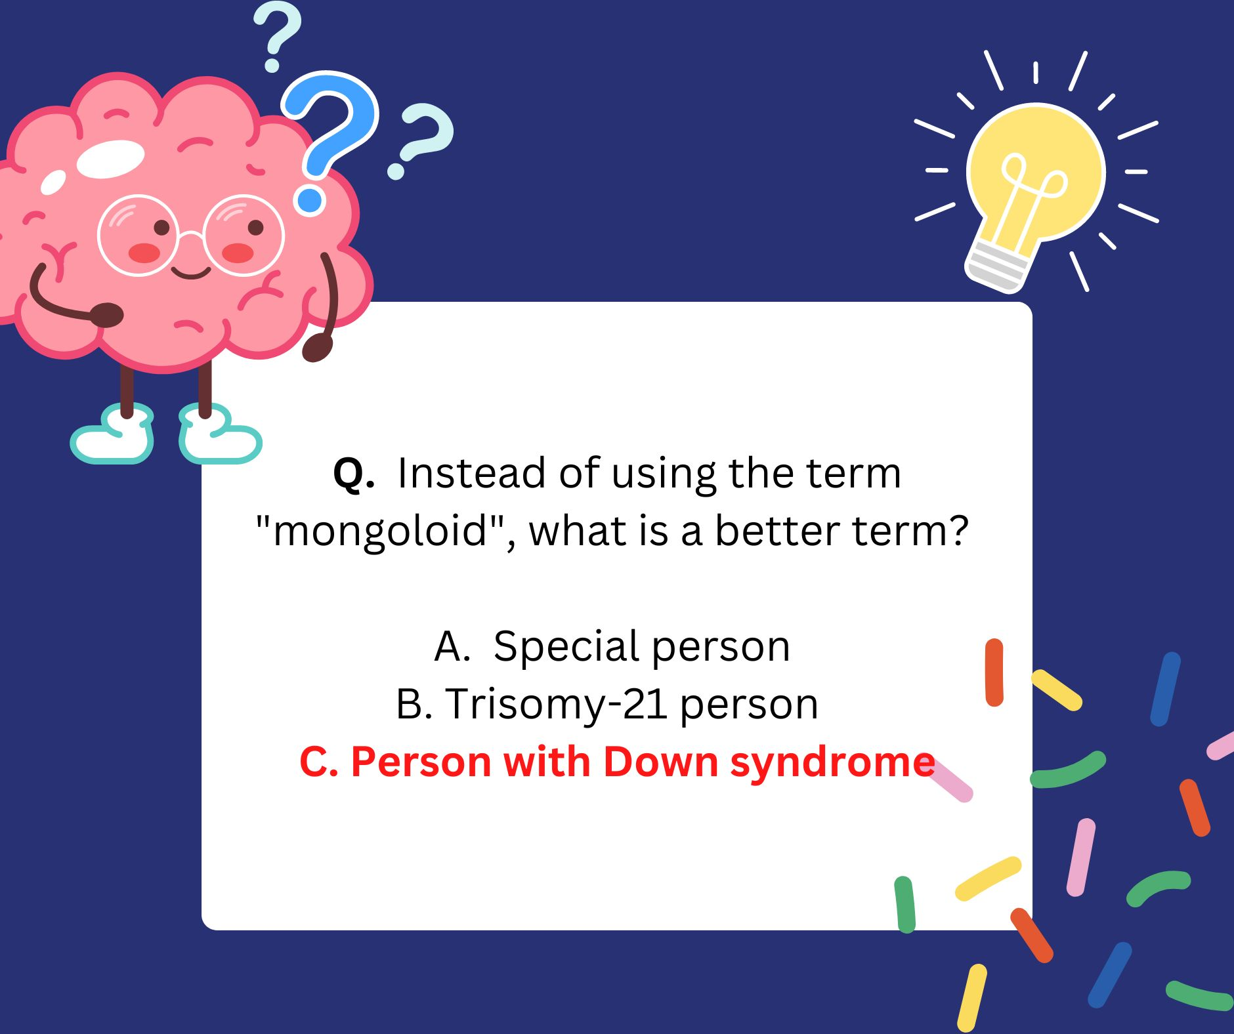
Your Tools
The quiz cards can be accessed here.
CARE • RESPECT • INTEGRITY • TRUST • ACCOUNTABILITY • SUSTAINABILITY
Notes:
End of session script: please see in the questions sheet.

Slide 22
‘Let’s Rumble with
Being Vulnerable’ Game
  Building inclusion and addressing discrimination
  Creating spaces for conversations and empathy
What is the Activity
This is an insightful activity to begin to uncover the day-to-day challenges and fears that colleagues experience in the workplace and make space to express these fears, strengthen collective empathy and work towards new ideas for strengthening safety, trust and inclusion as a team.
What Tools You will Need:
A facilitator who can help to explain the game, read the questions and facilitate discussion and reflection at the end.
A safe, large space for people to sit together in groups or pairs
Flipchart for facilitator to note thoughts and ideas
CARE • RESPECT • INTEGRITY • TRUST • ACCOUNTABILITY • SUSTAINABILITY

Slide 23
Instructions
Step one: pre-session task - Before the session, ask colleagues to reflect on just one of the questions below (choose between them) and write their answer down on a VIPP card/large post-it note (without their name), and bring to the session:
Name one elephant in the room that your group needs to have a conversation about
Describe the typical response in your group when someone makes a big mistake or fails.
What is the biggest barrier to psychological safety and trust in our team?
Step two: As colleagues enter the room, they can put the post it note/VIPP into a container for someone/facilitator to mix and then post on the wall.
Step three: When everyone is settled, the facilitator welcomes colleagues and reflects on some of the insights coming from the cards.
CARE • RESPECT • INTEGRITY • TRUST • ACCOUNTABILITY • SUSTAINABILITY
Notes:
Draft script:
Welcome to the Let’s Rumble with being Vulnerable Game.

Slide 24
Instructions continued
Step four: The facilitator randomly divides the bigger group up so that there are no more than five colleagues in each smaller group. And asks them to go to a quiet space and reflect on the following, reflections can be captured on flip chart:
Think about all the ways your group comes together both virtually and in person. Which actions/behaviours in your team tend to strengthen connections. Which tend actions/behaviours tend to weaken them?
Step five: After the above exercise, the facilitator asks the group/or each individual to Identify ONE action/commitment that they could do to further strengthen team connections (left column), and ONE they could take to address/mitigate what weakens the team connections (right column).
CARE • RESPECT • INTEGRITY • TRUST • ACCOUNTABILITY • SUSTAINABILITY
Notes:
Draft script:

Slide 25
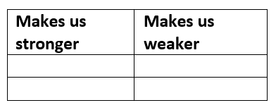
Your Tools
Draw a similar table as the one above, on a flipchart, for Step 5.
Ask the individuals/teams to put ONE action/commitment that they could do to further strengthen team connections in the left column and ONE they could take to address/mitigate what weakens the team connections in the right column.
Please download the template and tailor to your needs. You can access the form from here.
CARE • RESPECT • INTEGRITY • TRUST • ACCOUNTABILITY • SUSTAINABILITY

Slide 26
The Privilege Walk Game
  Building inclusion and addressing discrimination
What is the Activity
This is an insightful activity for about 10 to 20 people standing together in a line. The facilitator asks each one to take a step forward or stay in their place depending upon their answer to a question.
What Tools You will Need:
A facilitator who can help to explain the game, read the questions and facilitate discussion and reflection at the end.
A safe, large space for people to stand together and walk forward several steps
Flipchart for facilitator to note thoughts and ideas
CARE • RESPECT • INTEGRITY • TRUST • ACCOUNTABILITY • SUSTAINABILITY
Notes:
Draft script: Welcome to the Privilege Walk activity. This fun and interactive session is to help us all acknowledge that not everyone is starting their journey and career in UNICEF from the same place. The exercise is designed to help us to recognize and unpack the different sorts of privilege that exists within our society and our culture.
Often, we do not notice our own privilege because it is so ingrained within our culture. So this activity is a great way to begin our own conversations about privilege, our UNICEF office team and our organizational Values. There is not shame in realizing that we have come from different paths and from different experiences, only opportunities to strengthen our collective sense of belonging.
The great thing is that once we realize our privilege, we can also begin to strengthen our awareness and how each one of us can take responsibility for helping to dismantle privilege and power, if it is used in a way that goes against our core values. It helps us to reflect on how we can support each other more, and become even better allies.

Slide 27
Instructions
Before the game, review the set of questions and adapt according to your own context.
During the game: The facilitator asks participants to line up together – one can create a line to begin with so everyone knows where to stand and markers for each step to take is that makes it clearer.
The facilitator asks each person to take a step forward or stay in position in response to the question. Provide a moment for each person to look around them when they respond to each question and have either stayed or moved.
At the end of the session, the facilitator can invite the players to share any reflections or ideas.
CARE • RESPECT • INTEGRITY • TRUST • ACCOUNTABILITY • SUSTAINABILITY

Slide 28
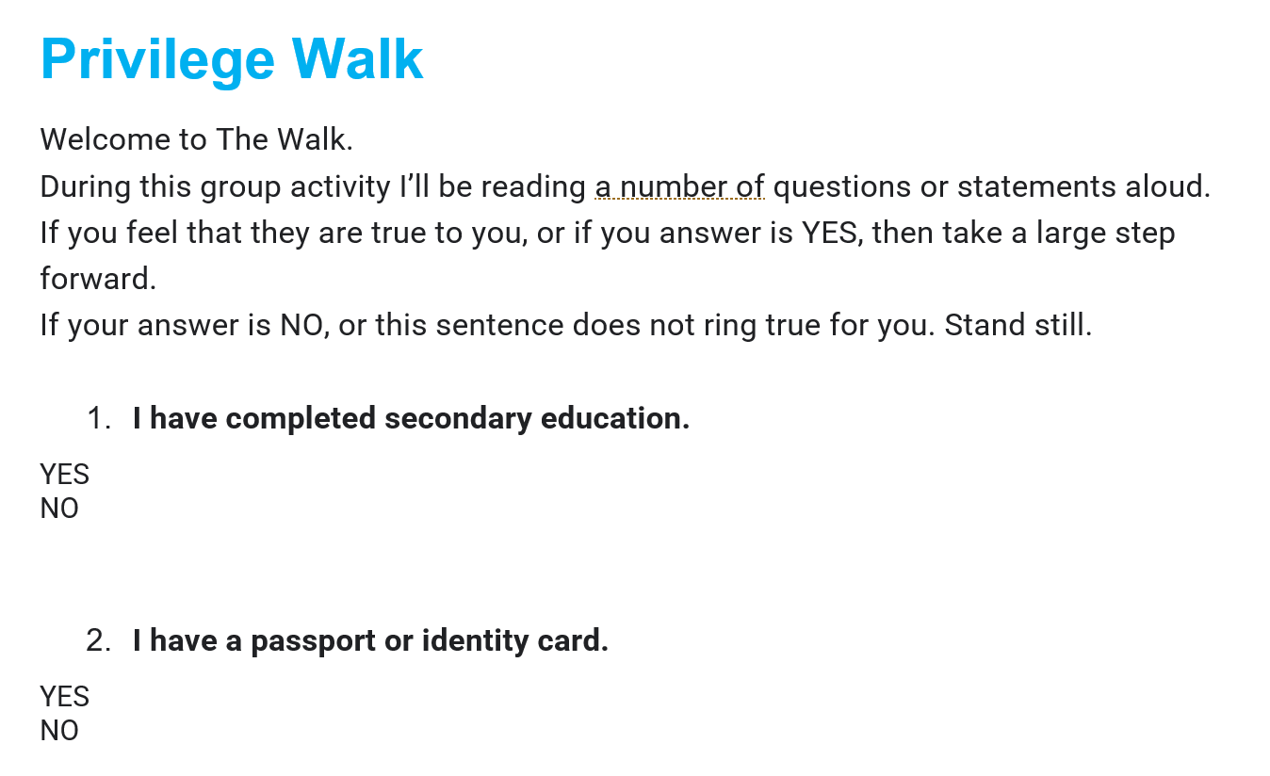
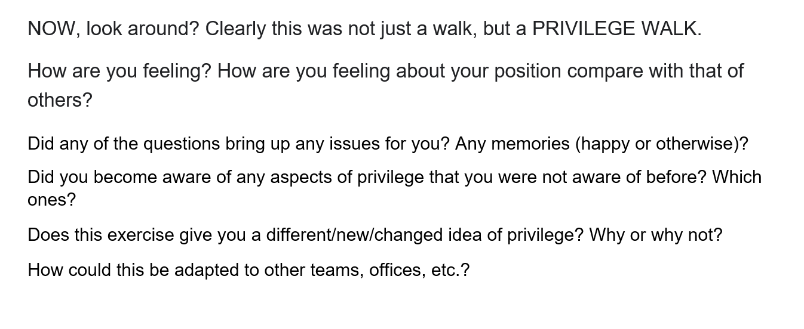
Your Tools
The Facilitator’s question and guide for the post-game conversation can be accessed here.
CARE • RESPECT • INTEGRITY • TRUST • ACCOUNTABILITY • SUSTAINABILITY
Notes:
End of session script: please see in the questions sheet.

Slide 29
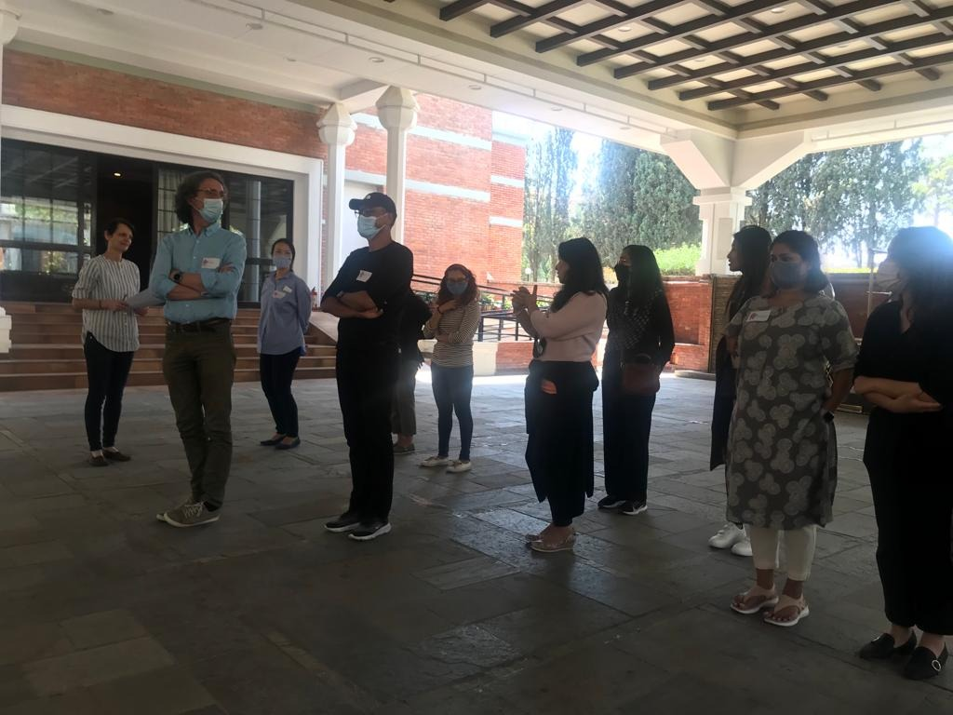
The Privilege Walk
in Action
Any questions on how it worked? Reach out to Bernadette at bgutmann@unicef.org
CARE • RESPECT • INTEGRITY • TRUST • ACCOUNTABILITY • SUSTAINABILITY

Slide 30
The River of Life
  Creating spaces for conversations and empathy
What is the Activity
This is an insightful activity for about 5 people or less to be in a group to share personal reflections and build empathy towards each other. The facilitator asks each participant to take some individual time out to answer a series of questions in the sheet provided. They can draw out their answers. When they are finished, they then come together in pairs or in a larger group (depending on how comfortable they feel) to share their River of Life. It is critical to ensure that the stories are shared where colleagues feel safe.
What Tools You will Need:
A facilitator who can help to explain the game, read the questions and facilitate discussion and reflection at the end.
A safe, large space for people to convene or go into individual space for reflection.
Flipchart for facilitator to note thoughts and ideas
CARE • RESPECT • INTEGRITY • TRUST • ACCOUNTABILITY • SUSTAINABILITY

Slide 31
Instructions
STEP 1
Think about the course of your life • If your life were a river, what shape would it take?
STEP 2
Now think about the various people who have accompanied you along this river’s journey. Record these key relationships and draw/note them in the appropriate places on your river of life.
STEP 3
Note what has been important to you. • What values, commitments?
STEP 4
Take a moment to share with one or a small group of colleague – where you feel safe and comfortable.
Source of these exercises: https://onbeing.org/wp-content/uploads/2019/05/on-being-river-of-life-exercise.pdf
CARE • RESPECT • INTEGRITY • TRUST • ACCOUNTABILITY • SUSTAINABILITY
Notes:
Draft script:
Welcome to the River of Life exercise.
This insightful activity gives us an opportunity to learn about each other as human beings first, and to put aside the functional aspect of who we are at work.
It is a moment of vulnerability for many of us as this activity asks us ot share something of ourselves that is personal and unique to who we are. Please feel free to share as less or more depending on whatever makes you comfortable. No one should feel awkward or exposed in this activity.
We want to build bridges together, get to know each other and reinforce those links of empathy that make us a stronger, more trusting team.
STEP one – some probing questions that the facilitator can ask:
• Where are the bends and turns, when your situation or perspective changed? Was the transition smooth or sudden? • Are there rocks or boulders — obstacles or life-altering moments — falling into your river? • Are there points at which it flows powerfully and purposefully or slows to a trickle?
STEP TWO – some more questions that the facilitator can ask:
If you wish, you can also record thoughts and feelings attached to these relationships. • What relationships have been most significant at different positions in your life? • Who has most shaped you? • Have there been significant losses of relationships along the way? • What groups or communities of people were most important?
STEP 3 – some probing questions"
Are there causes, or principles that have been most important to you at a given point in your life? • Toward what goals, if any, were your primary energies directed? Or, metaphorically speaking, what purposes and ends helped to shape the flow of life waters at a given time in your experience? As you finish depicting your river of life, review the whole diagram. Do its symbols and words seem to portray how you think and feel about the whole of your life? Is there some important element left out? Make adjustments as needed. Remember that no diagram can possibly capture all that shapes your journey
Back in plenary – the facilitator can share the below:
Thanks for sharing your experience today and listening to that of your colleagues. Getting to know each other, beyond what our role is, is key to our feeling a sense of inclusion and belonging in this team. We are more than our title, more than our job description and bring qualities to teams that are a part of our life's journey of lived experiences. Weh new see each other as fellow human beings, each with our own unique journeys but also a sense of connectedness as we go through our lives, we can better empathize and collaborate.

Slide 32
The LEGO Challenge
  Building inclusion and addressing discrimination
  Creating spaces for conversations and empathy
What is the Activity
This is a team-building activity in which groups must work together to build a structure out of LEGO bricks, but each individual has a secret “assignment” which makes the collaborative process more challenging. It emphasizes group communication, leadership dynamics, conflict, cooperation, patience and problem-solving strategy.
What Tools You will Need:
A facilitator
A comfortable space, with a table or space to lay out the LEGO bricks. Zone
Several Boxes of Lego
Printouts of Assignments
CARE • RESPECT • INTEGRITY • TRUST • ACCOUNTABILITY • SUSTAINABILITY

Slide 33
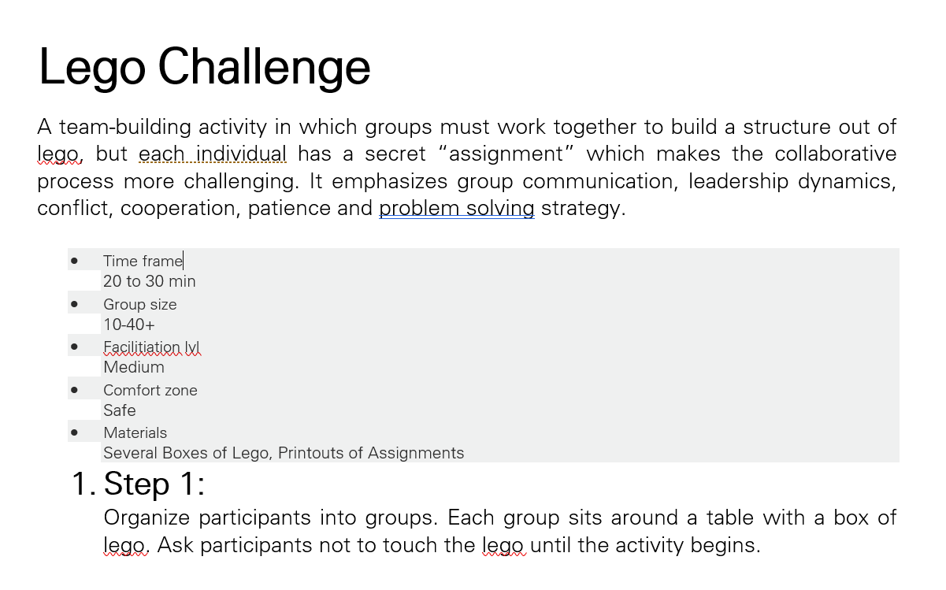
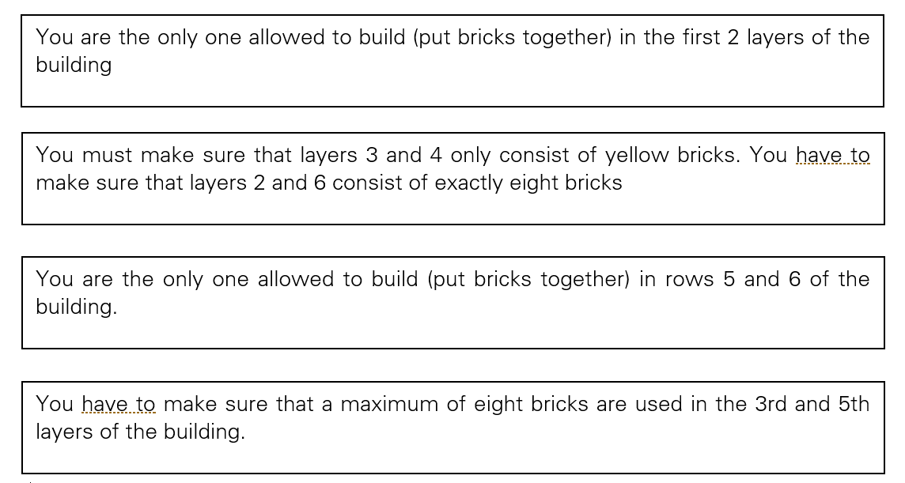
Your Tools
The Facilitator’s instructions can be accessed here.
Team tasks can be accessed here.
CARE • RESPECT • INTEGRITY • TRUST • ACCOUNTABILITY • SUSTAINABILITY
Notes:
End of session script: please see in the questions sheet.

Slide 34
  3. OPPORTUNITIES TO CREATE SAFE SPACES TO CHAT ABOUT BEHAVIOURS
CARE • RESPECT • INTEGRITY • TRUST • ACCOUNTABILITY • SUSTAINABILITY

Slide 35
The Spectrum of Behaviours Game
  Building Psychological Safety
  Building inclusion and addressing discrimination
  Creating spaces for conversations and empathy
What is the Activity
This is fun activity for about 10 to 20 people sitting together around a large printed snakes and ladders board, learning about different behaviours from the Spectrum of Behaviours Tool and sharing experiences.
What Tools You will Need:
A facilitator who can help to explain the game and facilitate discussions.
A safe, quiet space for people to sit together
A printed version of the big format Snakes and Ladders
Printed cards
A variety of fun team markers for each team to move around the board and a dice
Flipchart for facilitator to note down common thoughts and ideas
CARE • RESPECT • INTEGRITY • TRUST • ACCOUNTABILITY • SUSTAINABILITY

Slide 36
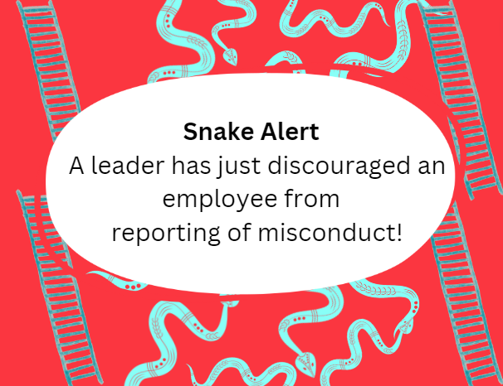
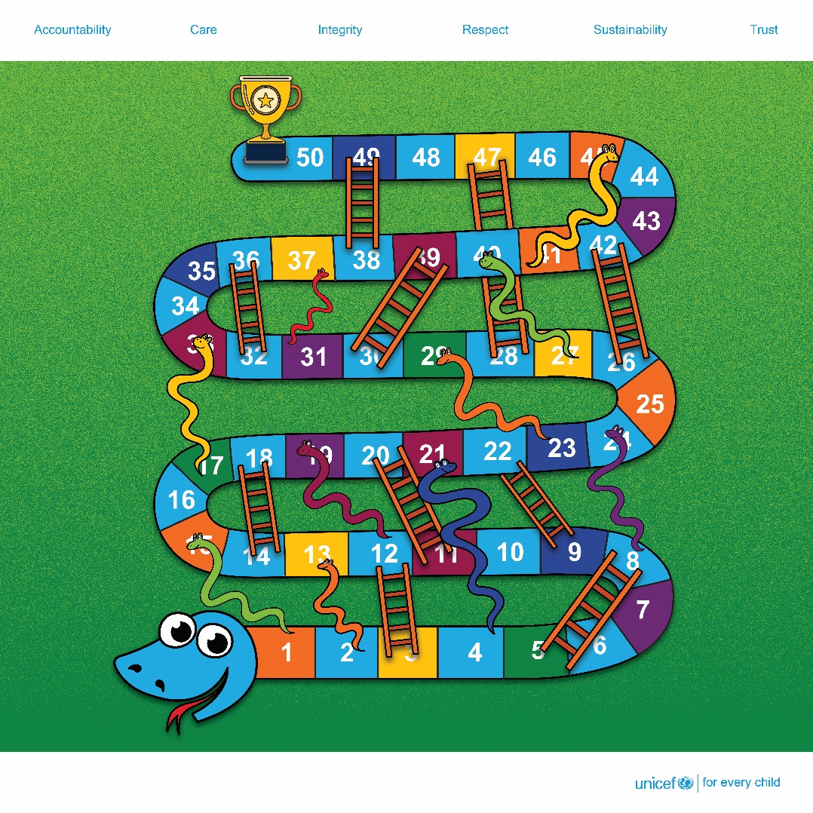
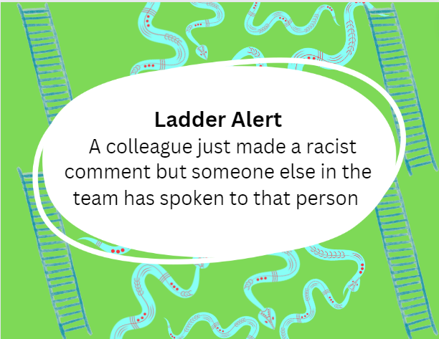
Your Tools
A set of printed cards with snake/ladder related behaviours can be accessed here – other, more contextually relevant behaviours can be customized, please contact Tania at tdhakhwa@unicef.org
The large scale (8feet x 8 feet) snakes and ladders board, access here
CARE • RESPECT • INTEGRITY • TRUST • ACCOUNTABILITY • SUSTAINABILITY

Slide 37
How to play
Up to about 20 players per board – divided up into pairs or three players in each group. The board is a large (8x8 feet), printed canvas that players can sit around (see image below).
It is the same principle as the traditional snakes and ladders game. The teams roll the dice and up the squares.
When they reach either a ladders or snakes, they will take a card from the deck that has a positive (ladder) or negative (snake) behaviours based on the Spectrum of Behaviours Toolkit. A team member can read out the card and they can discuss the behaviour either during or post-game.
CARE • RESPECT • INTEGRITY • TRUST • ACCOUNTABILITY • SUSTAINABILITY

Slide 38
Instructions
Step 1
Throw the dice and move according to the number.
Step 2
If the players land on a space with a snake they pick up a deck of cards from the “snake pile” and read out loud the behaviour, and then move down. If the players land on a space with a ladder they pick up a deck of cards from the “ladder pile” and read out the behaviour, and then move up.
Step 3: Players can have a short (5 minute +) sharing of any examples of how they have felt when have witnessed or experienced such a behaviour (keeping anonymity and privacy throughout). And note down on the flipchart behaviours they want to continue, start or stop.
Step 4: Who wins?
Everyone who has played the game and contributed to the discussion – the goal is sharing and learning!
CARE • RESPECT • INTEGRITY • TRUST • ACCOUNTABILITY • SUSTAINABILITY

Slide 39
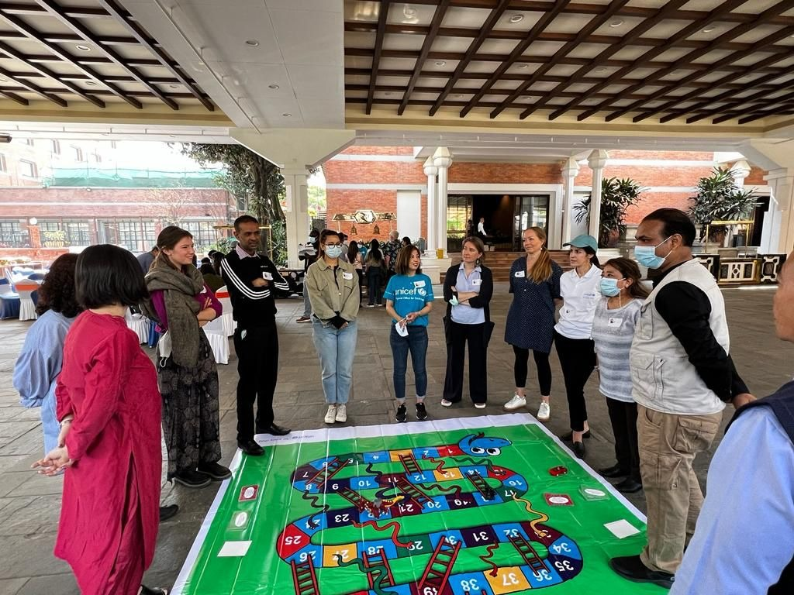
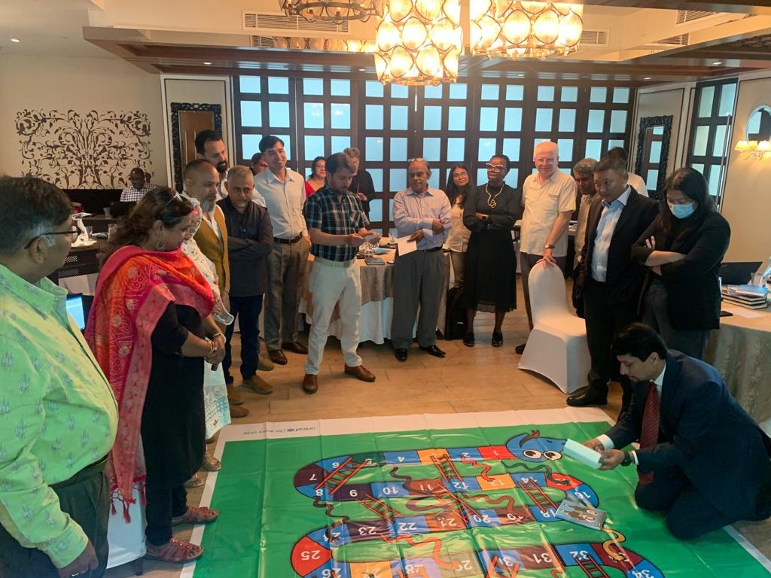
The Spectrum of Behaviours Tool Game
in Action
Any questions on how it worked? Reach out to Tania at tdhakhwa@unicef.org
CARE • RESPECT • INTEGRITY • TRUST • ACCOUNTABILITY • SUSTAINABILITY

Slide 40
  4. CREATIVE WAYS TO STRENGTHEN ALLYSHIP
CARE • RESPECT • INTEGRITY • TRUST • ACCOUNTABILITY • SUSTAINABILITY

Slide 41
“My Allyship Power”Game
  Creating spaces for conversations and empathy
What is the Activity
This is simple activity for about 10 to 20 learners to reflect on the Core Values as tools to harness their own powers to be better allies in the workplace and make a commitment to strengthen their behaviours related to other values.
What Tools You will Need:
A facilitator who can help to explain the game and facilitate discussions.
A safe, quiet space for people to sit together
Printouts of the Core Values
Notebooks or printouts of a Reflective Practice Template
CARE • RESPECT • INTEGRITY • TRUST • ACCOUNTABILITY • SUSTAINABILITY

Slide 42
Instructions
Step One: Ask colleagues the question below. They can take 5 minutes to reflect on an example.
Please think about a recent experience in which you demonstrated a UNICEF Core value that supported another colleague/e, one that is very important to you and which made you feel good about yourself.
Step Two: Ask colleagues to share in smaller groups of 5 or less their example, with a focus on listening to others’ examples. Come back into plenary and share some examples in the wider group. Ask colleagues to reflect on examples of behaviours shared by other colleagues, to think of one behaviour that they could strengthen.
Step Three: Ask colleagues to refer to their notebooks/Reflective Practice Template and commit to strengthening one behaviour, linked to the Core Values and being a better ally.
CARE • RESPECT • INTEGRITY • TRUST • ACCOUNTABILITY • SUSTAINABILITY
Notes:
Welcome to an opportunity to hink about how actions support our team welbign and productivity, through an affirmation exercise reminding us that we can be wide and good and it can free us to think about th wisdom and goodness in others.

Slide 43
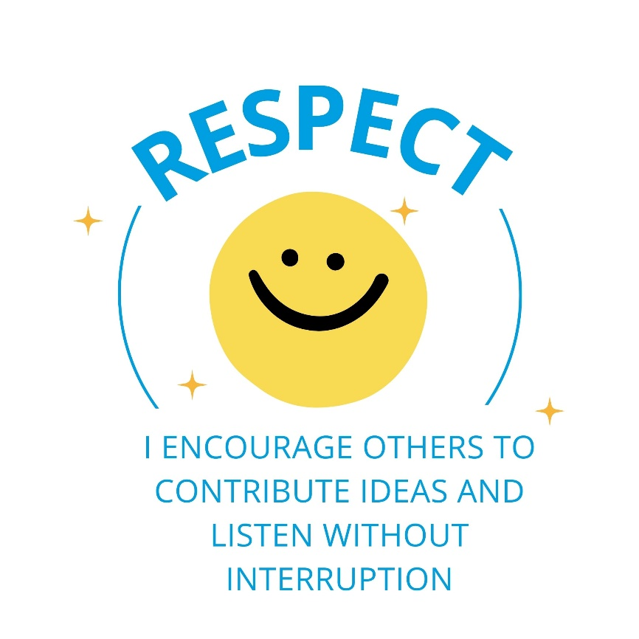
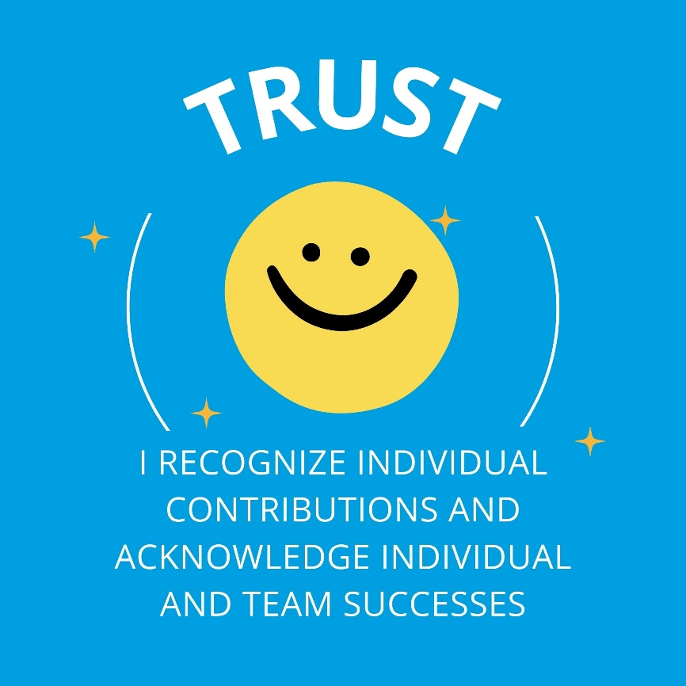
Your Tools
A set of these cards can be found here for printing up either on paper or as stickers.
The reflective practice document (as a word or PDF) can be found here.
CARE • RESPECT • INTEGRITY • TRUST • ACCOUNTABILITY • SUSTAINABILITY

Slide 44
The Ally – A Mini Drama
  Creating spaces for conversations and empathy
What is the Activity
This is a fun role play activity, especially good for all the budding thespians in a group! The idea is to role play a scenario where micro-aggressions are occurring and explore how colleagues can use tools to be an ally to someone who feels disempowered.
What Tools You will Need:
A facilitator who can help to explain the game and help narrate the scenario
Three volunteers to act
The scripts printed out for colleagues to read from
CARE • RESPECT • INTEGRITY • TRUST • ACCOUNTABILITY • SUSTAINABILITY

Slide 45
Instructions
Step One: Ask colleagues for three volunteers – let them choose and take 5 to 10 minutes to go through the script.
Step Two: Follow the script that has bene provided (or adapt if it helps to make it more relevant)
Step Three: Allow for colleagues to reflect during the questions and also at the end of the role play.
CARE • RESPECT • INTEGRITY • TRUST • ACCOUNTABILITY • SUSTAINABILITY

Slide 46
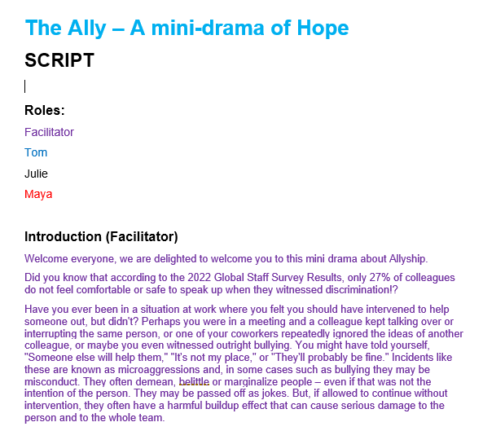
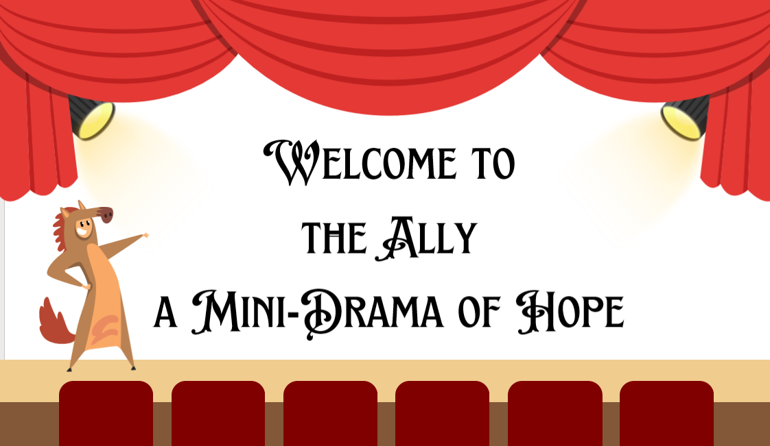
Your Tools
The script for the entire mini drama can be found here
The accompanying slides can be found here
CARE • RESPECT • INTEGRITY • TRUST • ACCOUNTABILITY • SUSTAINABILITY

Slide 47

We want to hear your ideas

Slide 48
Your ideas here
Your Ideas Here
CARE • RESPECT • INTEGRITY • TRUST • ACCOUNTABILITY • SUSTAINABILITY

Slide 49
Your ideas here
CARE • RESPECT • INTEGRITY • TRUST • ACCOUNTABILITY • SUSTAINABILITY

Slide 50
Your ideas here
CARE • RESPECT • INTEGRITY • TRUST • ACCOUNTABILITY • SUSTAINABILITY

