Slide 1
COMMUNITY ENGAGEMENT
TRAINING OF TRAINERS MANUAL
FOR USE BY FRONT-LINE TRAINERS IN LEBANON
Design and planning
Notes:
Click to add notes

Slide 2
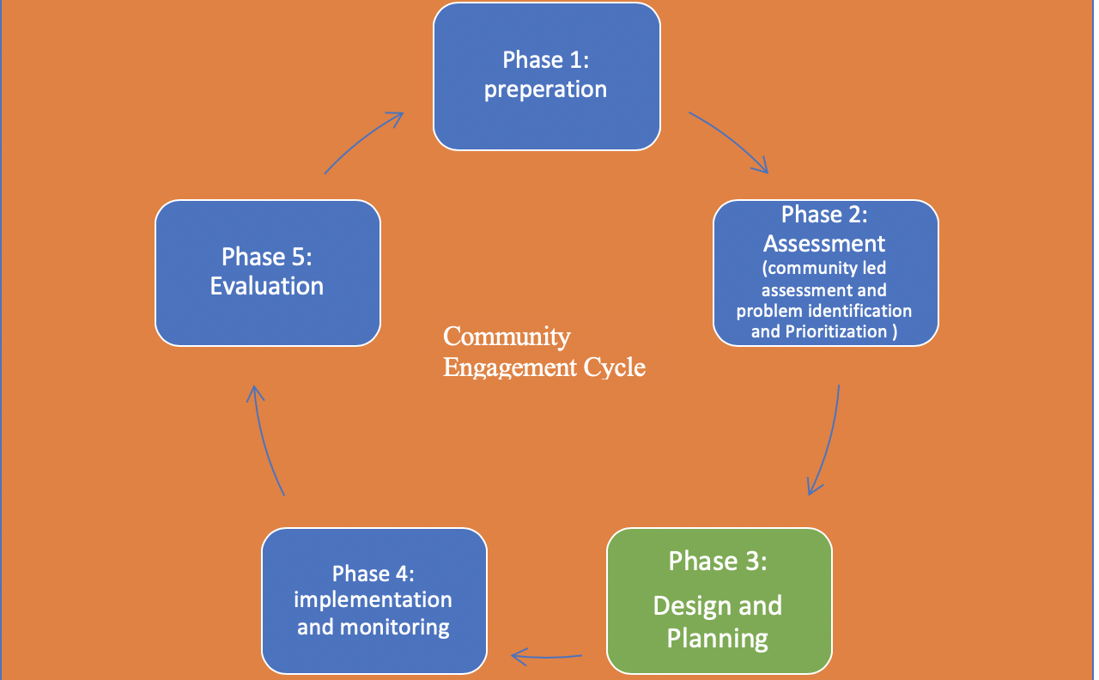
Design and planning phase

Slide 3
Design and Planning phase
During this phase, data from assessment phase and previous learnings will be used to design the CE program, providing equal opportunities to everyone to participate in the planning process.
Ensuring proper representation of different groups affected and targeted, vulnerable and marginalized groups. At this stage, clear roles and responsibilities need to be agreed with representatives and community leaders.

Slide 4
Setting clear objectives
Clear objectives are essential to an effective community engagement process. They comprise the goals that are required to achieve the purpose.
Clear objectives do not suggest rigidity of purpose; once an engagement process has begun, community members may see new purposes that emerge through the engagement process.
It is helpful to revisit the objectives occasionally throughout the engagement period to see if they are still valid and/or if adjustments need to be made

Slide 5
Differences between Goals, objectives and expected outcomes
Goal: is a long-term aim that requires several projects to attain it e.g. decrease the mortality rate of children aged 0-5 years in this city by 20% within 2 years
Specific objective: actions necessary to achieve a specific short-term project or activity. It is stated in term of the facilitator abilities. Represents what it is intended to be done. E.g. discuss with 80 % of mothers 5 preventive factors to children mortality.
Expected outcome: describe the desired behaviour or changes that will be required to achieve the main goal. It is the result that should be seen, on the short term, the mid-term, and the long-term among people who received the intervention. E.g. 80% of the mothers who attended the awareness will list 5 preventive factors to children death (short term expected outcome)

Slide 6
Clear audiences/Who will you Engage?
Audiences are essential to an effective CE process,
we need to understand well who we are targeting and what affects their decision-making process,
what media do they trust and follow and how do they make their essential decisions.

Slide 7
The CE activities and approaches
Activities will depend on what you want to achieve and who you need to reach.
Different communication channels will work better for different objectives, while different audiences will access and trust different communication channels.
The key is to select a range of activities and channels that can work together to achieve the CE objectives and support the wider programme aims.

Slide 8
What is an action plan and why do we need an action plan?

Slide 9
What needs to be included in an action plan ?

Slide 10
CE implementation plan
including specific objectives, activities, timelines and budgets need to be drafted setting out all activities required to handle the problem,
what we need to engage and communicate on,
with whom, how and when.
The CE Plan will also need to establishing a system to listen, collect, analyse, respond to and act on feedback and complaints during the implementation of the program.

Slide 11
Before you develop the plan
What is the problem? What are the root causes of the problem? How long has this problem existed? What has been done in the past? What worked, what didn’t work, what are the benefits of fixing it? What are the consequences if left unresolved?
Which community members are most affected by this problem?
What are the solutions? activities? What can we do about this problem now? Who are possible partners—local leaders, local organizations, service providers such as teachers, health providers, WASH technicians
Who will do these activities? Who will be responsible for implementation? Which community member(s)? NGOs? Local groups? Others? who will take the lead?
When will the implementation happen? For each activity, a realistic timeline for each step need to be set
Budget and resource mobilization: a clear budget need to be developed covering all activities in the plan and estimations for additional required resources that are not in hand. This will need to be followed by a resource mobilization plan, and how the additional resources will be collected.

Slide 12
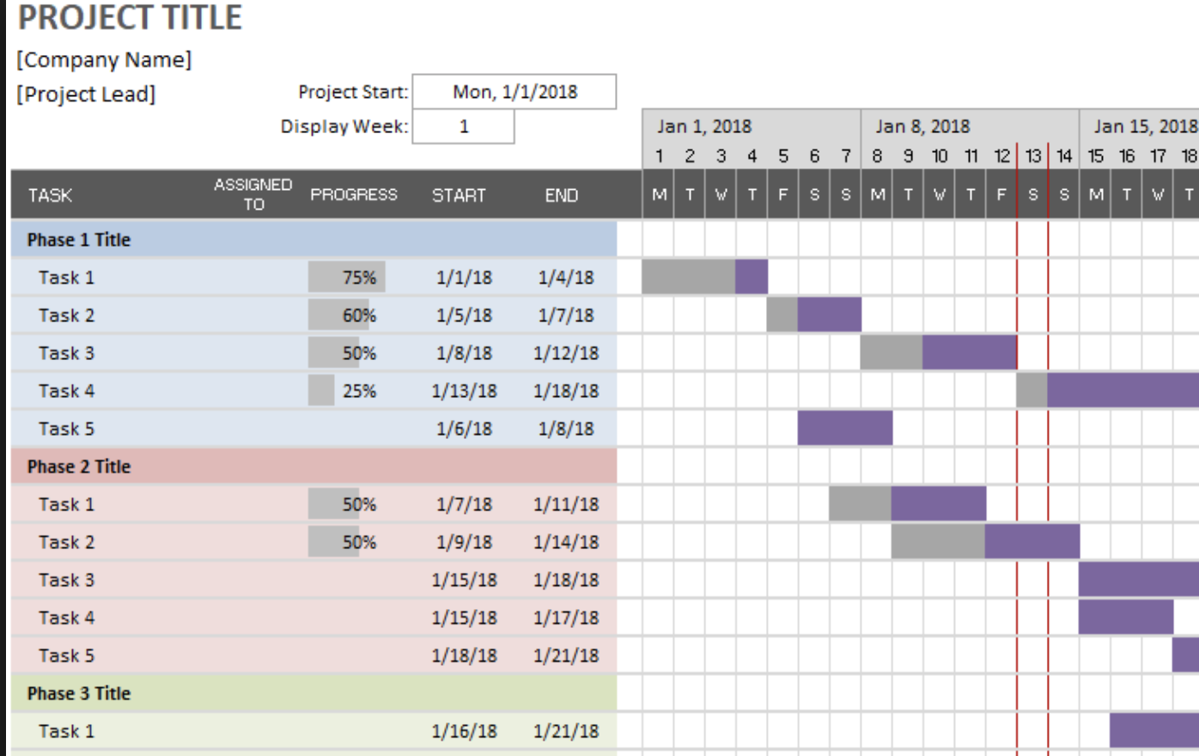
Gantt Chart

Slide 13
Template for Action Plan
Objectives
Activity | Outcomes | Timeline |  |  |  | Responsibility | Budget
 |  | Q1 | Q2 | Q3 | Q4

