Slide 1
COMMUNITY ENGAGEMENT
TRAINING OF TRAINERS MANUAL
FOR USE BY FRONT-LINE TRAINERS IN LEBANON
Community Engagement Step II
Assessment
Notes:
Click to add notes

Slide 2
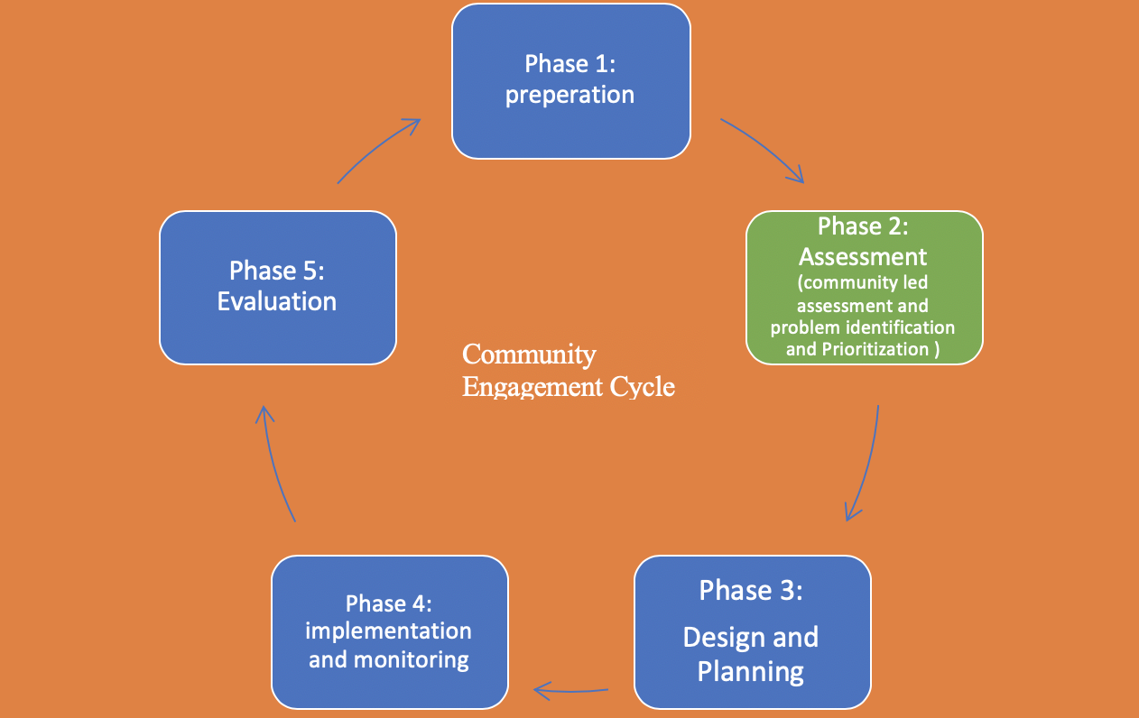
Step 2. ASSESSMENT

Slide 3
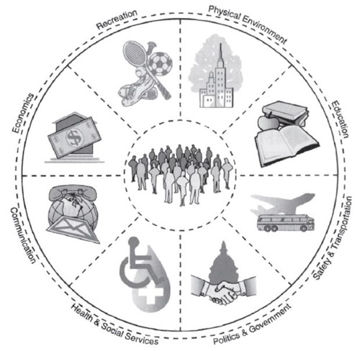
Assessment Phase
This phase is based on understanding the problem and factors contributing to its existence. The community-as- partner model is a guide to assess communities with a main focus on people at the centre, influenced by several subsystems that should be all evaluated

Slide 4
Assessment tools/Approaches
Search and review existing information
Use a wide range of assessment tools
Mapping
Community meetings
SWOT analysis
Problem tree analysis,
Participatory action research (PAR)
Child Led Data Collection tool
Windshield Survey:
3. Plan and undertake Studies and Surveys

Slide 5
Assessment tools/Approaches
Search and review existing information (secondary data)
Information is always available
lots of secondary data
Research reports, and activities are available that can be of great value and can provide valuable insights and information
Understanding the problem and analysing root causes and coming up with possible solutions

Slide 6
Assessment tools/Approaches
Use a wide range of assessment tools that can help us understand the problem like:
Mapping, a tool that can be used to tell a story about what is happening in communities, it can be used to identify “hot spots” which can be extremely useful in targeting interventions.
Community meetings: a community meeting is either a formal or informal public gathering that brings together local residents to discuss issues, voice concerns, and express preferences for community priorities. In these meetings, discussions are around issues related to the community’s strengths and potential challenges.
SWOT analysis, a technique for understanding Strengths and Weaknesses, and identifying both the Opportunities and the Threats. SWOT analysis is designed to facilitate a realistic, fact-based, data-driven look at the situation or problem the community is facing.

Slide 7
Assessment tools/Approaches
Problem tree analysis, A problem tree analysis is a pictorial representation of a problem, its causes and its consequences. This analysis tool helps the project team get a quick glance of how a range of complex issues contribute toward a problem and how this problem branches out into a set of consequences.
Participatory action research (PAR) an approach to research in communities that emphasizes participation and action. It seeks to understand the world by trying to change it, collaboratively and following reflection. PAR emphasizes collective inquiry and experimentation grounded in experience and social history. Within a PAR process, "communities of inquiry and action evolve and address questions and issues that are significant for those who participate as co-researchers.”
Child Led Data Collection tool is a group of young researchers formed to carry out data collection on child rights issues within the frame work of UNICEF programs priorities for child protection, education, health and Nutrition and WASH within their location.
Windshield Survey: are observations of the community characteristics made by driving a car or by walking. It is used to assess general community needs – to estimate the poverty level, for example – or to examine more specific facets of the community’s physical, social, or economic character

Slide 8
Assessment tools/Approaches
Plan and undertake Studies and Surveys to better understand the problem and its magnitude. Several types can be used, most commonly Qualitative and Quantitative methods (In Depth Interviews, and Focus Group Discussions).
Depending on this situation, problem, capacities and timeframe CE planners and community members involved in the process can decide on the best tools and methods to carry out the assessment phase.
The proposed list of tools is not exhaustive and other tested tools the partners have can be used.

Slide 9
Community Mapping
Have you done community mapping before?
Tell us your experience

Slide 10
Community Mapping
Mapping
Objective:
Empower and support the community leaders in learning about their community "as they see it now”.
They will “see” themselves through the tangible and graphic representation that they create themselves.

Slide 11
Community Mapping
Mapping Process:
Get together with community leaders to explain the process.
Ask the leaders to call a meeting of the community members who would be interested in explaining or diagramming their community
At the meeting discuss life in the community to create a friendly atmosphere
Ask the community to draw/construct a map of their community, showing the location of houses, other buildings, river, farmlands, etc. – including any special topic, such as health (and the locations and persons important to health)
When completed, review the map together as a group and make corrections until everyone is satisfied
Discuss features of the map, e.g. clustering of houses, location of school, shops, etc.

Slide 12
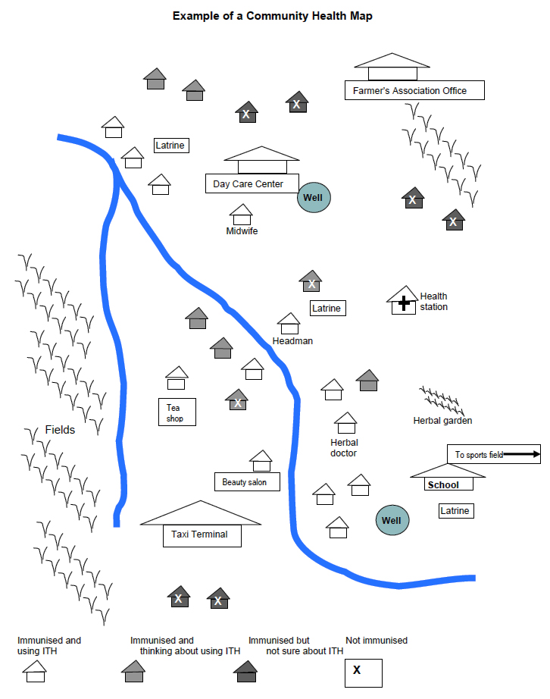

Slide 13
Community Mapping
Aim of Community Mapping :
Community mapping can serve many functions. In some cases, an outside analyst is helpful for a technical perspective. In others, this activity can serve as a valuable resource when conducted by community residents alone.
Select local & technical analysts, & set a time.
Develop criteria for observation.
Create mapping diagram.

Slide 14
Community Mapping
Analyze diagram.
Brainstorm available solutions
Take any necessary follow-up steps to pursue those solutions

Slide 16
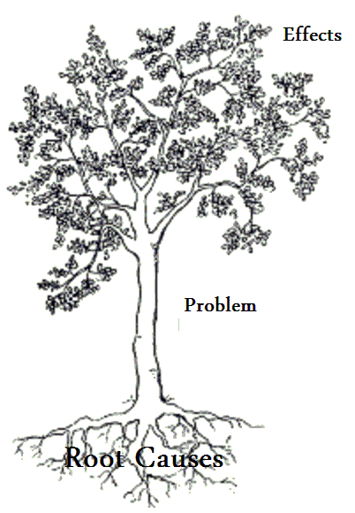
UNDERSTANDING THE PROBLEM Problem Tree
Violation of child rights, illiteracy, more poverty, deterioration in their overall health…etc.
Step 3: Problem Identification
The problem: Child Labour
Root causes: Poverty, Syrian refugee adults have restricted access to the labour market in Lebanon, social norms, lack of knowledge …etc.

Slide 17
PROBLEM TREE EXERCISE
The problem: Child Labour in Refugees Camp
“WHY” this is so?
-----------------------------
“WHY” this is so?
-----------------------------
The answers to all the “WHY” question are the root causes
“WHY” this is so?
-----------------------------
“WHY” this is so?
-----------------------------

Slide 18
Identify The Problem Using Assessment Information
What is the problem? | Youth drop out of school
What are the root causes? | Poverty pressure to earn money no time/space at home to do homework working parents not at home illiterate/low ed. parents School environment French curriculum students don’t understand assignments teachers not sympathetic

Slide 19
Identify The Problem Using Assessment Information
How long has it existed? | More than 20 years
What was done in the past? | Recreational activities & sports Psychosocial support sessions Note: these strategies do not address root causes
Who are the affected community members? | Youth out of school Their parents Shop keepers

Slide 20
Problem tree example –Discrimination in schools

Slide 21
Do you have an example of problem tree analysis that you can share with us ?

