Slide 1
Data Management for POC EID
Supplementary Content 2: Use of logbooks for record keeping
POC EID Training Toolkit
v. May 2019

Slide 2
Agenda
1
Learning Objectives
2
Importance of documentation and keeping record
3
Use of Logbooks
4
M&E Indicators

Slide 3
Learning Objectives
1
At the end of this topic participants will be able to:
Understand the importance of correct recording and documentation
Learn how to completely fill in the logbooks and forms that will be used within the POC EID program
Understand the role of M&E and schedule for routine data collection
3

Slide 4
Agenda
1
Learning Objectives
2
Importance of documentation and keeping record
3
Use of Logbooks
4
M&E Indicators

Slide 5
Importance of documentation
2
Documentation plays a crucial role in any test and treatment program setting
Documentation is the only to assure the quality of care provided to clients is not only maintained, but can be consistently improved
Documentation is necessary to identify problems within the health facility itself and overall health care system; accurate records are needed to find effective solutions to current problems and prevent others from happening in the future
Another way to look at documentation is to echo the old philosophical question: “If a health care worker renders services and there is no documentation to support it, did it happen?”
No documentation = No work done!
5

Slide 6
Why is good record keeping important?
2
Well kept records are the primary source of information for providing effective, high-quality health care services; good recordkeeping underpins the entire testing and treatment program.
Managing and improving any health care program relies on this information, without it the program cannot function. Good recordkeeping means that information is available where and when it is needed.
Consistent, high-quality recordkeeping allows programs to trust the information that is available.
If a program can easily access and trust information then it can be used to make more informed decisions and to take appropriate actions to solve problems and improve the quality of services provided.
6

Slide 7
Agenda
1
Learning Objectives
2
Importance of documentation and keeping record
3
Use of Logbooks
4
M&E Indicators

Slide 8
POC EID Logbook
3
[Before the start of the training, insert here a copy of the POC EID testing logbook or register that will used at the facility. During the training, discuss each field of the logbook and how it should be completed]
When discussing each of the next slides, clearly indicate who should complete each record, when the record should be completed, and what format the data should be in.
8

Slide 9
POC EID Logbook
3
[Before the start of the training, insert here a copy of the lab request form that will used at the facility (if applicable). During the training, discuss each field of the lab form and how it should be completed]
9

Slide 10
POC Device Error Tracking Logbook
3
[Before the start of the training, insert here a copy of the logbook that will be used to track rejected tests/errors that will used with the POC device. During the training, discuss each field of the logbook and how it should be completed]
10

Slide 11
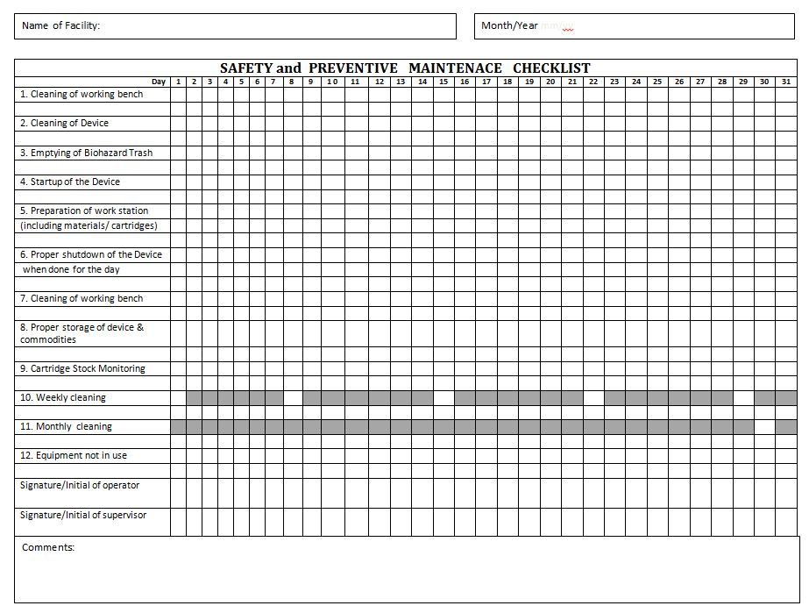
Safety and Preventive Maintenance Checklist
3
[Before training, update this slide with different image if an alternative checklist will be used for safety and preventive maintenance – this image is of the generic checklist provided in the POC EID Training Toolkit]
11

Slide 12
POC Consumption Tracking/Inventory Management
3
[Before the start of the training, insert images of the forms that will be used for consumption tracking and/or inventory management for POC EID products.]
12

Slide 13
Additional POC Records/Logbooks
3
[Before the start of the training, insert images of any additional records/logbooks/forms that will be used during POC EID testing. Insert as many slides as needed to cover all record keeping sources.]
13

Slide 14
Agenda
1
Learning Objectives
2
Importance of documentation and keeping record
3
Use of Logbooks
4
M&E Indicators

Slide 15
What is Monitoring and Evaluation (M&E)?
4
M&E is a process that helps improve program performance and achieve results
The M&E process involves collecting and analyzing data in order to make informed decisions about program performance, management and resource allocation
M&E can be conducted at the facility, region or national level
All M&E relies on complete, accurate data
15

Slide 16
M&E framework for POC EID
4
Goal of POC EID To expedite clinical decision-making by reducing test turn-around time for EID, thereby enabling earlier treatment initiation for HIV-positive infants
Impact
Improve quality of life for HIV-positive infants
Increase survival rate of children diagnosed with HIV
Outcomes
Increase access to high-quality POC EID testing
Accurately identify HIV-positive Infants
Decrease time to treatment initiation for HIV-positive infants
16

Slide 17
M&E indicators measure progress and success of POC EID implementation
4
Number of POC EID tests performed and results returned to caregivers
Number of HIV-positive infants identified through the use of POC EID
Proportion of caregivers receiving EID test results on the same day as the test
Proportion of HIV-positive infants initiated on ART within 2 months of testing
Turnaround time from EID sample collection to ART initiation
Error rates, rate of device utilization, and operator performance metrics as captured through testing data automatically recorded by the POC device
Device functionality including frequency and reasons for inability to use the device (e.g. stock outs, breakdowns, etc.)
[Before the start of the training, add any additional M&E indicators that will be included in the national M&E program]
17

Slide 18
M&E Data collection plan
[Before the start of the training, include here a list of data sources that will be used for routine M&E and the frequency of M&E data collection (eg. monthly, quarterly, semi-annually). Examples of data sources include: POC EID register, patient records, mentorship reports, service and maintenance logs, onboard device data etc.]
18

Slide 19
Questions?
Thank You!
19

Slide 20
Acknowledgments
The development of the POC EID Training Package was made possible
thanks to Unitaid’s support.
Unitaid accelerates access to innovation so that critical health products
can reach the people who need them.

