Slide 1
Rapid tests and PCR lab-testing
complement each other
to detect diseases efficiently.

Slide 2
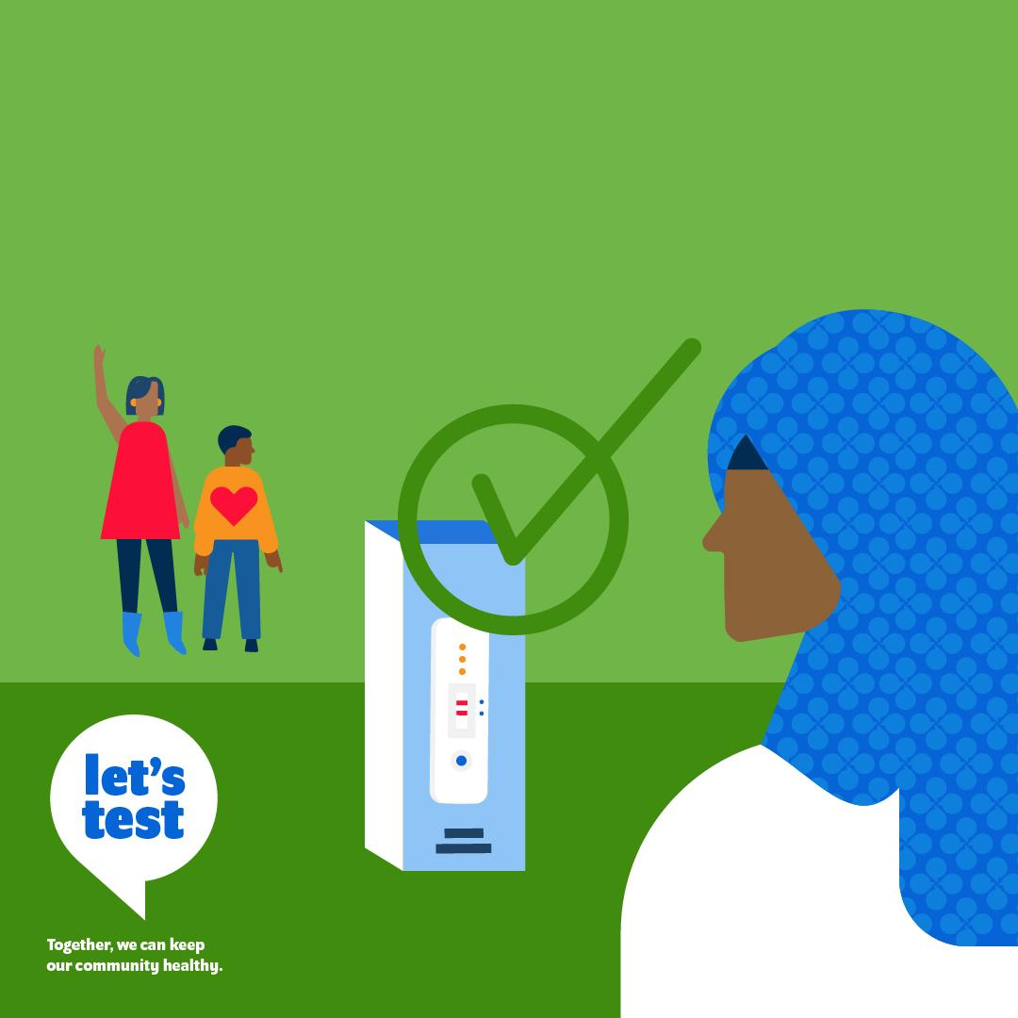
Quality assured rapid tests
are an important tool to
enable communities to screen
for common illnesses.

Slide 3
I don’t feel comfortable going
to a health centre for a test.
The healthcare workers know that I’m not from here and I feel unwelcome. It just isn’t worth it.
Sylvia,
Migrant Worker
Make testing accessible for all.

Slide 4
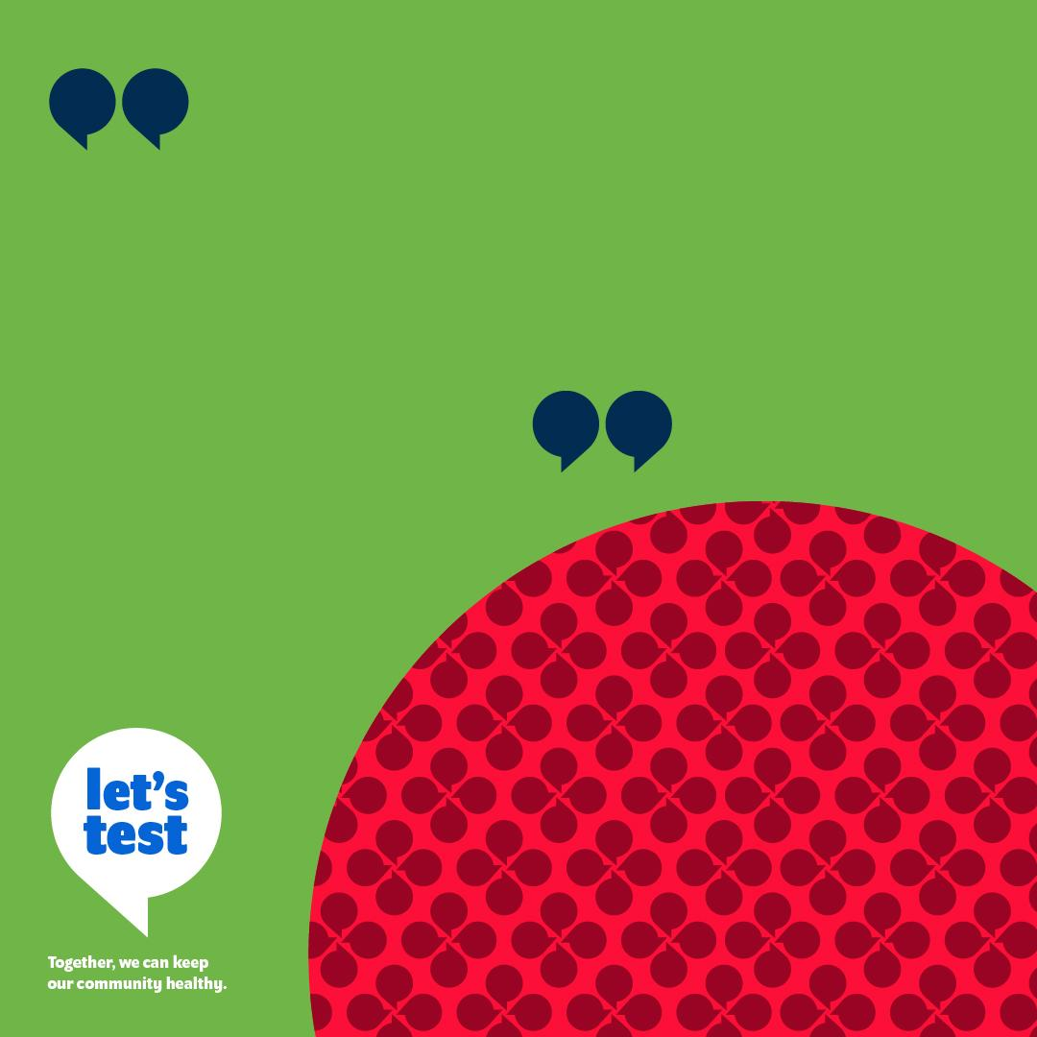
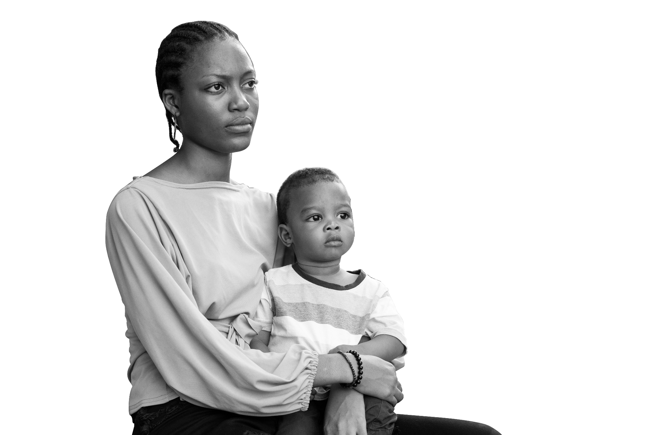
Going to the health centre to
get a PCR test ends up costing
me a week’s worth of wages,
so I don’t go. I wish I could
just do a test at home
like I do for malaria.
Akara,
Single mother
Make testing accessible for all.

Slide 5
The only time I am able to go to a testing centre is during school hours and it takes a full day to get there and back. This is a big year and I don’t want to miss out on important classes and tests.
Dara,
Student
Make testing accessible for all.

