Slide 1
Testing matters
because it saves lives!
It ensures the health and
well-being of your communities.

Slide 2
The benefits of testing
outweigh the costs because
you can detect and manage
outbreaks early.
This helps you use resources wisely
and avoid disruptions to ongoing
health priorities.

Slide 3
Testing gives you data that
helps you to make informed
and proactive decisions
based on the true burden
of disease.

Slide 4
Leaders from around the world
have pledged to support
Universal Health Coverage (UHC),
which requires widespread
access to testing.

Slide 5
Testing is a powerful tool
that has helped country
leaders to manage multiple
diseases such as malaria,
HIV, TB, and COVID-19.

Slide 6
Testing is a key pillar
of Primary Health Care.
Without testing, PHC providers cannot
identify and treat diseases effectively.

Slide 7
Testing supports the
early detection and
management of outbreaks.
Outbreaks can have serious negative impacts,
from health and education to communities
and economies.

Slide 8
Testing first
saves people
time and money.

Slide 9
Testing matters
because it saves lives!
Testing first
prevents community
outbreaks and
consequences such as
lockdowns or business
and school closures.

Slide 10
Testing first
reduces the cost
of care and health
system spending.

Slide 11
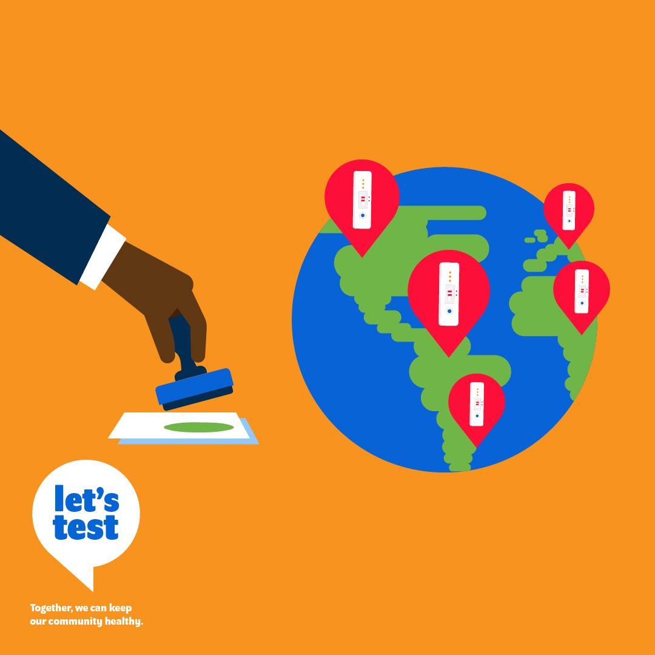
The quality of self-tests is
regulated by international
authorities.
Stringent regulatory authority (SRA) approved,
quality-assured self-tests for COVID-19 meet
global quality standards for self-use.

Slide 12
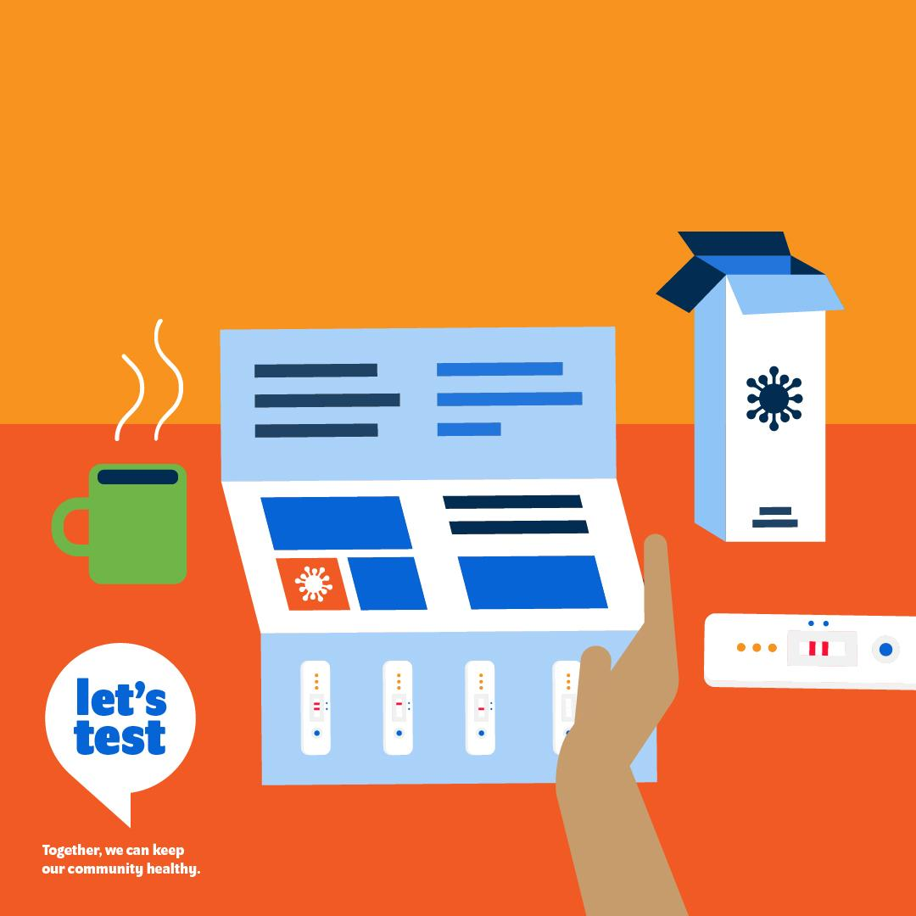
They include validated
packaging and insert
instructions to guide
effective self-use.

Slide 13
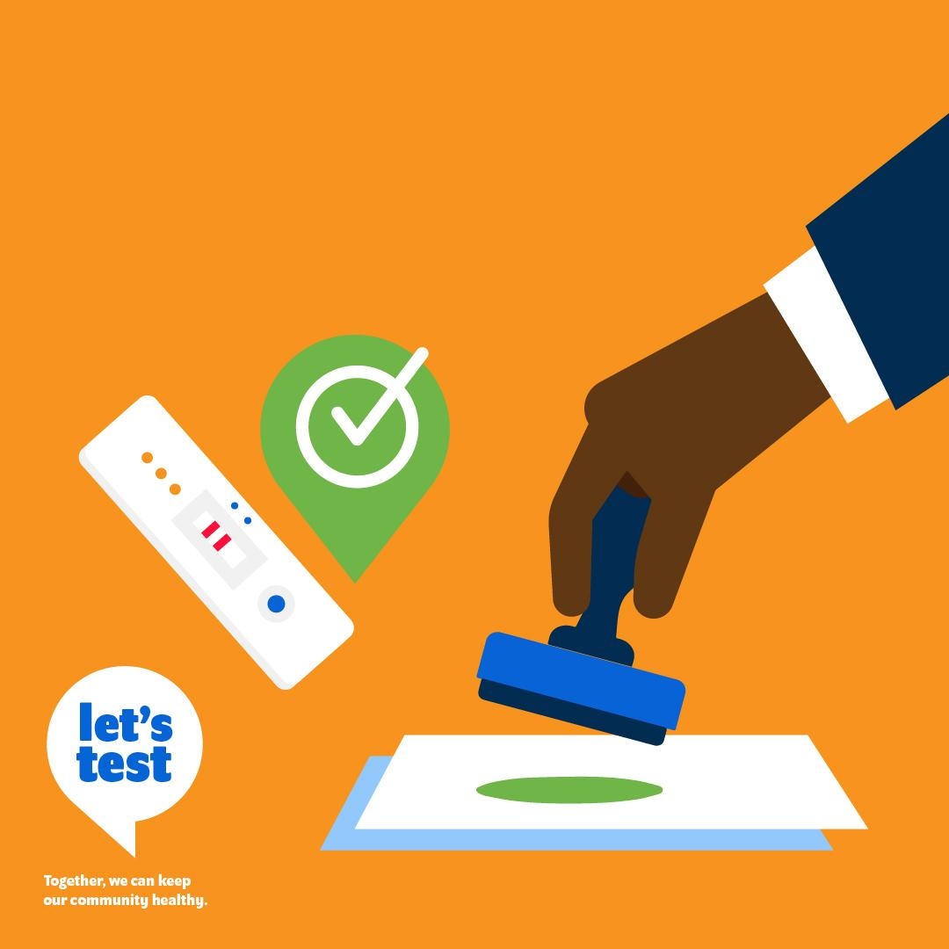
SRA approved self-use
tests should be prioritized
for local regulatory
approval and access.

Slide 14
By prioritising testing,
you can strengthen
your health system.

Slide 15
Quality assured self-tests
are reliable when users are
able to follow instructions
correctly.

Slide 16
81%
Of people in LICs & LMICs do not have access to testing (other than HIV and malaria). Lancet, 2021
Testing is an essential step
towards universal health
coverage.

Slide 17
Without testing,
quality healthcare
for all is not possible.

Slide 18
Testing generates data that empowers all levels of the health system to fulfill their priorities.

Slide 19
COVID-19 testing should
be integrated into the
standard of care, such
that the test is done
as a routine service.
Health Policymaker

Slide 20
Around the world, community
health workers have shown
that it is possible to provide
a range of services previously
restricted to health facilities.

Slide 21
There are over
3 million
Community Health Workers
Globally. (WHO)
Imagine if each one could also provide testing as a standard service.

Slide 22
Continued testing
access is critical, even
in populations with high
vaccination rates.

Slide 23
Breakthrough COVID-19
cases can still happen,
even among the vaccinated.
Testing helps us identify
and manage these cases.

Slide 24
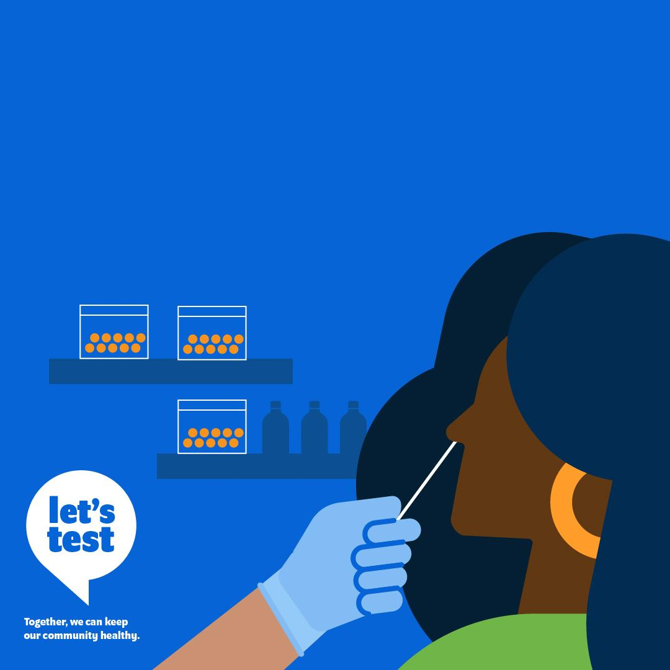
Even when symptoms are
mild, testing can ensure
that community members
get the right treatment
at the right time.

Slide 25
It also reduces the
spread of disease
in the community.

Slide 26
Testing matters
because it saves lives!
Protect the most vulnerable
people in your community
by prioritizing testing.

Slide 27
Testing matters
because it saves lives!
In times of crisis,
private health providers
have an important role.

Slide 28
Engaging with the private
sector helps patients access
testing and treatment, when
and where they need it.

Slide 29
The cost of a test
goes far beyond the
price of the test itself.

Slide 30
It also includes:
Transport to the
nearest health centre.

Slide 31
It also includes:
A full day’s missed wages while waiting in long queues.

Slide 32
It also includes:
Childcare.

Slide 33
800 million people
spend at least 10%
of their household
budgets on health
expenses. (WHO)
`
Without affordability for all,
testing access for all is impossible.

Slide 34
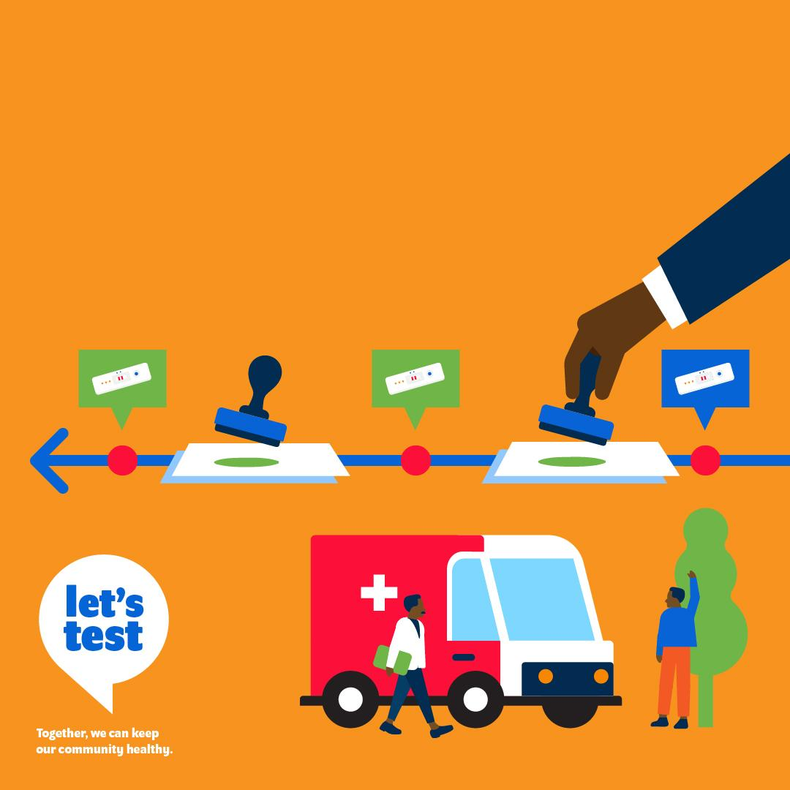
Timely regulatory reviews
of diagnostic tests ensure
that quality assured tests
are accessible when they
are needed.

