Slide 1
Testing first
saves people
time and money.

Slide 2
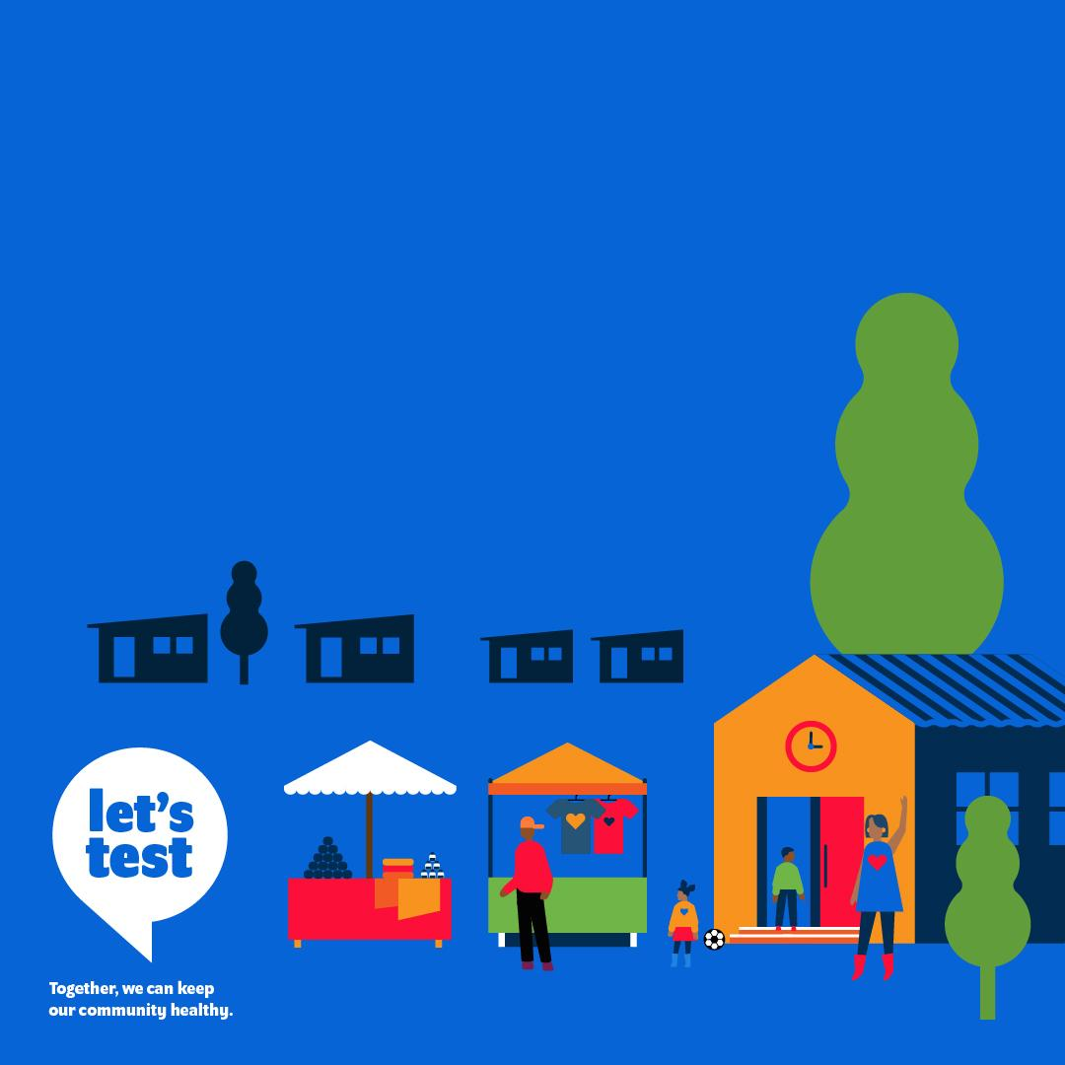
Testing matters
because it saves lives!
Testing first
prevents community
outbreaks and
consequences such as
lockdowns or business
and school closures.

Slide 3
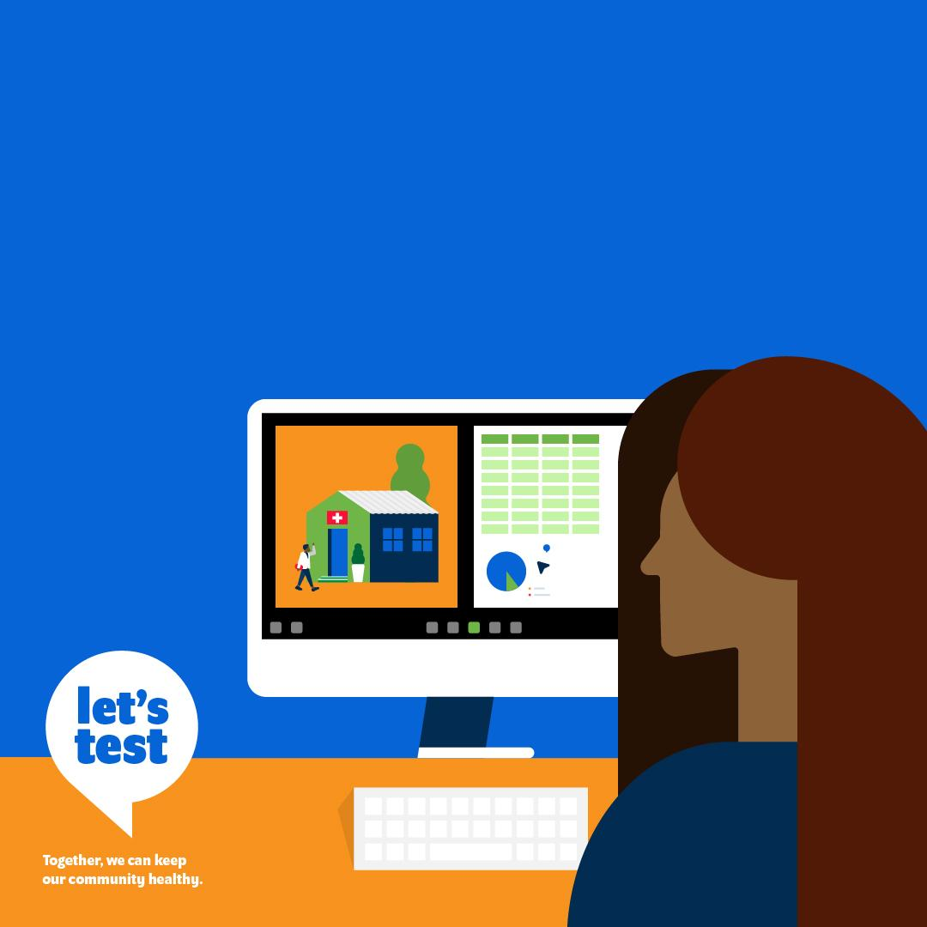
Testing first
reduces the cost
of care and health
system spending.

Slide 4
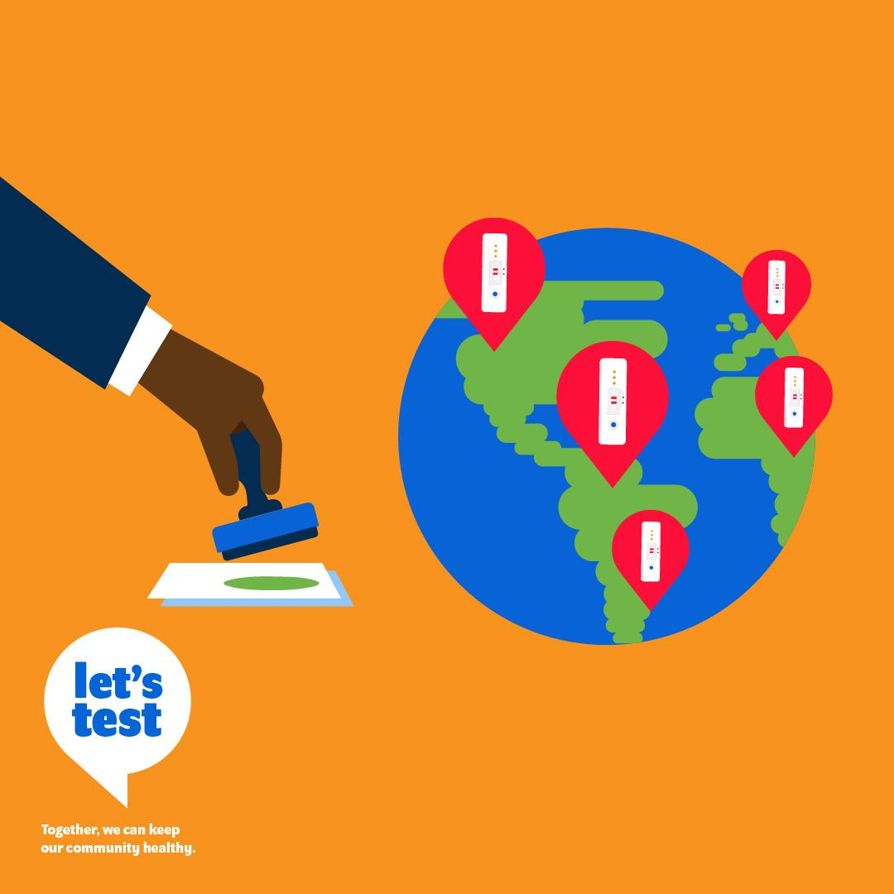
The quality of self-tests is
regulated by international
authorities.
Stringent regulatory authority (SRA) approved,
quality-assured self-tests for COVID-19 meet
global quality standards for self-use.

Slide 5
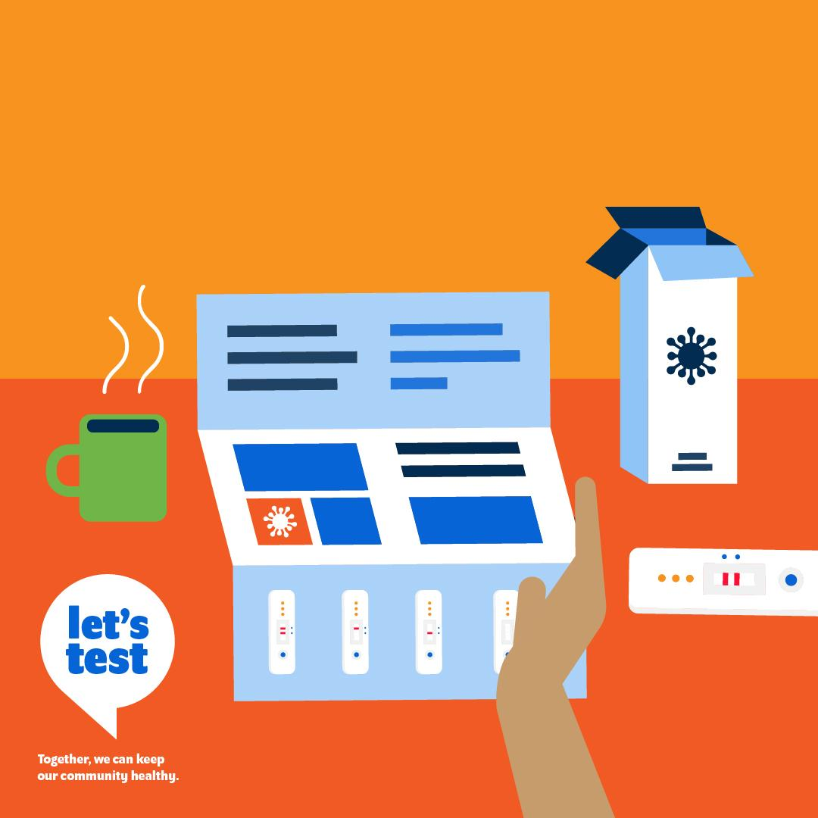
They include validated
packaging and insert
instructions to guide
effective self-use.

Slide 6
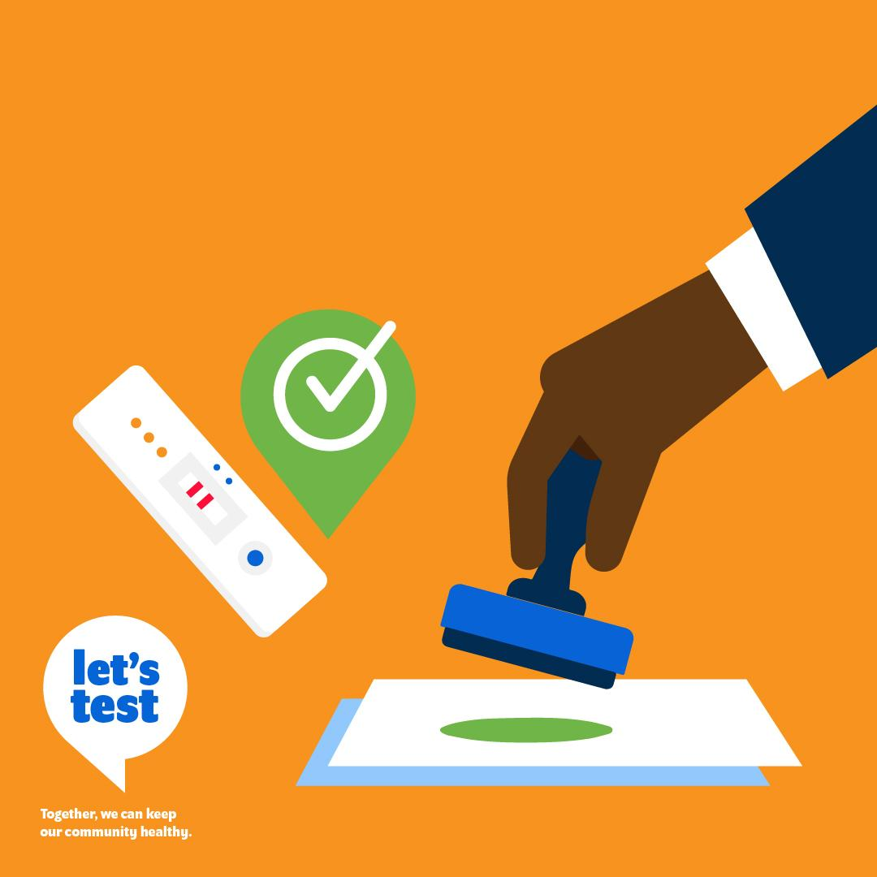
SRA approved self-use
tests should be prioritized
for local regulatory
approval and access.

Slide 7
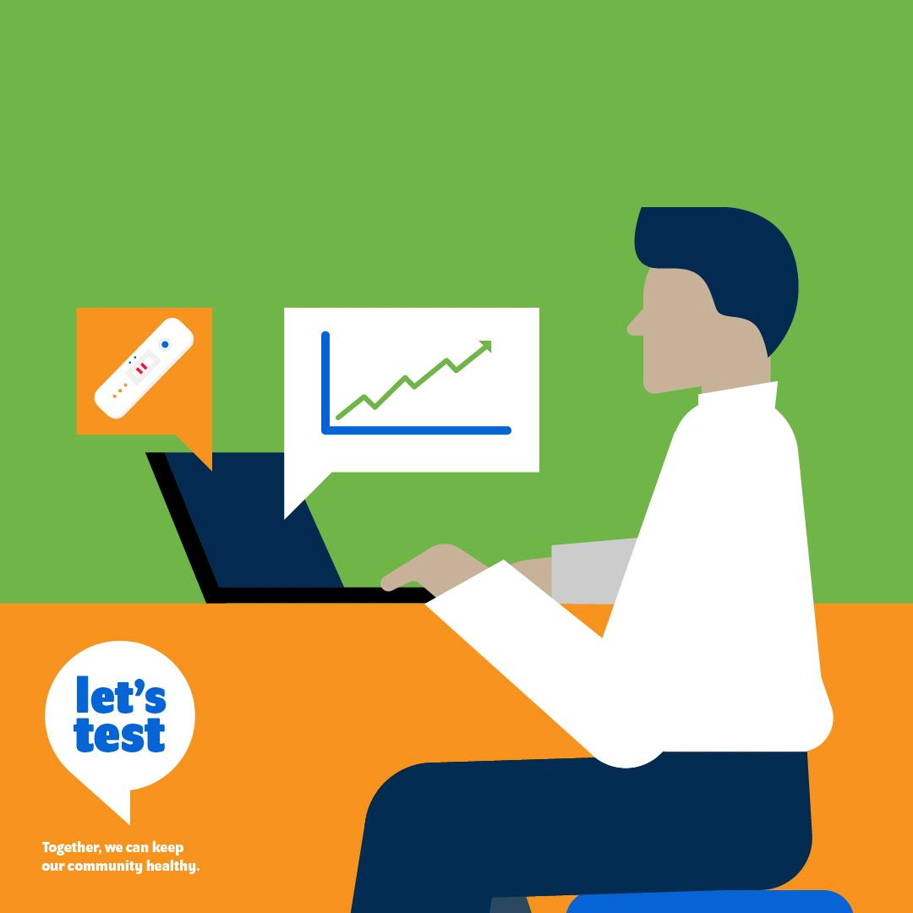
By prioritising testing,
you can strengthen
your health system.

Slide 8
Quality assured self-tests
are reliable when users
are able to follow
Instructions correctly.

